Slide 1
Run-Time Ethics Checking for Autonomous Unmanned Vehicles
A Practical Approach
CRUSER Project Report
9 April 2013
Don Brutzman, George Lucas, Duane Davis
Modeling, Virtual Environments, Simulation (MOVES)
Naval Postgraduate School (NPS), Monterey California USA

Slide 2
Topics
Motivation: human-taskable underwater robots
  Expressive power, semantics, syntax for a full solution
  Rational Behavior Model (RBM) 3-layer architecture: Strategic plans, Tactical operations, Execution control
Mission Planning, Execution with Ethical Constraints
  Declarative mission exemplar is helpful, general
  What does it mean to define, apply ethical constraints?
  Autonomous Vehicle Command Language (AVCL)
  AUV Workbench simulation results
  Topics for future student thesis work

Slide 3

Acknowledgements
Bob McGhee and Duane Davis contributed substantially to functionality of this approach
Mike Bailey, Terry Norbraten and Curtis Blais made improvements to AUV Workbench code
Mark Dankel & Bradley Strawser provided essential feedback on ethics considerations
CRUSER provided support
for NPS faculty, staff labor

Slide 4
Prior work: wargames and workshops include robot tasking, ethics issues
Future Unmanned Naval Systems (FUNS) wargame
  explored long-term autonomy issues for groups of robots sharing reconnaissance, self-defense tasks
CETMONS workshop explored robot ethics
  Sponsored by USNA Stockdale Leadership Center
  Can robots ever be given lethal weapons?
  Both humans, robotic systems make errors in war
  If robots make fewer errors than humans, then likely it becomes immoral to avoid using robots!
  Slippery slope but includes potential benefits also

Slide 5
Motivating problem: ethics
How can robotic systems behave ethically?
  Important for military operations abroad
  Civil and scientific operations also coexist daily
Not necessarily about religion or morality
  Law of armed conflict internationally recognized; often captured as Rules of Engagement (ROE) guidance for specific national or coalition forces
  Military readiness must be prepared for combat
Legal basis for civil activity is often well defined
  Also measurable: are you vulnerable to lawsuit?!

Slide 6
Motivation: human-taskable maritime robots
We’re looking to near-term future when UUVs can offload work and augment human activity
Various excellent robot solutions must remain compatible with human concepts and tasking
  Necessary for mission planning and justification
  Otherwise the robots are simply not autonomous
Extensive/exhaustive prelaunch testing is critical
  For mission confidence and in-water reliability
This work is building an extendable architecture…
  … for continued efforts bridging human, robot logic
Notes:
Prelaunch testing includes both human and software rehearsal.

Slide 7
Our approach
Define missions that include ethical constraints without relying on artificial intelligence (AI) or obscure abstractions for appropriate behavior
  No embedded homunculus or abstract ethicist engine
Design robot missions in way that can be adapted to a variety of disparate robot paradigms
  Generally adaptable to tasking of diverse systems
Build on patterns that work well for human groups cooperating on difficult, dangerous tasks
  Otherwise still need human at end of comms tether

Slide 8
Key insight #1
Humans in military units are able to deal with these challenges without ethical quandaries
Careful definitions are provided for
  Tasks, missions, objectives, coordinated operations
  Ethical constraints and rules of engagement
These allow both measured and rapid response, independently and cooperatively
  Commanders do not deploy illegal, immoral weapons
  Unmanned systems must also pass similar scrutiny, otherwise commanders cannot utilize them

Slide 9
Enabling factor: maritime environment
Major national controversy unfolding: drone use for conduct of reduced-risk warfare
  Many factors involved: technical, political, social
  Remote human control
  Complex, confounded environments
Maritime environment is much less ambiguous
  Fewer IFFN issues, friend foe neutral
  Presence of bad actors usually confirmable
  Law of Sea, Laws of Armed Conflict, etc.

Slide 10
Rational Behavior Model (RBM)
3-layer robot architecture
Background
Strategic
  Declarative planning of goals while avoiding obstacles and observing constraints
Tactical
  Operational control of navigation, tactical and mission tasks. Sensor employment.
Execution
  Low-level control tasks. Open-loop, closed-loop commands for propulsors and effectors.
Twenty+ years of well-documented, progressive work

Slide 11
Turing machine
Background
Turing machine (TM)
  consists of a finite state machine (FSM)
  augmented by an external agent in the form of a potentially infinite memory
  realized as tape of an “incremental tape recorder”
Often referenced but seldom used
  Extensive theoretical development has shown that Universal TM has greatest computational power
  Clumsy to program, infrequently used
  Nevertheless, appealing basis for theoretical design since it maps to general theory of any computation
Notes:
Turing Award is commonly referred to as the Nobel Prize of computer science.

Slide 12
Prior work: technical reports and papers on Mission Execution Automaton (MEA)
Background
We adapted Universal Turing Machine (UTM) architecture to create a universal multiphase human-interactive MEA
  Express fundamental logic of mission planning
  Corresponds to RBM Strategic level implementation
  Goal: demonstrate computational generality
Implemented using Prolog language for easy backtracking during planning
  Prolog dialect: Allegro Common Lisp
  Interactive, text based
  Human provides external-world sensing responses
Notes:
Thank You Bob and Duane!

Slide 13
Goal-based Mission Example
Simple yet general mission goals, decision logic
Common approach, adaptable to other vehicles
Extendable and refinable mission tasking

Slide 14
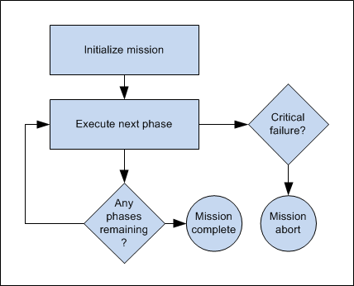
Mission execution rule set: simply loop through goal tasks

Slide 15
Example Goal-based Mission Definition
Goal 1. Proceed to Area A and search the area. If the search is successful execute Goal 2. If the search is unsuccessful, execute Goal 3.
Goal 2. Obtain environment sample from Area A. If the sample is obtained, execute Goal 3. If the sample cannot be obtained, proceed to recovery position to complete the mission.
Goal 3. Proceed to Area B and search the area. Upon search success or failure, execute Goal 4.
Goal 4. Proceed to Area C, rendezvous with UUV-2. Upon rendezvous success or failure, transit to recovery position to complete the mission.
Notes:
Clumsy but readable. Humans can agree on intent.

Slide 16
Goal-based Mission Example
Robot mission conduct
can be independent of
software implementation
Strategic Level
Tactical Level
MEA Start
Tactics module sequencer
Phase 1: Search Area A
Fail
Succeed
Sample Environment Phase Controller
Area Definition
Phase 2:
Sample Environment in Area A
Queries
Sampling Requirements
Phase 3: Search Area B
Operational and Ethical Constraints Checking
Responses: Succeed
or Fail
System State and Sensor Data
Vehicle
Commands
Fail
Succeed
Succeed
Fail
Tactical-Level modules with shared vehicle state
and telemetry history
Phase 4: Rendezvous with
UUV-2 in Area C
Succeed
Phase 5: Transit
Return to Base
Fail
Controller Parameters
Fail
Succeed
Sensor Settings, Responses
Real-time orders
Mission Abort
Mission Complete
Execution Level
handles real-time control and response
Surface
Recovery position
Notes:
Right hand side: our robot architecture handles these task assignments one way. Another robot architecture may handle it a different way. Each however can be expected to sufficiently capable to report success or failure of each assignment. If not, then that robot is unresponsive and not really taskable with confidence by humans.

Slide 17
Executable mission rule set: loop through phases
Background
(<-- (execute_mission)
(initialize_mission)
(repeat) (execute_current_phase) (done) !)
(<-- (initialize_mission)
(abolish current_phase 1)
(asserta ((current_phase 1))))
(<-- (execute_current_phase)
(current_phase ?x) (execute_phase ?x) !)
(<-- (done) (current_phase 'mission_complete))
(<- (done) (current_phase 'mission_abort))
Notes:
Human readability of source code is often something in the eye of the beholder! Your mileage may vary.

Slide 18
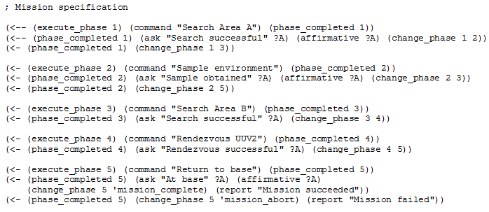
Executable mission phases for this example added to Prolog rule set
Background

Slide 19
Running mission example #1
Background
CG-USER(1): (?- (execute_mission))
Search Area A!
Search successful? yes
Sample environment!
Sample obtained? yes
Search Area B!
Search successful? yes
Rendezvous UUV2!
Rendezvous successful? yes
Return to base!
At base? yes
Mission succeeded.
Yes
User enters responses
to mission execution automaton (MEA) queries, thereby providing environmental responses and testing mission logic
These correspond to ethics checks measured by robot, or supervised by a human

Slide 20
Running mission examples # 2, 3
Background
CG-USER(2): (?- (execute_mission))
Search Area A!
Search successful? yes
Sample environment!
Sample obtained? no
Return to base!
At base? yes
Mission succeeded.
CG-USER(3): (?- (execute_mission))
Search Area A!
Search successful? no
Search Area B!
Search successful? no
Rendezvous UUV2!
Rendezvous successful? yes
Return to base!
At base? no
Mission failed.
Human operators can logically test various mission alternatives to gain confidence
Simulation can also run through every option exhaustively to further confirm correctness

Slide 21
Adding ethical constraints to mission requirements
Following the leader:
how do human teams accomplish tasks ethically?
The same rules need to apply to unmanned systems.

Slide 22
Example ethical constraints, civil
Safe navigation, follow pertinent rules of road
Satisfactory navigational accuracy (GPS etc.)
Have received timely clearance to enter a specific geographic area for given time period
  Also vertical clearance for underwater depth zone or airborne altitude zone
Sufficient vehicle health, power, safety status
Meet communication requirements for tasking
  Identity beacon, transponder, AIS tracking, etc.
  Recording and reporting on situational data, etc.

Slide 23
Example ethical constraints, military
Meet all relevant, international civil requirements
Identification friend foe (IFF), blue-force tracking
  friendly/hostile/neutral/unknown
Prior determination of contact’s hostile intent
  Robot option to warn without fear of self protection
ROE use of deadly force, weapons releasability
  Brevity codes: weapons safe, hold, tight, free
  Confirmation and permission requirements
After-action reporting, damage assessment
Et cetera, et cetera…

Slide 24
Civil ethical constraint support in AVCL, AUV Workbench
Civil ethical constraints | Define | Test | Notes
Mission tasking | √ | partial | AVCL goals
Safe navigation and transit | √ | √ | AVCL avoidance areas
Follow pertinent rules of road |  |  | Requires rule-engine path planner, sensing model
Satisfactory navigational accuracy (GPS etc.) | √ | √ | Needed: sensor error models
Clearance to enter a specific geographic area | √ | √
Vertical clearance for underwater depth zone or airborne altitude zone | √ | √
Timing requirements using specific times or duration | √ | √
Sufficient vehicle health, power, safety status | partial | partial
Meet communication requirements for tasking | partial | partial | Message-passing scheme
Identity beacon, transponder, AIS tracking, etc.
Recording and reporting on situational data

Slide 25
Military ethical constraint support in AVCL, AUV Workbench
Military ethical constraints | Define | Test | Notes
Meet all relevant, international civil requirements | partial | partial | See above
Mission tasking | √ | partial | AVCL goals
Contact identification, tracking signatures |  |  | Available in C2 systems
Identification friend foe (IFF), blue-force tracking (friendly/hostile/neutral/unknown/etc.) |  |  | Available in C2 data models
Robot option to warn without fear of self protection |  |  | Implementable via messaging
Determination of contact’s hostile intent |  |  | Available in C2 data models, dissertation work in progress
Confirmation and permission requirements |  |  | Implementable via messaging
ROE use of deadly force, weapons releasability using brevity codes: weapons safe, hold, tight, free | partial | partial | Requires weapons model
Proportional weapons response |  |  | Requires weapons and threat models
After-action reporting | partial | partial | AVCL goals
Damage assessment |  |  | Requires models of interest
Notes:
http://en.wikipedia.org/wiki/Brevity_code

Slide 26
Key insight #2
Ethical behaviors don’t define the mission plan.
rather
Ethical constraints inform the mission plan.

Slide 27
Goal-based Mission Example, with constraints
Strategic Level
Tactical Level
MEA Start
Tactics module sequencer
Constraint
Phase 1: Search Area A
Fail
Succeed
Sample Environment Phase Controller
Area Definition
Phase 2:
Sample Environment in Area A
Queries
Sampling Requirements
Phase 3: Search Area B
Operational and Ethical Constraints Checking
Constraint
Responses: Succeed
or Fail
Constraint
System State and Sensor Data
Vehicle
Commands
Fail
Succeed
Succeed
Fail
Tactical-Level modules with shared vehicle state
and telemetry history
Phase 4: Rendezvous with
UUV-2 in Area C
Succeed
Phase 5: Transit
Return to Base
Fail
Constraint
Constraint
Controller Parameters
Fail
Succeed
Sensor Settings, Responses
Real-time orders
Mission Abort
Mission Complete
Execution Level
handles real-time control and response
Surface
Recovery position

Slide 28
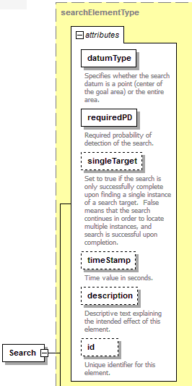
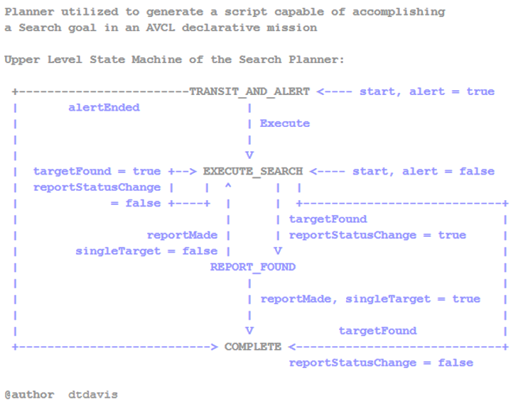
Example goal-planning logic: Search

Slide 29
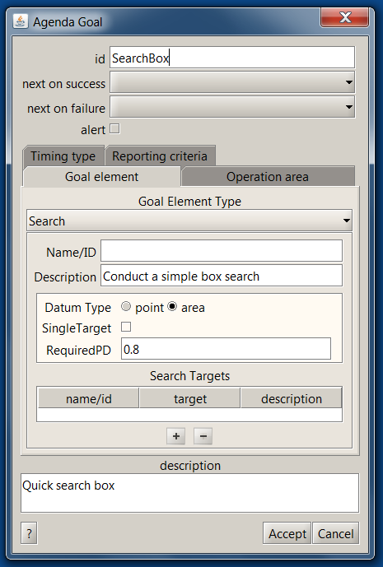
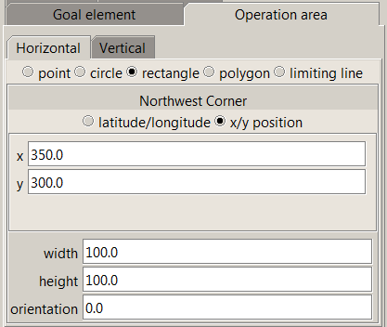
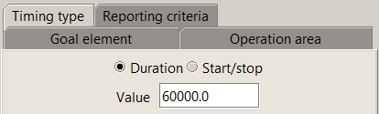
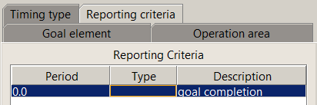
Example goal definition
Notes:
TODO: updated screen shot from Mike

Slide 30
AVCL mission goals support
AVCL mission goals | Define | Test | Definition
Attack | partial |  | To conduct a type of offensive action characterized by employment of firepower and maneuver to close with and destroy an enemy.
Decontaminate | √ |  | To provide purification making an area safe by absorbing, destroying, neutralizing, making harmless, or removing chemical, biological, or nuclear contamination.
Demolish | √ |  | To destroy structures, facilities, or material by any available means.
IlluminateArea | √ |  | To provide locale lighting by searchlight or pyrotechnics.
Jam | √ |  | To deliberately radiate, re-radiate or reflect electromagnetic energy with the object of impairing the use of electronic devices or systems.
MarkTarget | √ |  | To make visible (by the use of light, infrared, laser, smoke, etc.) of an object in order to allow its identification by another object.
MonitorTransmissions | √ |  | To conduct electronic warfare support operations with a view to searching, locating, recording and analyzing radiated electromagnetic energy.
Patrol | √ | √ | To gather information or carry out a security mission.
Rendezvous | √ | partial | Achieve a meeting at a specified time and place.
Reposition | √ | √ | To change position from one location to another.
SampleEnvironment | partial |  | Collect environmental samples for testing for chemical compounds, biological creatures, or nuclear hazards.
Search | √ | √ | To look for lost or unlocated objects or persons.

Slide 31
Theory versus practice
In theory: theory and practice are the same.
In practice: they’re not.
- Yogi Berra
Current tests: simulations

Slide 32
Challenge: broad implementation
Can we
  Define mission goals readable by humans + robots
  Produce actionable tasking for different AUVs
  Produce software examples that can run properly in simulation and in robots
Can we also
  Define goal constraints ethically and measurably
Yes
Initial tests successful

Slide 33
Autonomous Vehicle Command Language (AVCL)
AVCL is a command and control language for humans running autonomous unmanned vehicles
  Close correspondence to human naval terminology
  Common XML representations for mission scripts, agenda plans, and post-mission recorded telemetry
Operators can utilize a single archivable and validatable format for robot tasking, results
  directly convertible to and from a wide variety of different robot command languages
https://savage.nps.edu/Savage/AuvWorkbench/AVCL/AVCL.html

Slide 34
AVCL vocabulary: AllCommandsUuv.xml
List, unit test all execution, tactical AVCL commands
  Simple unit testing of workbench software
  Confirm AUV Workbench interface, XML validation
  Mission unit tests for comprehensive coverage likely to follow
Also for other robotics platforms
  AllCommandsUsv.xml AllCommandsUav.xml AllCommandsUgv.xml
  Each provides a vocabulary list showing the current tactical repertoire (rather than runnable missions)
Notes:
Considering adding “dead reckoning” to 2D plot to assist in mission rehearsal visualization

Slide 35
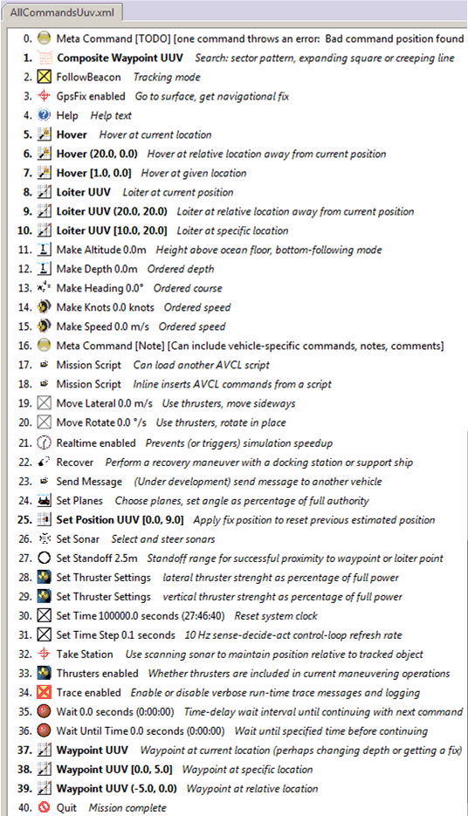
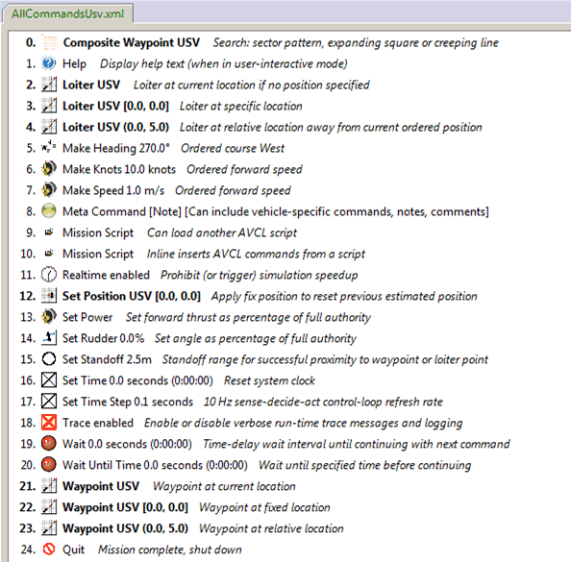

Slide 36
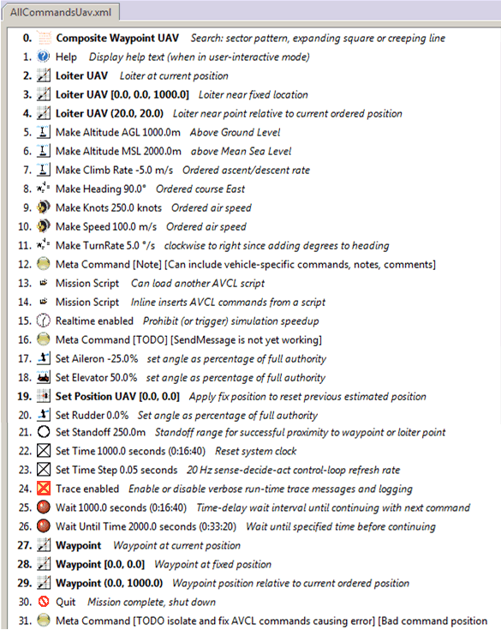
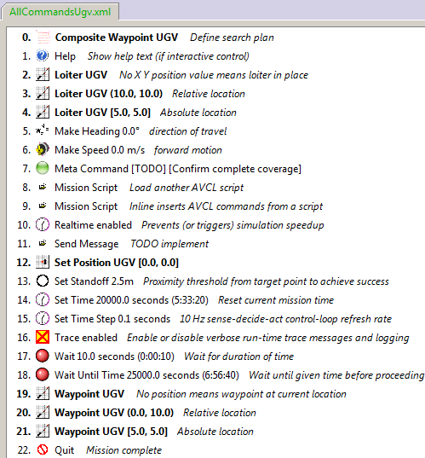

Slide 37
Example mission, as pseudo-code XML
<?xml version="1.0" encoding="UTF-8"?>
<UUVMission>
<GoalSet>
<Goal area=”A” id=”goal1”>
<Search nextOnSucceed=”goal2” nextOnFail=”goal3”/>
</Goal>
<Goal area=”A” id=”goal2”>
<SampleEnvironment nextOnSucceed=”goal3” nextOnFail=”recover”/>
</Goal>
<Goal area=”B” id=”goal3”>
<Search nextOnSucceed=”goal4” nextOnFail=”goal4”/>
</Goal>
<Goal area=”C” id=”goal4”>
<Rendezvous nextOnSucceed=”recover” nextOnFail=”recover”/>
</Goal>
<Goal area=”recoveryPosition” id=”recover”>
<Transit nextOnSucceed=”missionComplete” nextOnFail=”missionAbort”/>
</Goal>
</GoalSet>
</UUVMission>
XML is readable by human or robot,
captures logic of canonical mission

Slide 38
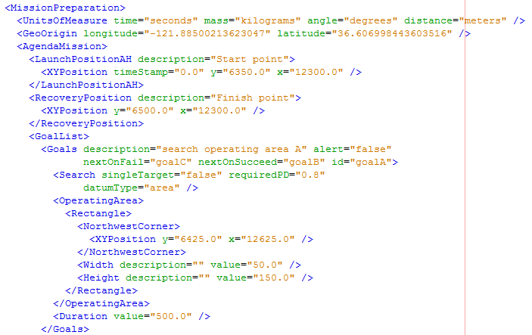
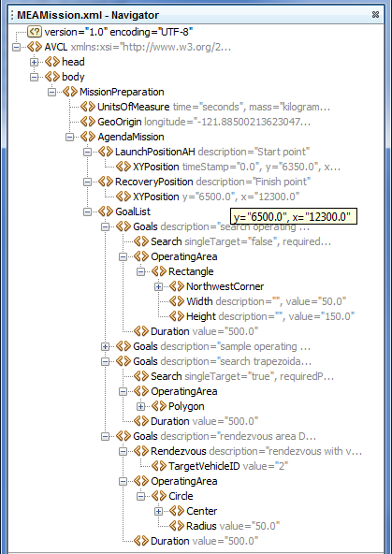
Corresponding example:
MEAMission.xml using AVCL xml

Slide 39
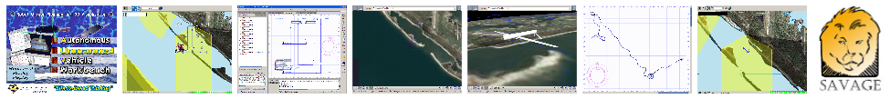
AUV Workbench
Autonomous Unmanned Vehicle Workbench supports underwater, surface and air vehicles
  physics-based mission rehearsal
  real-time task-level control of robot missions, and
  replay of recorded results
  Industry-friendly open-source license, Sourceforge
  Basis: RBM 3-level architecture, AVCL commands
Used to rehearse strategic-level MEAMission.xml
  https://savage.nps.edu/AuvWorkbench

Slide 40
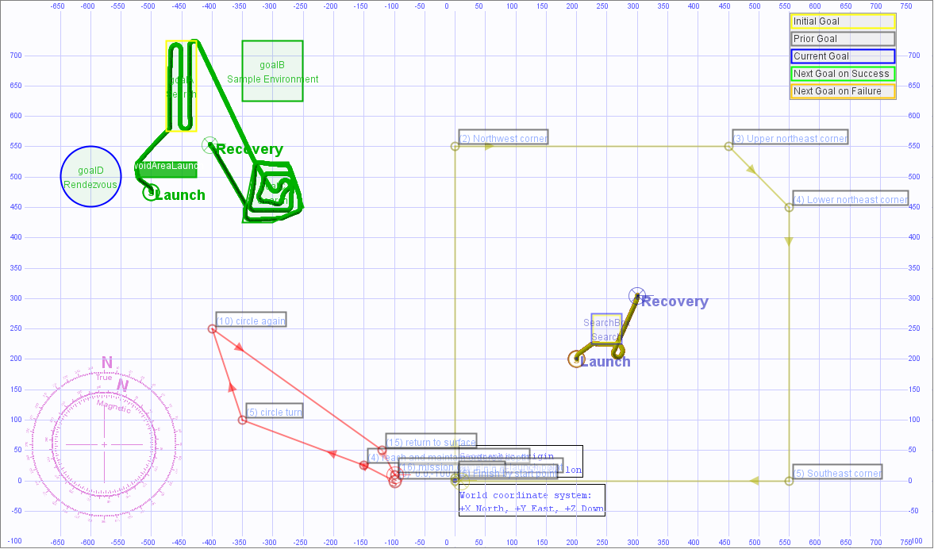
4 example missions, UUV and USV

Slide 41
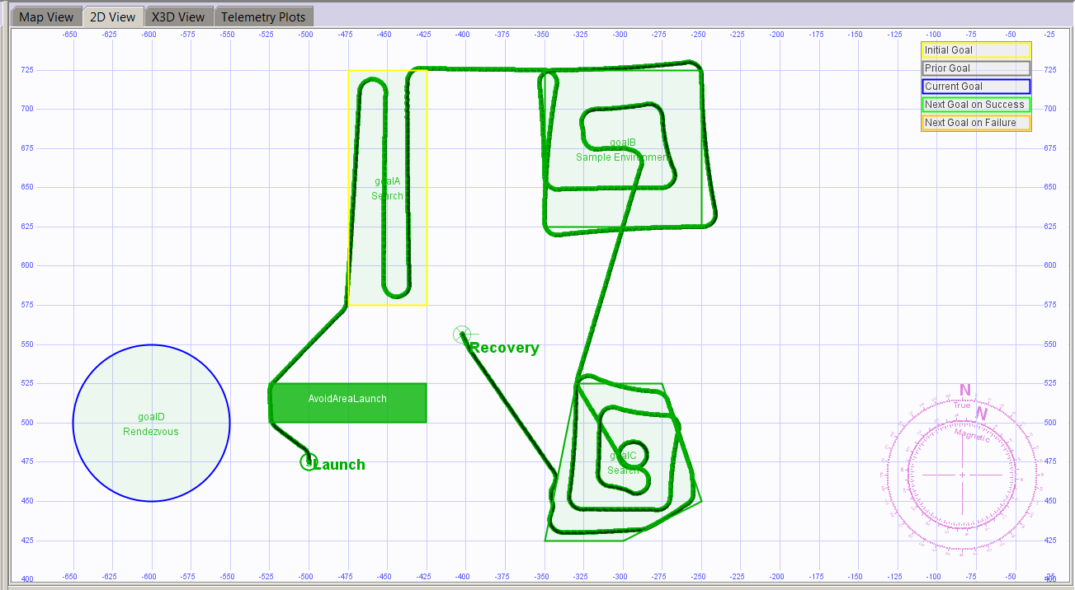
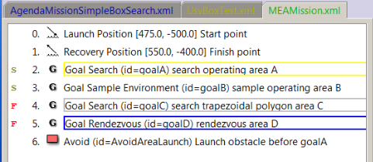
MeaMission.xml simulation preview
Search planning
produces waypoints
All events logged
Recovery
Launch
Rendezvous not supported
All searches complete
Notes:
These results are similar to the previously shown user-driven example #3: rendezvous attempt fails, so robot returns for recovery

Slide 42
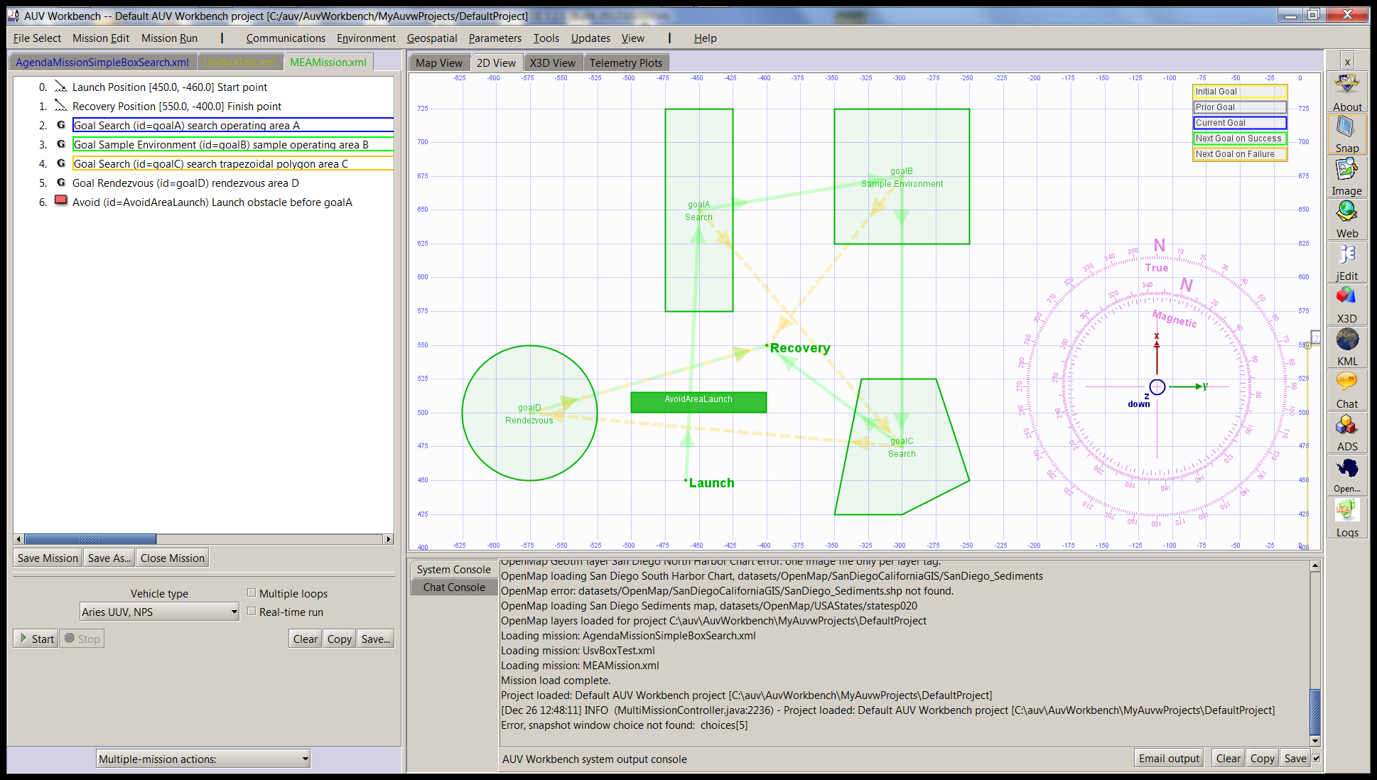
MeaMission.xml simulation 0, launch

Slide 43
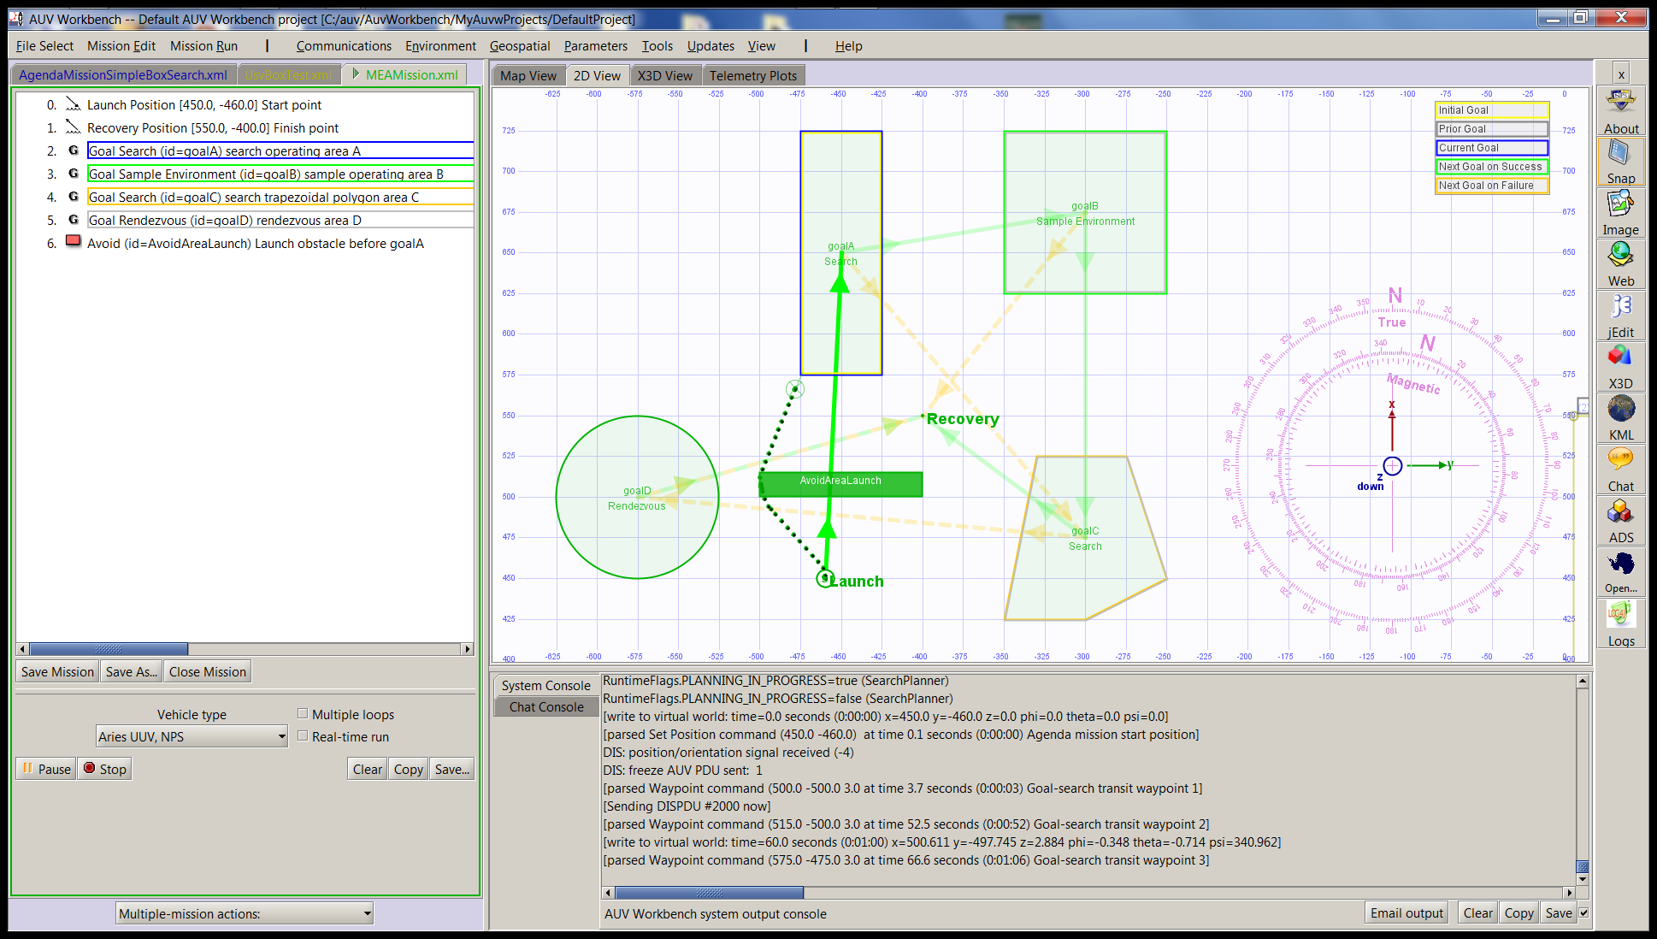
MeaMission.xml simulation 1, transit

Slide 44
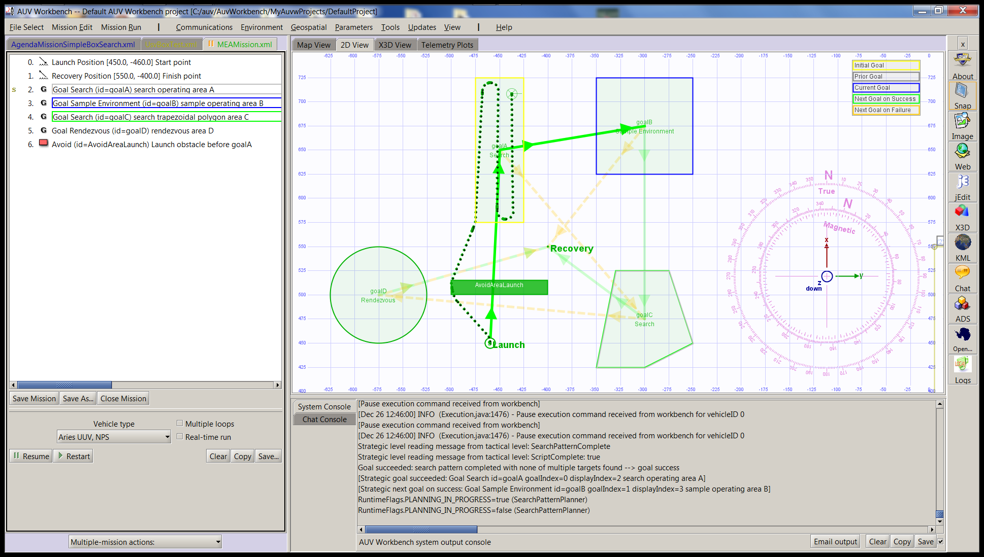
MeaMission.xml simulation 2, search

Slide 45
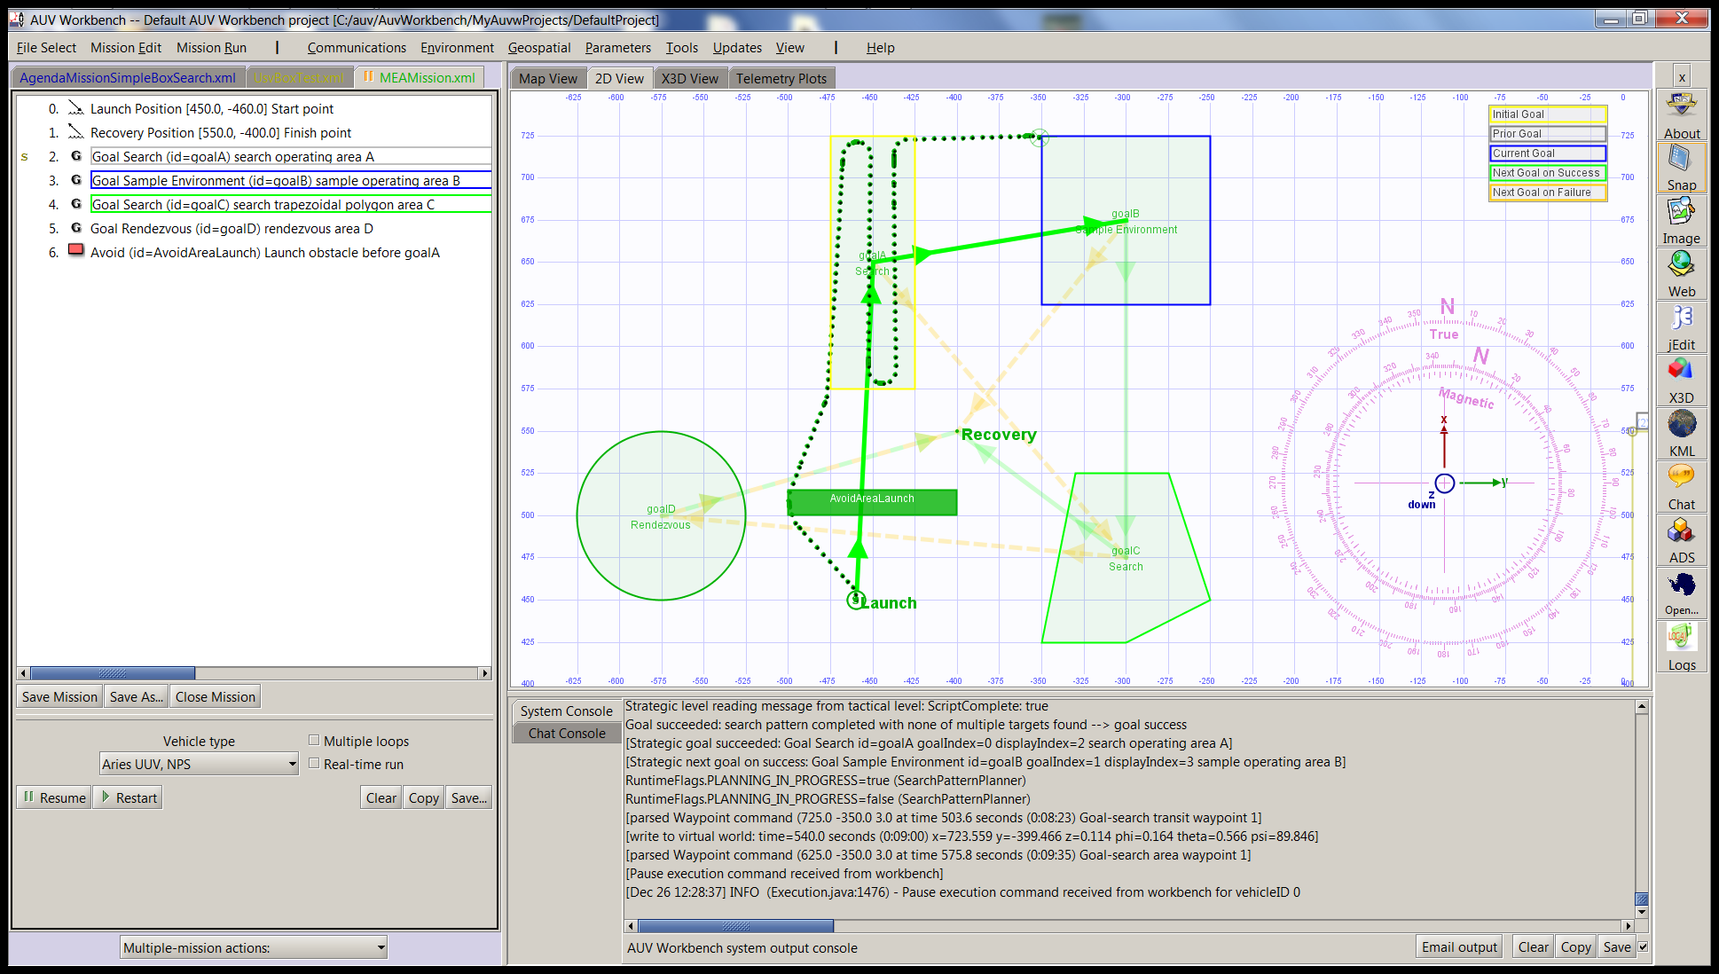
MeaMission.xml simulation 3, transit

Slide 46
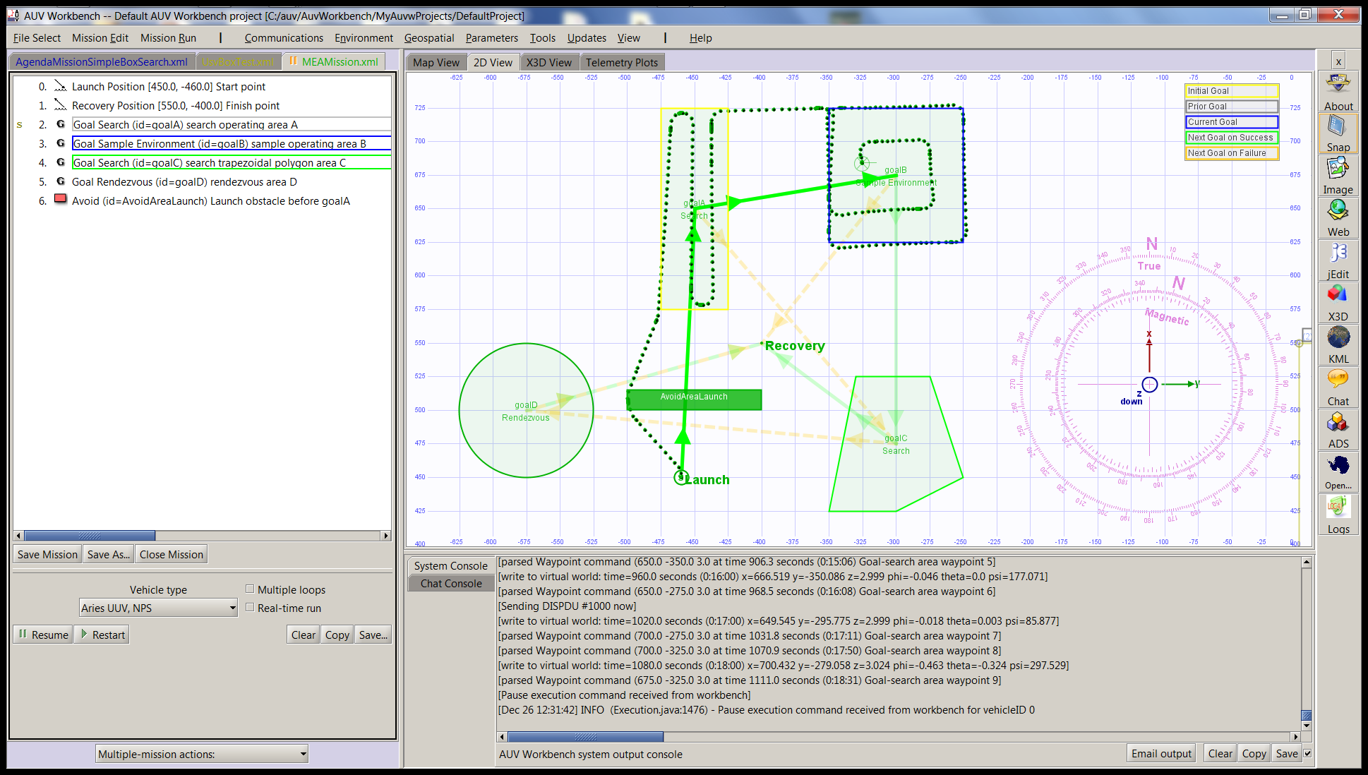
MeaMission.xml simulation 4, sample

Slide 47
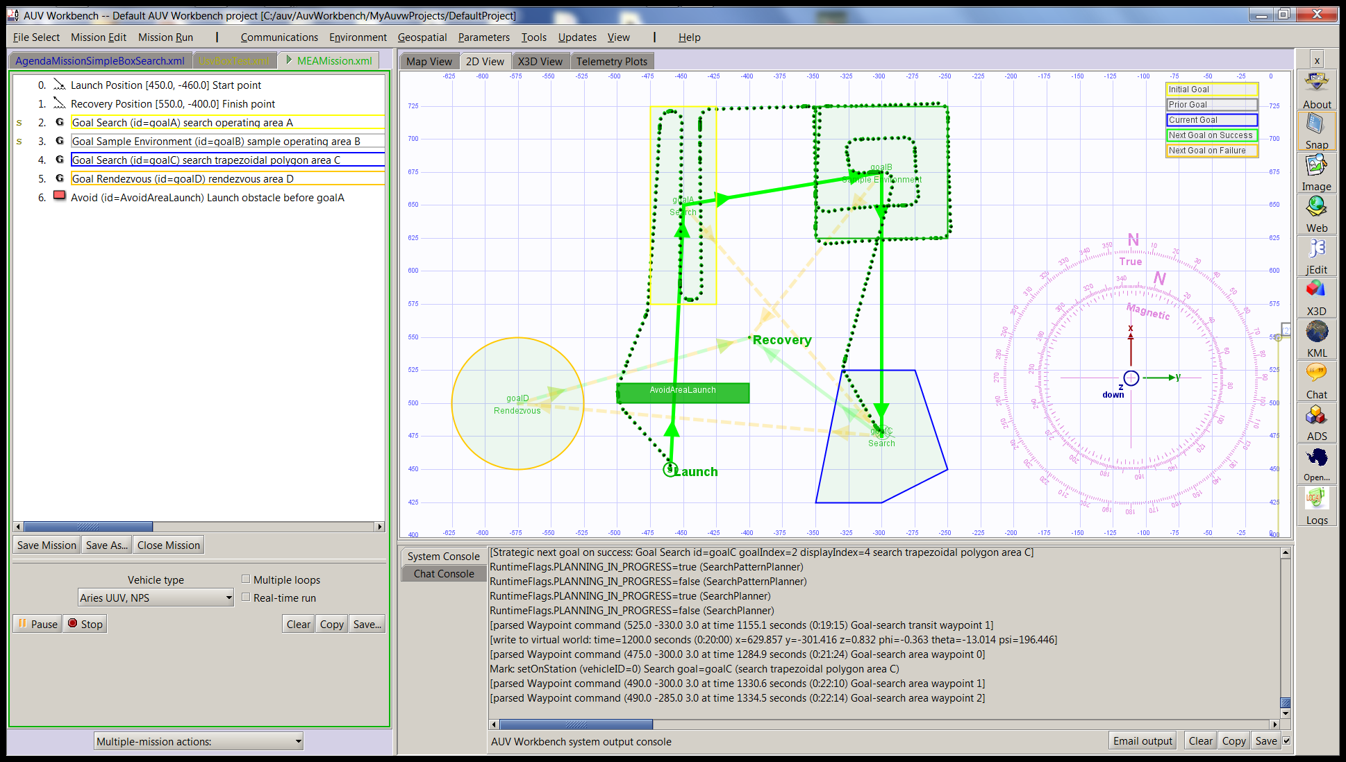
MeaMission.xml simulation 5, transit

Slide 48
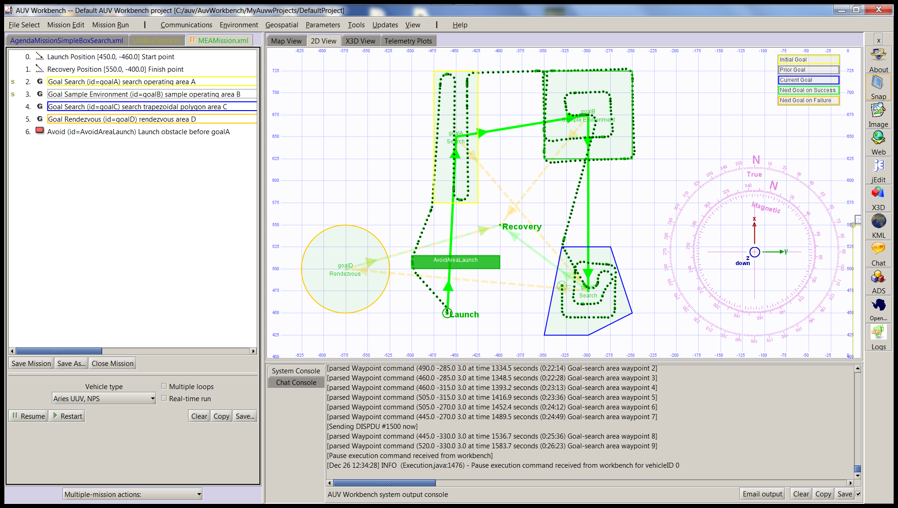
MeaMission.xml simulation 6, search

Slide 49
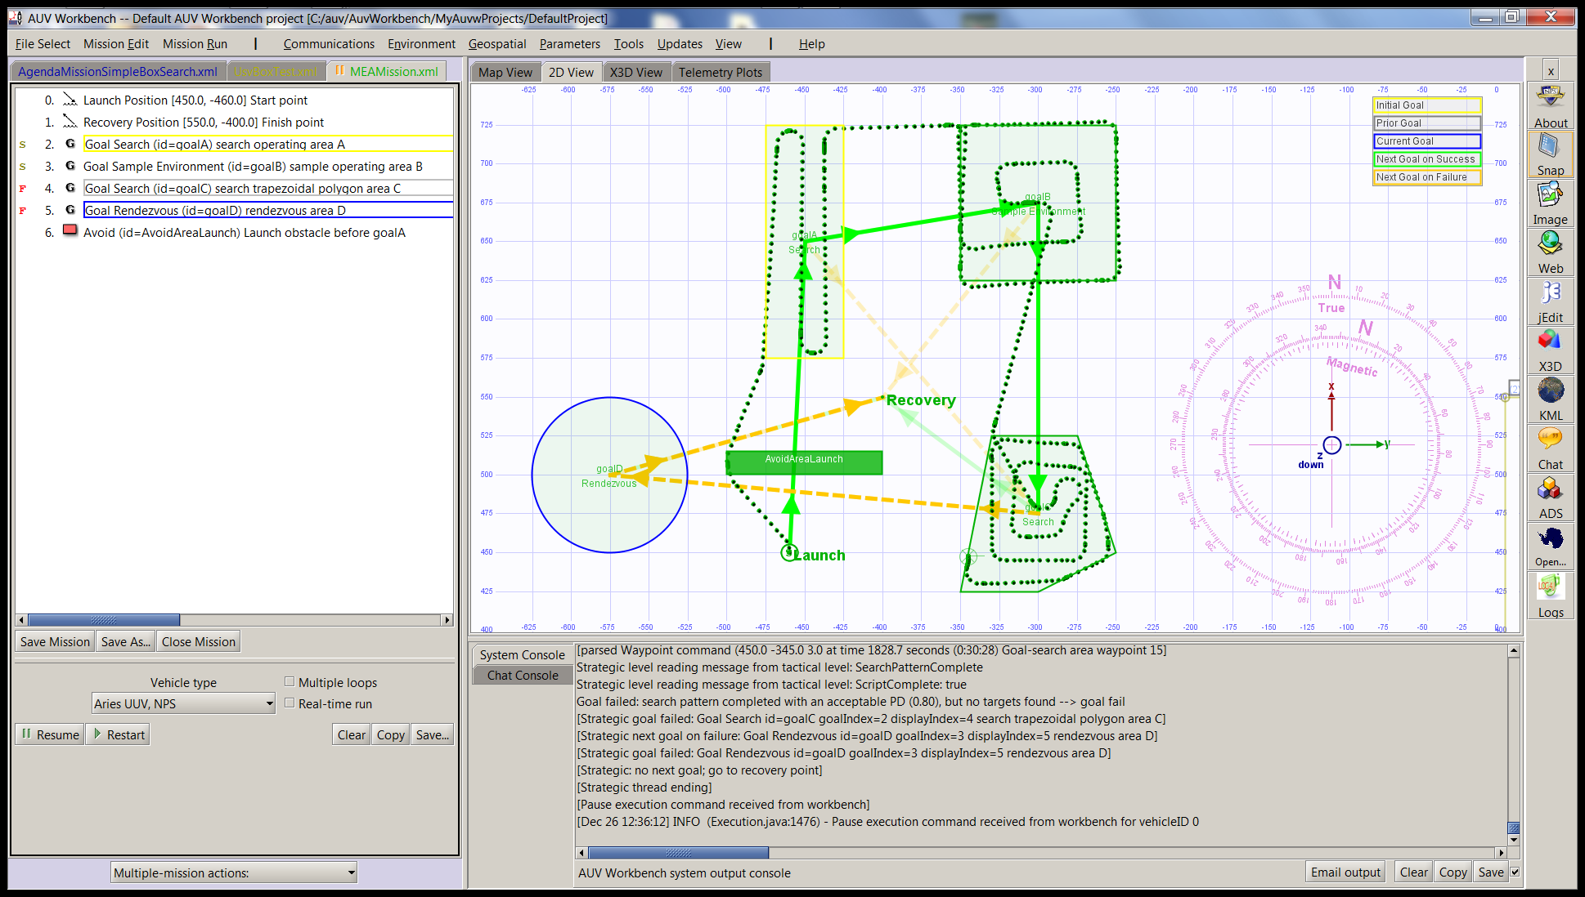
MeaMission.xml simulation 7, rdvu fail

Slide 50
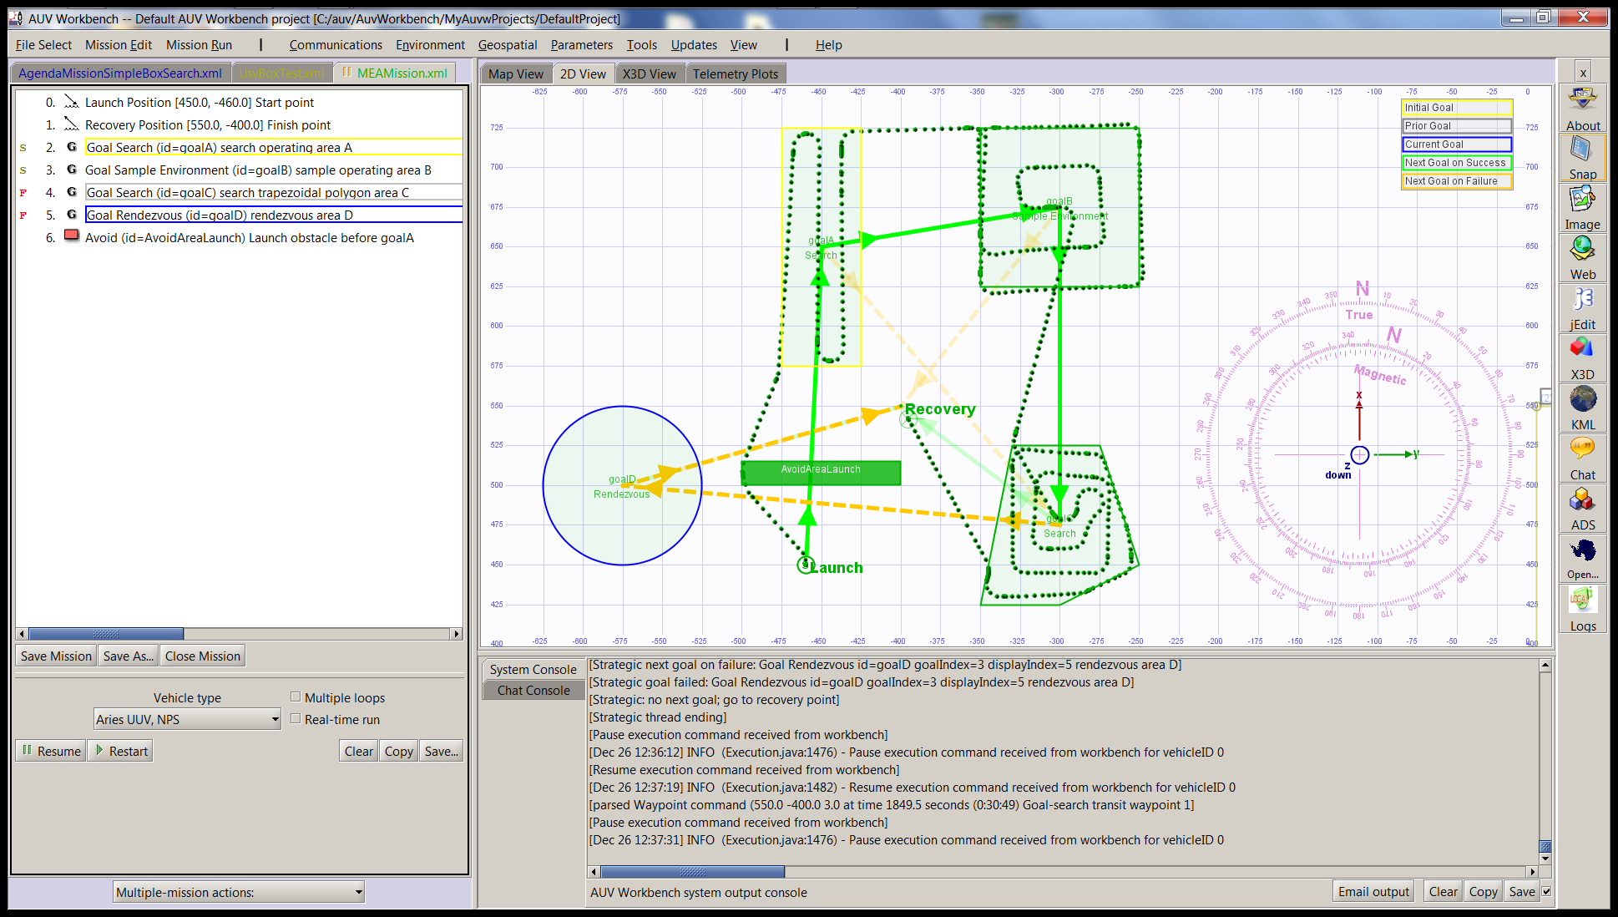
MeaMission.xml simulation 8, transit

Slide 51
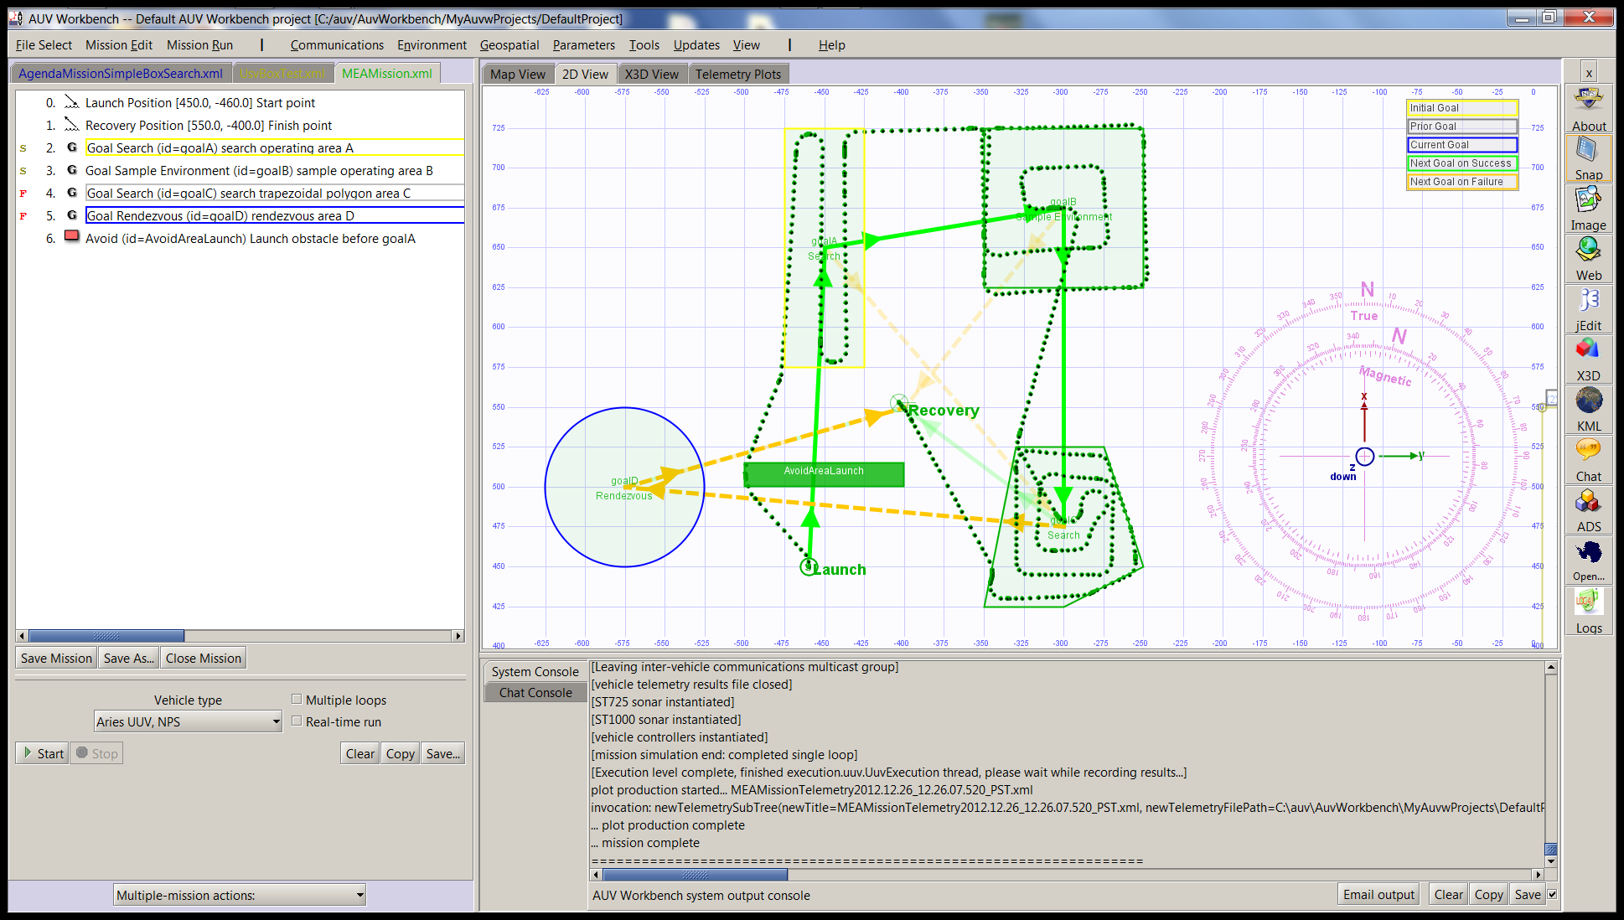
MeaMission.xml simulation 9, recovery

Slide 52
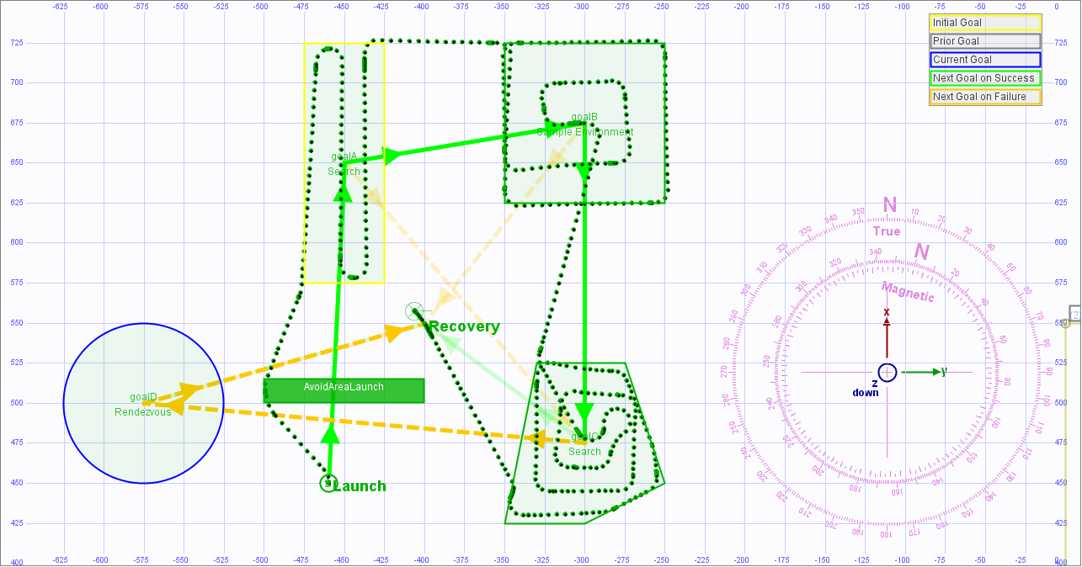
MeaMission.xml simulation 10, complete

Slide 53
Mission definition observations
MEA formalism assumes human generation of mission orders
  Example expressed using AVCL
  Can also be expressed in other languages such as Java, Prolog, CLIPS rule sets, C++, etc.
  As shown in multiple RBM theses, dissertations
Key insight #3. We continue our exploration of producing general mission orders that are:
  Understandable by (legally culpable) humans
  Reliably and safely executable by robots
Notes:
This presentation demonstrates 2 implementations illustrating the example mission

Slide 54
Generality to other robots
High-level mission planners tend to be dissimilar
  Much of AI can be posed as search algorithms
  Various RBM strategic-level implementations possible
Strong match between RBM tactical, execution AVCL vocabularies and many other robots
  We’ve written many AVCL importers/exporters
Generality principle still holds, however:
  Outputs of higher-level mission planners can be expressed as AVCL tactical commands!
  Perhaps unsurprising since we’ve designed AVCL command sets using human procedures at sea

Slide 55
Looking ahead

Slide 56
Thoughts on autonomous ethics
Ethics: everything old is new again!
  Possibly unexplored or unconsidered territory?
  Significant history of experience: mine warfare
Assume success… then what?
  Even if perfectly executable, proper robot logic is not useful unless it is a directly extension of warfighter logic
  Rules of Engagement, Concepts of Operations, Doctrine, Tactics, etc. must be expressible in equivalent terms in order to be effective, usable
  Civilian equivalents: Rules of Road, safety, etc.

Slide 57
Multi-layer robot architectures… onward and upward!
3 layers defined in Rational Behavior Model (RBM) robot architecture are fairly common in robotics
  Strategic: planning, goal evaluation, strategy
  Tactical: navigation, operations, mission conduct
  Execution: low-level control of systems
Autonomous Vehicle Command Language (AVCL)
  Maps to various commands, goals, robot dialects
Possible 4th layer above: Rules of Engagement?
  provide ethical constraints and boundary conditions on robot strategic planning and tactics
  Must work cooperatively, satisfactorily with humans
Notes:
Human military organizations are able to align tactical guidance through common command and control (C2) languages.
So it should not be shocking that, once you rise above software source code dialects to tasking, robot interoperability is possible.

Slide 58
Immediate project work pending
Ready to resume
Student interns from US Naval Academy
  Also if allowed: CSUDH, MAOS, CalPoly, others
Defining suite of missions, orders to test ethics
  Single or multiple robots, multiple contacts
  Ordinary encounters in isolation
  Support roles, occasional human supervision
  Ethical conundrums
Repeatable simulation experiments
  Mission reports are autogenerated products
  Lesson plans, research challenges, experiments

Slide 59
Candidate student theses
Build, test both operations order and ROEs for unmanned systems supporting fleet assets
Explore missions that test ethical conundrums related to autonomous robot lethality
Test missions afloat in Monterey Bay or at TNT exercises Camp Roberts, Fort Hunter Liggett
  map AVCL, AUV Workbench to other NPS robots
Numerous further topics possible, let’s discuss
  Your topic here, perhaps…

Slide 60
Software development TODO
Keep building realistic models for AUV Workbench
  Have added our first ROV model + joystick control
  Mission reports, KML, X3D graphics visualization
  Control and dynamics coefficients, sensor models
  Emphasis on education and undergraduate students
Develop larger repertoire of missions
  XSLT stylesheet to convert AVCL strategic mission into usable source code (Prolog, Java, C++, etc.)
  Let virtual world provide sensor responses
Integrate standard Prolog within AUV Workbench
  Gnu open-source Java-based Gnu Prolog

Slide 61
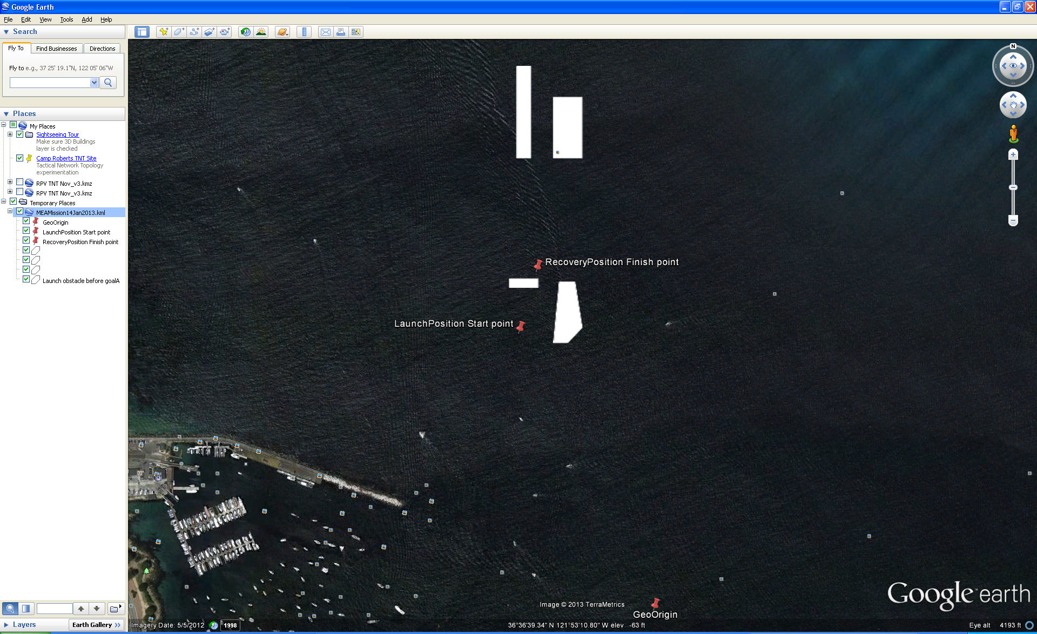
Sharable technique: KML track exports

Slide 62
Discussion
“There are more things in heaven and earth than are dreamt of in our philosophy, Horatio.”
William Shakespeare, Hamlet
Collaboration, contributions, insight and dialog
are always welcome
Notes:
The authors also gratefully acknowledge fruitful dialog and discussions with Dr. George Lucas USNA/NPS and Mark Dankel.

Slide 63
Contact
Don Brutzman, Ph.D.
brutzman@nps.navy.mil
brutzman@nps.navy.smil.mil
http://faculty.nps.edu/brutzman
Code USW/Br, Naval Postgraduate School
Monterey California 93943-5000 USA
1.831.656.2149 work
1.831.402.4809 cell

Slide 64
Contact
George R. Lucas, Jr., Ph.D.
grlucas@nps.edu
Professor of Ethics & Public Policy
Naval Postgraduate School
Monterey California 93943-5000 USA
Distinguished Chair of Ethics
VADM James Stockdale Center for Ethics
U.S. Naval Academy

Slide 65
Contact
CDR Duane Davis USN (Ret.) Ph.D.
dtdavi1@nps.edu
Code CS/Da
Naval Postgraduate School
Monterey California 93943-5000 USA
1.831.656.7980 work

