Slide 1
Universal Mission Controller with Run-Time Ethics Checking for Autonomous Unmanned Vehicles
AUV 2012 Southampton UK
IEEE Oceanic Engineering Society
25 September 2012
Don Brutzman, Bob McGhee, Duane Davis
Modeling, Virtual Environments, Simulation (MOVES)
Naval Postgraduate School (NPS), Monterey California USA

Slide 2
Topics
Motivation: human-taskable underwater robots
  Expressive power, semantics, syntax for a full solution
Rational Behavior Model (RBM) 3-layer architecture
  Strategic plans, Tactical operations, Execution control
Mission Planning and Execution
  Declarative mission exemplar is helpful, general
  What does it mean to define, apply ethical constraints?
Future Work
  Broader integration, tasking with ethical constraints

Slide 3
Motivating problem: ethics
How can robotic systems behave ethically?
  Important for military operations abroad
  Civil and scientific operations also coexist daily
Not necessarily about religion or morality
  Law of armed conflict internationally recognized; often captured as Rules of Engagement (ROE) guidance for specific national or coalition forces
  Military readiness must be prepared for combat
Legal basis for civil activity is often well defined
  Also measurable: are you vulnerable to lawsuit?!

Slide 4
Motivation: human-taskable underwater robots
We’re looking to near-term future when UUVs can offload work and augment human activity
Various excellent robot solutions must remain compatible with human concepts and tasking
  Necessary for mission planning and justification
  Otherwise the robots are simply not autonomous
Extensive/exhaustive prelaunch testing is critical
  For mission confidence and in-water reliability
This work is building an extendable architecture…
  … for continued efforts bridging human, robot logic
Notes:
Prelaunch testing includes both human and software rehearsal.

Slide 5
Our approach
Define missions that include ethical constraints without relying on artificial intelligence (AI) or obscure abstractions for appropriate behavior
  No embedded homunculus or ethicist engine
Design robot missions in way that can be adapted to a variety of disparate robot paradigms
  Generally adaptable to tasking of diverse systems
Build on patterns that work well for human groups cooperating on difficult, dangerous tasks
  Otherwise still need human at end of comms tether

Slide 6
Rational Behavior Model (RBM)
3-layer robot architecture
Strategic
  Declarative planning of goals while avoiding obstacles and observing constraints
Tactical
  Operational control of navigation, tactical and mission tasks. Sensor employment.
Execution
  Low-level control tasks. Open-loop, closed-loop commands for propulsors and effectors.
Twenty+ years of well-documented, progressive work

Slide 7
Turing machine
Turing machine (TM)
  consists of a finite state machine (FSM)
  augmented by an external agent in the form of a potentially infinite memory
  realized as tape of an “incremental tape recorder”
Often referenced but seldom used
  Extensive theoretical development has shown that Universal TM has greatest computational power
  Clumsy to program, infrequently used
  Nevertheless, appealing basis for theoretical design since it maps to general theory of any computation
Notes:
Turing Award is commonly referred to as the Nobel Prize of computer science.

Slide 8
Prior work: two technical reports on Mission Execution Automaton (MEA)
We adapted Universal Turing Machine (UTM) architecture to create a universal multiphase human-interactive MEA
  Express fundamental logic of mission planning
  Corresponds to RBM Strategic level implementation
  Goal: demonstrate computational generality
Implemented using Prolog language for easy backtracking during planning
  Prolog dialect: Allegro Common Lisp
  Interactive, text based
  Human provides external-world sensing responses
Notes:
Thank You Bob and Duane!

Slide 9
Goal-based Mission Example
Simple yet general mission goals, decision logic
Common approach, adaptable to other vehicles
Extendable and refinable mission tasking

Slide 10
Example Goal-based Mission Definition
Goal 1. Proceed to Area A and search the area. If the search is successful execute Goal 2. If the search is unsuccessful, execute Goal 3.
Goal 2. Obtain environment sample from Area A. If the sample is obtained, execute Goal 3. If the sample cannot be obtained, proceed to recovery position to complete the mission.
Goal 3. Proceed to Area B and search the area. Upon search success or failure, execute Goal 4.
Goal 4. Proceed to Area C, rendezvous with UUV-2. Upon rendezvous success or failure, transit to recovery position to complete the mission.
Notes:
Clumsy but readable. Humans can agree on intent.

Slide 11
Goal-based Mission Example
Strategic Level
Tactical Level
MEA Start
Tactics module sequencer
Phase 1: Search Area A
Fail
Succeed
Sample Environment Phase Controller
Area Definition
Phase 2:
Sample Environment in Area A
Queries
Sampling Requirements
Phase 3: Search Area B
Operational and Ethical Constraints Checking
Responses: Succeed
or Fail
System State and Sensor Data
Vehicle
Commands
Fail
Succeed
Succeed
Fail
Tactical-Level modules with shared vehicle state
and telemetry history
Phase 4: Rendezvous with
UUV-2 in Area C
Succeed
Phase 5: Transit
Return to Base
Fail
Controller Parameters
Fail
Succeed
Sensor Settings, Responses
Real-time orders
Mission Abort
Mission Complete
Execution Level
handles real-time control and response
Surface
Recovery position
Notes:
Right hand side: our robot architecture handles these task assignments one way. Another robot architecture may handle it a different way. Each however can be expected to sufficiently capable to report success or failure of each assignment. If not, then that robot is unresponsive and not really taskable with confidence by humans.

Slide 12
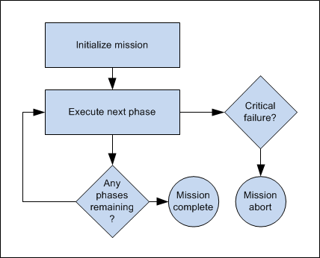
Mission execution rule set: simply loop through phases

Slide 13
Executable mission rule set: loop through phases
(<-- (execute_mission)
(initialize_mission)
(repeat) (execute_current_phase) (done) !)
(<-- (initialize_mission)
(abolish current_phase 1)
(asserta ((current_phase 1))))
(<-- (execute_current_phase)
(current_phase ?x) (execute_phase ?x) !)
(<-- (done) (current_phase 'mission_complete))
(<- (done) (current_phase 'mission_abort))
Notes:
Human readability of source code is often something in the eye of the beholder! Your mileage may vary.

Slide 14
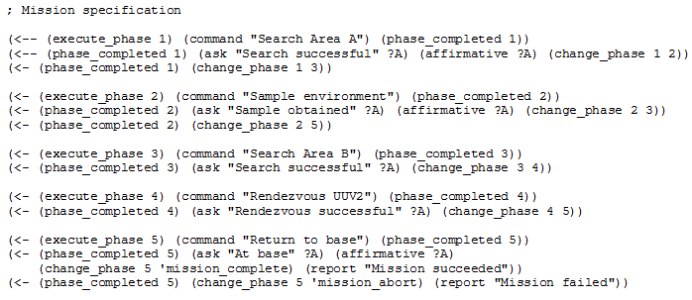
Executable mission phases for this example added to Prolog rule set

Slide 15
Adding ethical constraints to mission requirements
Following the leader:
how do human teams accomplish tasks ethically?
The same rules need to apply to unmanned systems.

Slide 16
Example ethical constraints, civil
Safe navigation, follow pertinent rules of road
Satisfactory navigational accuracy (GPS etc.)
Have received timely clearance to enter a specific geographic area for given time period
  Also vertical clearance for underwater depth zone or airborne altitude zone
Sufficient vehicle health, power, safety status
Meet communication requirements for tasking
  Identity beacon, transponder, AIS tracking, etc.
  Recording and reporting on situational data, etc.

Slide 17
Example ethical constraints, military
Meet all relevant, international civil requirements
Identification friend foe (IFF), blue-force tracking
  friendly/hostile/neutral/unknown
Prior determination of hostile intent
  Robot option to warn without fear of self protection
ROE use of deadly force, weapons releasability
  Brevity codes: weapons safe, hold, tight, free
  Confirmation and permission requirements
After-action reporting, damage assessment
Et cetera, et cetera…

Slide 18
Key insight
Ethical behaviors don’t define the mission plan.
rather
Ethical constraints inform the mission plan.

Slide 19
Goal-based Mission Example, with constraints
Strategic Level
Tactical Level
MEA Start
Tactics module sequencer
Constraint
Phase 1: Search Area A
Fail
Succeed
Sample Environment Phase Controller
Area Definition
Phase 2:
Sample Environment in Area A
Queries
Sampling Requirements
Phase 3: Search Area B
Operational and Ethical Constraints Checking
Constraint
Responses: Succeed
or Fail
Constraint
System State and Sensor Data
Vehicle
Commands
Fail
Succeed
Succeed
Fail
Tactical-Level modules with shared vehicle state
and telemetry history
Phase 4: Rendezvous with
UUV-2 in Area C
Succeed
Phase 5: Transit
Return to Base
Fail
Constraint
Constraint
Controller Parameters
Fail
Succeed
Sensor Settings, Responses
Real-time orders
Mission Abort
Mission Complete
Execution Level
handles real-time control and response
Surface
Recovery position

Slide 20
Running mission example #1
CG-USER(1): (?- (execute_mission))
Search Area A!
Search successful? yes
Sample environment!
Sample obtained? yes
Search Area B!
Search successful? yes
Rendezvous UUV2!
Rendezvous successful? yes
Return to base!
At base? yes
Mission succeeded.
Yes
User enters responses
to mission execution automaton (MEA) queries, thereby providing environmental responses and testing mission logic
These correspond to ethics checks measured by robot, or supervised by a human

Slide 21
Running mission examples # 2, 3
CG-USER(2): (?- (execute_mission))
Search Area A!
Search successful? yes
Sample environment!
Sample obtained? no
Return to base!
At base? yes
Mission succeeded.
Yes
CG-USER(3): (?- (execute_mission))
Search Area A!
Search successful? no
Search Area B!
Search successful? no
Rendezvous UUV2!
Rendezvous successful? yes
Return to base!
At base? no
Mission failed.
Yes
Human operators can logically test various mission alternatives to gain confidence
Simulation can also run through every option exhaustively to further confirm correctness

Slide 22
Theory versus practice
In theory: theory and practice are the same.
In practice: they’re not.
- Yogi Berra

Slide 23
Challenge: broad implementation
Can we
  Define mission goals readable by humans + robots
  Produce actionable tasking for different AUVs
  Produce software examples that can run properly in simulation and in robots
Can we also
  Define goal constraints ethically and measurably
Yes
Appears possible

Slide 24
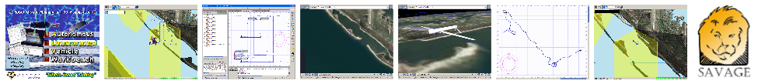
AUV Workbench
Tutorial on Thursday
Autonomous Unmanned Vehicle Workbench supports underwater, surface and air vehicles
  physics-based mission rehearsal
  real-time task-level control of robot missions, and
  replay of recorded results
  Industry-friendly open-source license, Sourceforge
  Basis: RBM 3-level architecture, AVCL commands
Used to rehearse strategic-level MEAMission.xml
  https://savage.nps.edu/AuvWorkbench

Slide 25
Autonomous Vehicle Command Language (AVCL)
AVCL is a command and control language for autonomous unmanned vehicles
  Close correspondence to human naval terminology
  Common XML representations for mission scripts, agenda plans, and post-mission recorded telemetry
Operators can utilize a single archivable and validatable format for robot tasking, results
  directly convertible to and from a wide variety of different robot command languages
https://savage.nps.edu/Savage/AuvWorkbench/AVCL/AVCL.html

Slide 26
AVCL vocabulary: AllCommandsUuv.xml
List, unit test all execution, tactical AVCL commands
  Simple unit testing of workbench software
  Confirm AUV Workbench interface, XML validation
  Mission unit tests for comprehensive coverage likely to follow
Also for other robotics platforms
  AllCommandsUsv.xml AllCommandsUav.xml AllCommandsUgv.xml
  Each provides a vocabulary list showing the current tactical repertoire (rather than runnable missions)
Notes:
Considering adding “dead reckoning” to 2D plot to assist in mission rehearsal visualization

Slide 27
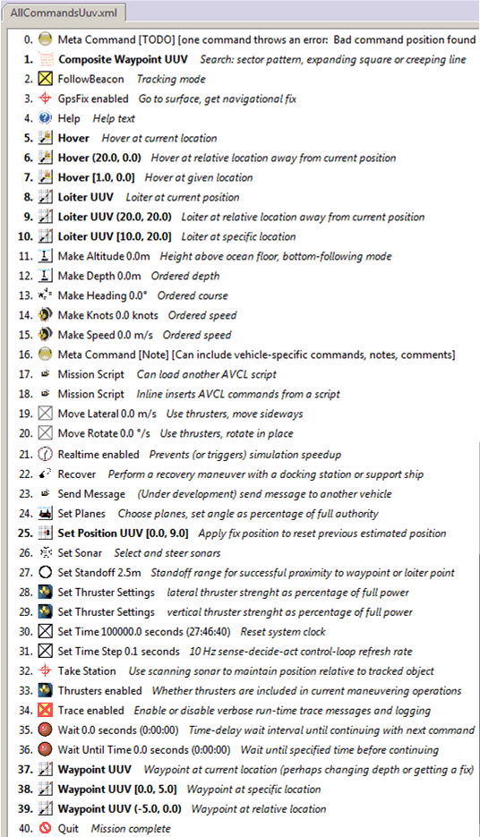
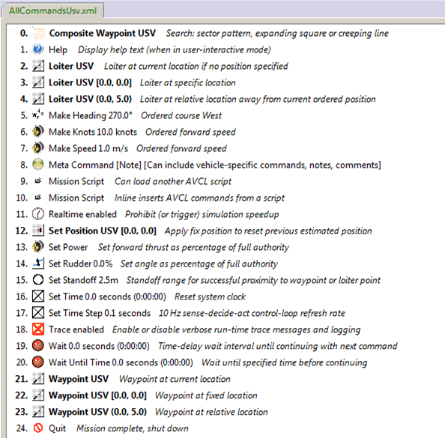

Slide 28
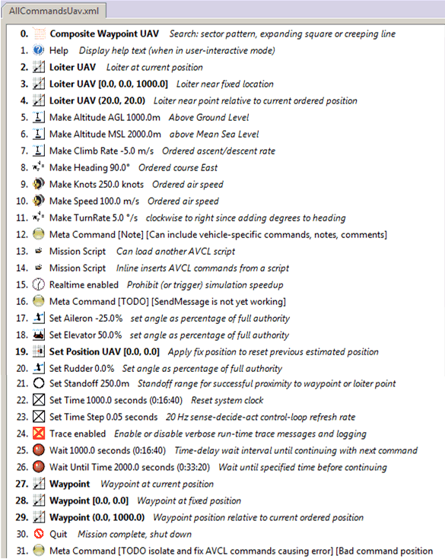
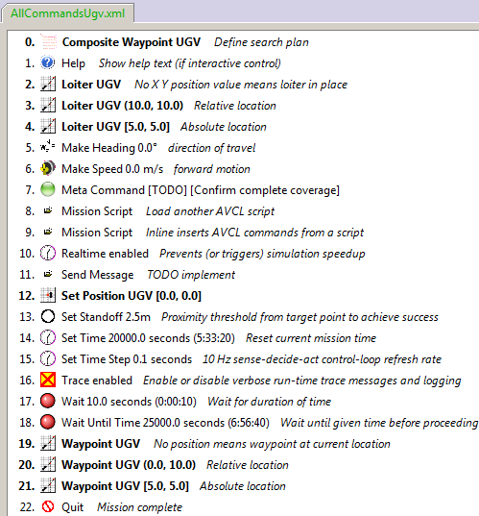

Slide 29
Example mission, as pseudo-code XML
<?xml version="1.0" encoding="UTF-8"?>
<UUVMission>
<GoalSet>
<Goal area=”A” id=”goal1”>
<Search nextOnSucceed=”goal2” nextOnFail=”goal3”/>
</Goal>
<Goal area=”A” id=”goal2”>
<SampleEnvironment nextOnSucceed=”goal3” nextOnFail=”recover”/>
</Goal>
<Goal area=”B” id=”goal3”>
<Search nextOnSucceed=”goal4” nextOnFail=”goal4”/>
</Goal>
<Goal area=”C” id=”goal4”>
<Rendezvous nextOnSucceed=”recover” nextOnFail=”recover”/>
</Goal>
<Goal area=”recoveryPosition” id=”recover”>
<Transit nextOnSucceed=”missionComplete” nextOnFail=”missionAbort”/>
</Goal>
</GoalSet>
</UUVMission>
Readable either by human or robot
Captures logic of canonical mission

Slide 30
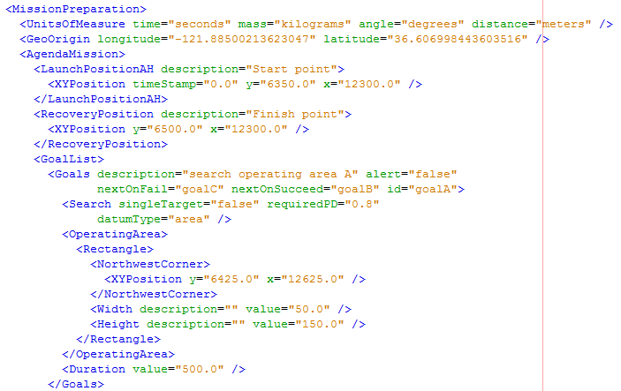
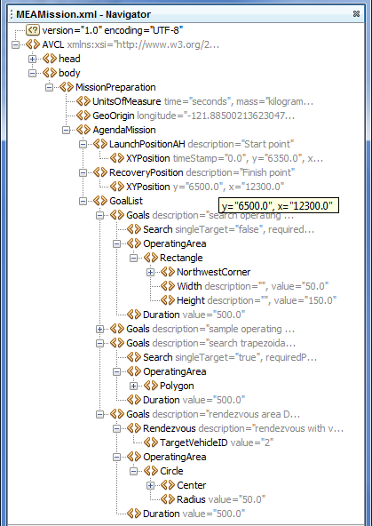
Corresponding example:
MEAMission.xml using AVCL xml

Slide 31
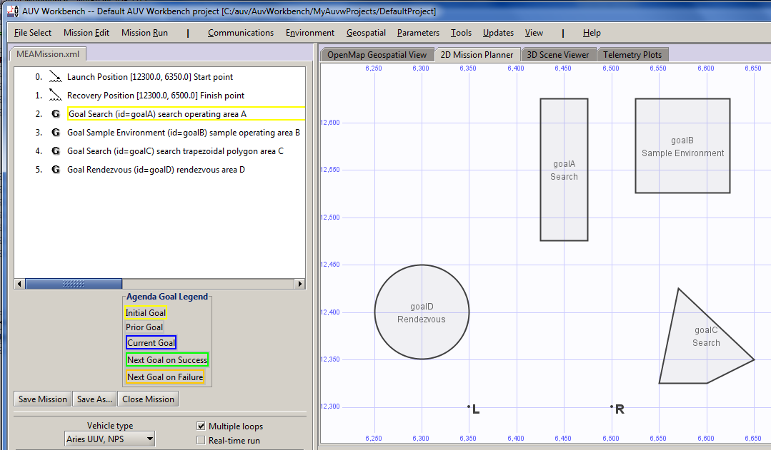
AUV Workbench MEA mission
Notes:
Similar to original mission with some small additional tasking for further testing

Slide 32
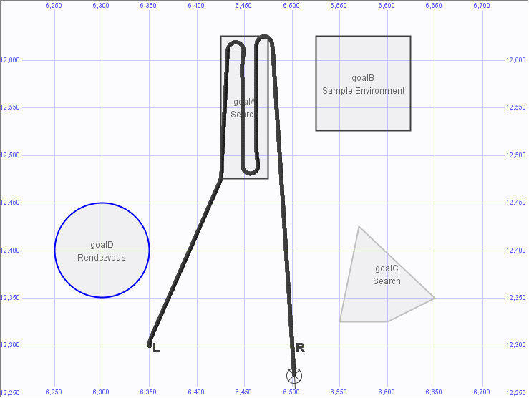
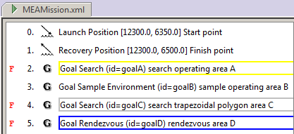
MeaMission.xml results
Search complete, return
Search planning
produces waypoints
Launch
Recovery
Notes:
These results are similar to the previously shown user-driven example #3: original search fails, so robot returns for recovery

Slide 33
Mission definition observations
MEA formalism assumes human generation of mission orders
  Example expressed using UTM constructs in Prolog
  Can also be expressed in other languages such as AVCL, CLIPS rule sets, C++, Java, etc.
  As shown in multiple RBM theses, dissertations
We are continuing our exploration of producing general mission orders
  Understandable by (legally culpable) humans
  Reliably, safely executable by robots
Notes:
This presentation demonstrates 2 implementations illustrating the example mission

Slide 34
Generality to other robots
High-level mission planners tend to be dissimilar
  Much of AI can be posed as search algorithms
  Various RBM strategic-level implementations possible
Strong match between RBM tactical, execution AVCL vocabularies and many other robots
  We’ve written many AVCL importers/exporters
Generality principle still holds, however:
  Outputs of higher-level mission planners can be expressed as AVCL tactical commands!
  Perhaps unsurprising since we’ve designed AVCL command sets using human procedures at sea

Slide 35
Looking ahead

Slide 36
Thoughts on autonomous ethics
Everything old is new again
  Largely unexplored or unconsidered territory?
  Significant history of experience: mine warfare
Assume success… then what?
  Even if perfectly executable, proper robot logic is not useful unless it is a directly extension of warfighter logic
  Rules of Engagement, Concepts of Operations, Doctrine, Tactics, etc. must be expressible in equivalent terms in order to be effective, usable
  Civilian equivalents: Rules of Road, safety, etc.

Slide 37
Multi-layer robot architectures… onward and upward!
3 layers defined in Rational Behavior Model (RBM) robot architecture are fairly common in robotics
  Strategic: planning, goal evaluation, strategy
  Tactical: navigation, operations, mission conduct
  Execution: low-level control of systems
Autonomous Vehicle Command Language (AVCL)
  Continue mappings to different robot dialects
Possible 4th layer above: Rules of Engagement?
  provide ethical constraints and boundary conditions on robot strategic planning and tactics
  Must work cooperatively, satisfactorily with humans
Notes:
Human military organizations are able to align tactical guidance through common command and control (C2) languages.
So it should not be shocking that, once you rise above software source code dialects to tasking, robot interoperability is possible.

Slide 38
NPS wargames and workshops include robot tasking, ethics issues
Future Unmanned Naval Systems (FUNS) wargame explored long-term autonomy issues for robot groups sharing reconnaissance tasks
CETMONS workshop explored robot ethics
  Sponsored by USNA Stockdale Leadership Center
  Can robots ever be given lethal weapons?
  Both humans, robotic systems make errors in war
  If robots make fewer errors than humans, then likely it becomes immoral to avoid using robots!
  Slippery slope but includes potential benefits also

Slide 39
Next steps, wish list
Keep building realistic models for AUV Workbench
  Have added our first ROV model + joystick control
  Mission reports, KML, X3D graphics visualization
  Control and dynamics coefficients, sensor models
  Emphasis on education and undergraduate students
Develop larger repertoire of missions
  XSLT stylesheet to convert AVCL strategic mission into usable source code (Prolog, Java, C++, etc.)
  Let virtual world provide sensor responses
Integrate standard Prolog within AUV Workbench
  Gnu open-source Java-based Gnu Prolog

Slide 40
Acknowledgements and Discussion
This work would not be possible without many years of work and guidance by Bob McGhee.
Collaboration, contributions and dialog
are always welcome
Notes:
The authors also gratefully acknowledge fruitful dialog and discussions with Dr. George Lucas USNA/NPS and Mark Dankel.

Slide 41
Contact
Don Brutzman, Ph.D.
brutzman@nps.navy.mil
brutzman@nps.navy.smil.mil
http://faculty.nps.edu/brutzman
Code USW/Br, Naval Postgraduate School
Monterey California 93943-5000 USA
1.831.656.2149 work
1.831.402.4809 cell

Slide 42
Contact
Bob McGhee, Ph.D.
robertbmcghee@gmail.com
MOVES Institute
Naval Postgraduate School
Monterey California 93943-5000 USA

Slide 43
Contact
CDR Duane Davis USN (Ret.) Ph.D.
dtdavi1@nps.edu
Code CS/Da
Naval Postgraduate School
Monterey California 93943-5000 USA
1.831.656.7980 work

