Slide 1
Ethical Control of Unmanned Systems
Repeatable Mission Evaluation through
Unmanned Systems Data Strategy
Project Update for CRUSER
Consortium for Robotics Unmanned Systems Education and Research
Don Brutzman, Curtis Blais, Terry Norbraten, and Kristen Fletcher
Naval Postgraduate School (NPS)
10 December 2021
Notes:
Distribution is unrestricted. See Open-Source License for Ethical Control for details controlling this work.

Slide 2
Ethical Control quad chart

Slide 3
Team Members and Focus-Area Presentations
Curtis Blais, Co-PI
  Data modeling and formal ontology development
  Mission Execution Ontology (MEO) and C2SIM standard with NATO
Kristen Fletcher
  Legal and ethical policies, ramifications
Terry Norbraten
  Software design, development, and testing
  Data conversion using Data Format Description Language (DFDL)
Don Brutzman, PI
  Ethically constrained control of unmanned systems and robot missions by human supervisors and warfighters
  Unmanned systems data strategy and LVC interoperability architecture

Slide 4
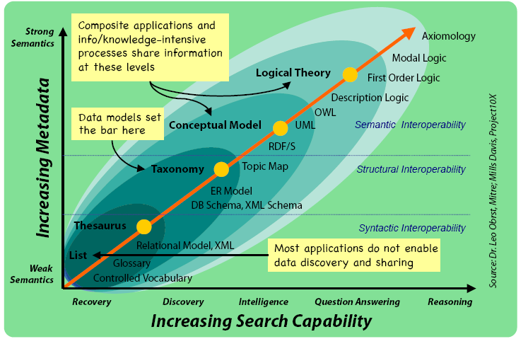
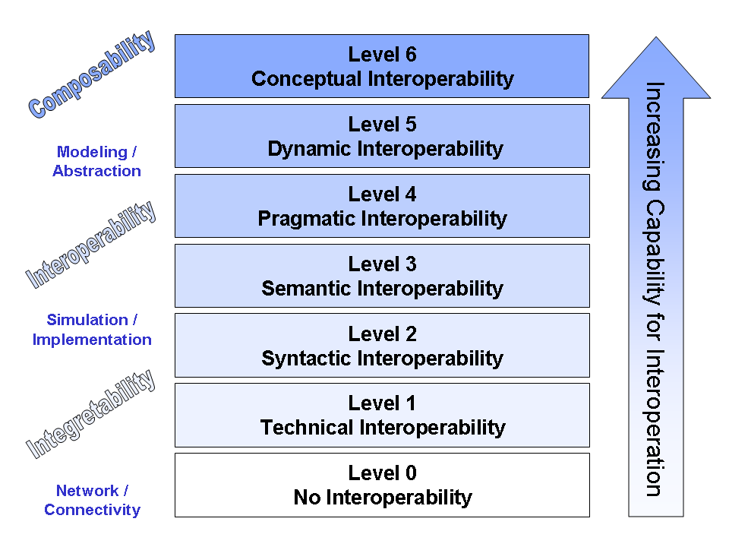
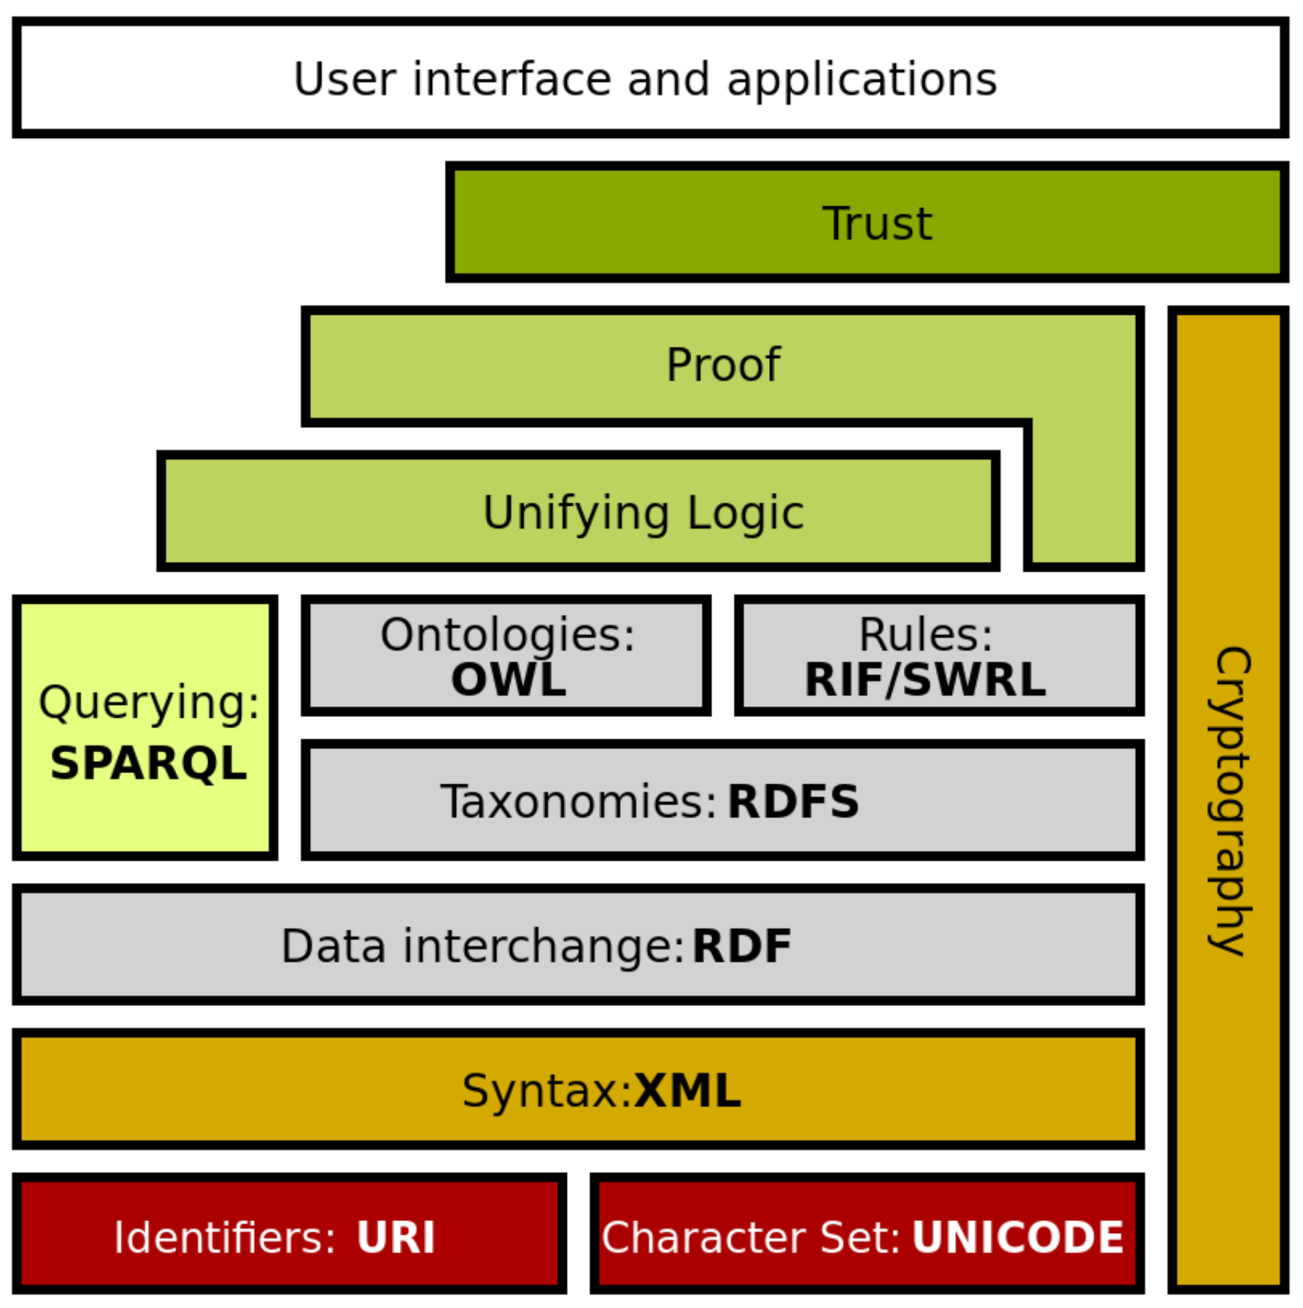
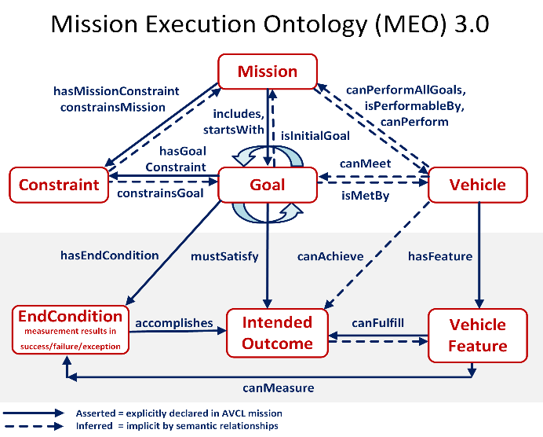
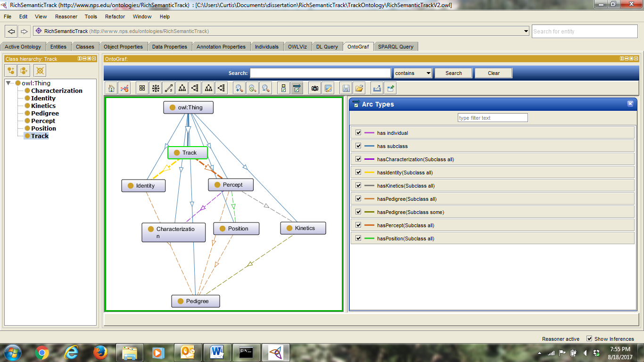
Curtis Blais, Co-PI
Data Modeling and Formal Ontology Development
Integratability
n

Slide 5
Motivation: Need for Stronger Semantics in Data Modeling
Improving
Interoperability
Improving
Enterprise
Data Sharing
Improving
Linking Data
at Web-Scale
Stronger
Semantic
Representation
Improving
Mission-Specific
Information Sharing
Improving
Automation / Autonomy

Slide 6
Improving Semantic Representation
Knowledge Representation (KR) is an area of artificial intelligence (AI) research and practice focused on encoding meaning into data.
Academia and industry now have a detailed path toward higher levels of machine understanding corresponding to human understanding.
Refer to the Ontology Spectrum on the next slide (source: Obrst, Leo, and Mills Davis. 2006. SICoP White Paper Series Module 2: Semantic Wave 2006 - Executive Guide to the Business Value of Semantic Technologies, Project 10X, May 2015).
Acronyms: Database (DB) ; Extensible Markup Language (XML); Resource Description Language / Schema (RDF/S); Unified Modeling Language (UML); Web Ontology Language (OWL)

Slide 7
Ontology Spectrum
Improving Semantic Representation

Slide 8
Improving Interoperability
Interoperability: “the capability of a system to automatically, without human intervention, provide services to and accept services from other systems, and to use the services so exchanged to enable the systems to work together to achieve a desired outcome” (Blais and Lacy 2004).
Academia and industry have laid out a path toward higher levels of interoperability: refer to the Levels of Conceptual Interoperability Model (LCIM) on the next slide (source: Tolk, Andreas, Saikou Y. Diallo, Charles D. Turnitsa, and Leslie S. Winters. 2006. “Composable M&S Web Services for Net-centric Applications.” Journal for Defense Modeling & Simulation (JDMS), 3:1:27-44. January.).
Objective is to achieve conceptual and pragmatic interoperability.

Slide 9
Levels of Conceptual Interoperability
Improving Interoperability: Levels of Conceptual Interoperability Model
Integratability

Slide 10
Semantic Web: Knowledge Representation at Web Scale
Architects of the World Wide Web have laid out a layered set of standards to achieve the Semantic Web vision: “not a separate Web but an extension of the current one, in which information is given well-defined meaning, better enabling computers and people to work in cooperation” (Berners-Lee et al. 2001)
Ultimate goal: achieve a scalable trusted information infrastructure where humans and software interact meaningfully, in a repeatable environment where expectations of quality and integrity are met.
Scalable approach indicates that single (ship + robot) solutions have potential to grow and encompass many simultaneous systems, thus improved data sharing, mission deconfliction, coordinated operations

Slide 11
Semantic Web Stack
Extends larger Web architecture
All of these data languages are approved W3C standards
Proof and unifying logic are mathematically well defined
Trusting derived (composed) statements arises from
Encryption + digital signature confirms trusted data sources
Formal logic is basis for deriving new information
Wikipedia: Semantic Web Stack
Of note: this project is exercising every layer of Semantic Web stack.

Slide 12
Autonomous Vehicle Command Language (AVCL)
AVCL is a command and control language for humans supervising autonomous unmanned vehicles.
  Clarity arises from close correspondence to human naval terminology.
Structured vocabulary defining terms and relationships for mission planning, execution, conduct, recording and replay across diverse robot types.
Common-ground XML representations for
  Mission agenda plans, mission scripts, and post-mission recorded telemetry results.
  Future work: defining unit tests and expected results for verification and validation.
Operators have single archivable, validatable format for robot tasking, results
  directly convertible to and from a wide variety of different robot command languages.
Mission Tasking
https://savage.nps.edu/Savage/AuvWorkbench/AVCL/AVCL.html

Slide 13
AVCL mission goals vocabulary (Davis 2015)
AVCL mission goals | Define | Used | Definition
Attack | partial | √ | To conduct a type of offensive action characterized by employment of firepower and maneuver to close with and destroy an enemy.
Decontaminate | √ |  | To provide purification making an area safe by absorbing, destroying, neutralizing, making harmless, or removing chemical, biological, or nuclear contamination.
Demolish | √ |  | To destroy structures, facilities, or material by any available means.
IlluminateArea | √ |  | To provide locale lighting by searchlight or pyrotechnics.
Jam | √ |  | To deliberately radiate, re-radiate or reflect electromagnetic energy with the object of impairing the use of electronic devices or systems.
MarkTarget | √ | √ | To make visible (by the use of light, infrared, laser, smoke, etc.) of an object in order to allow its identification by another object.
MonitorTransmissions | √ | √ | To conduct electronic warfare support operations with a view to searching, locating, recording and analyzing radiated electromagnetic energy.
Patrol | √ | √ | To gather information or carry out a security mission.
Rendezvous | √ | Partial | Achieve a meeting at a specified time and place.
Reposition | √ | √ | To change position from one location to another.
SampleEnvironment | Partial | √ | Collect environmental samples for testing for chemical compounds, biological creatures, or nuclear hazards.
Search | √ | √ | To look for lost or unlocated objects or persons.
More
Goal Types Foreseen

Slide 14
Example AVCL mission agenda, as pseudo-code XML
<?xml version="1.0" encoding="UTF-8"?>
<UUVMission>
<GoalSet>
<Goal area=”A” id=”goal1”>
<Search nextOnSuccess=”goal2” nextOnFailure=”goal3”/>
</Goal>
<Goal area=”A” id=”goal2”>
<SampleEnvironment nextOnSuccess=”goal3”
nextOnFailure=”recover”/>
</Goal>
<Goal area=”B” id=”goal3”>
<Search nextOnSuccess=”goal4” nextOnFailure=”goal4”/>
</Goal>
<Goal area=”C” id=”goal4”>
<Rendezvous nextOnSuccess=”recover” nextOnFailure=”recover”/>
</Goal>
<Goal area=”recoveryPosition” id=”recover”>
<Transit nextOnSuccess=”missionComplete” nextOnFailure=”missionAbort”/>
</Goal>
</GoalSet>
</UUVMission>
AVCL is readable by human or robot,
captures logic of mission tasking
XML ensures syntactically correct, well-defined, numerically valid
Needed: semantic representation
to check ethical, logical consistency

Slide 15
Motivating insights: converting data into logic
"The answer to your question is the response to the query."
  Jim Hendler and Dean Allemang
  Meaningfulness of an answer matches the precise meaning of a question.
"Trying to use the Semantic Web without SPARQL is like trying to use a relational database without SQL.“
  Tim Berners-Lee
  Language representations are needed for query as well as for information.
"The proof of the pudding is in the eating."
  Wiktionary
  Confidence in results requires testing.
Notes:
X3D Ontology for Semantic Web, https://www.web3d.org/x3d/content/semantics/semantics.html

Slide 16
Mission Execution Ontology (MEO) Development
Define MEO from concepts, properties, relationships using Protégé tool.
Create full set of canonical missions in AVCL (XML).
Determine exemplar mappings for AVCL primitives to Turtle for RDF/OWL.
Write conversion stylesheet AvclToMEO.xslt for full expressiveness.
Convert all AVCL missions to corresponding triples.
Confirm AVCL MEO, missions validate satisfactorily using Protégé, ARQ.
Automate build process as suite of repeatable unit-test queries (log).
SPARQL queries to test AVCL mission representations in Turtle.
Write SPARQL metaqueries to test, document MEO ontology relationships.
Continuing work: Adding Shapes Constraint Language (SHACL) statements for mission validation.
Continuing work: Ontology linking (mission specification, mission data stream, ethics, policies, provenance) for query and automated reasoning.

Slide 17
Description Logic (DL) Rules provide basis for Mission Execution Ontology (MEO)
Rules | Description Logic Equations | Plain-language description
M = Mission Rules
M1 | Mission ⊑ ∀startsWith.Goal ⊓ =1startsWith.Goal | A Mission can only start with a Goal and must start with exactly one Goal
M2 | Mission ⊑ ∀includes.Goal ⊓ ≥1includes.Goal | A Mission can only include Goals and must include one of more Goals
M3 | Mission ⊑ ∀hasConstraint.Constraint | A Mission can only be constrained by Constraints
M4 | startsWith ⊑ includes | A Mission must include the Goal that it starts with
M5 | Mission ⊑ ∀performableBy.Vehicle | A Mission can only be performed by a Vehicle
M6 | Cannot be expressed in DL | A Mission cannot be performable by a Vehicle unless that Vehicle has the ability to identify all Constraints associated with that mission
M7 | Cannot be expressed in DL | A Mission cannot be performable by a Vehicle unless that Vehicle has the capability to accomplish all Goals included in that Mission
Excerpted from full
Mission Execution Ontology Decision Logic Tables
Original author: Duane Davis
Model updated by Curtis Blais in collaboration with Raytheon engineers through NPS-Raytheon CRADA

Slide 18
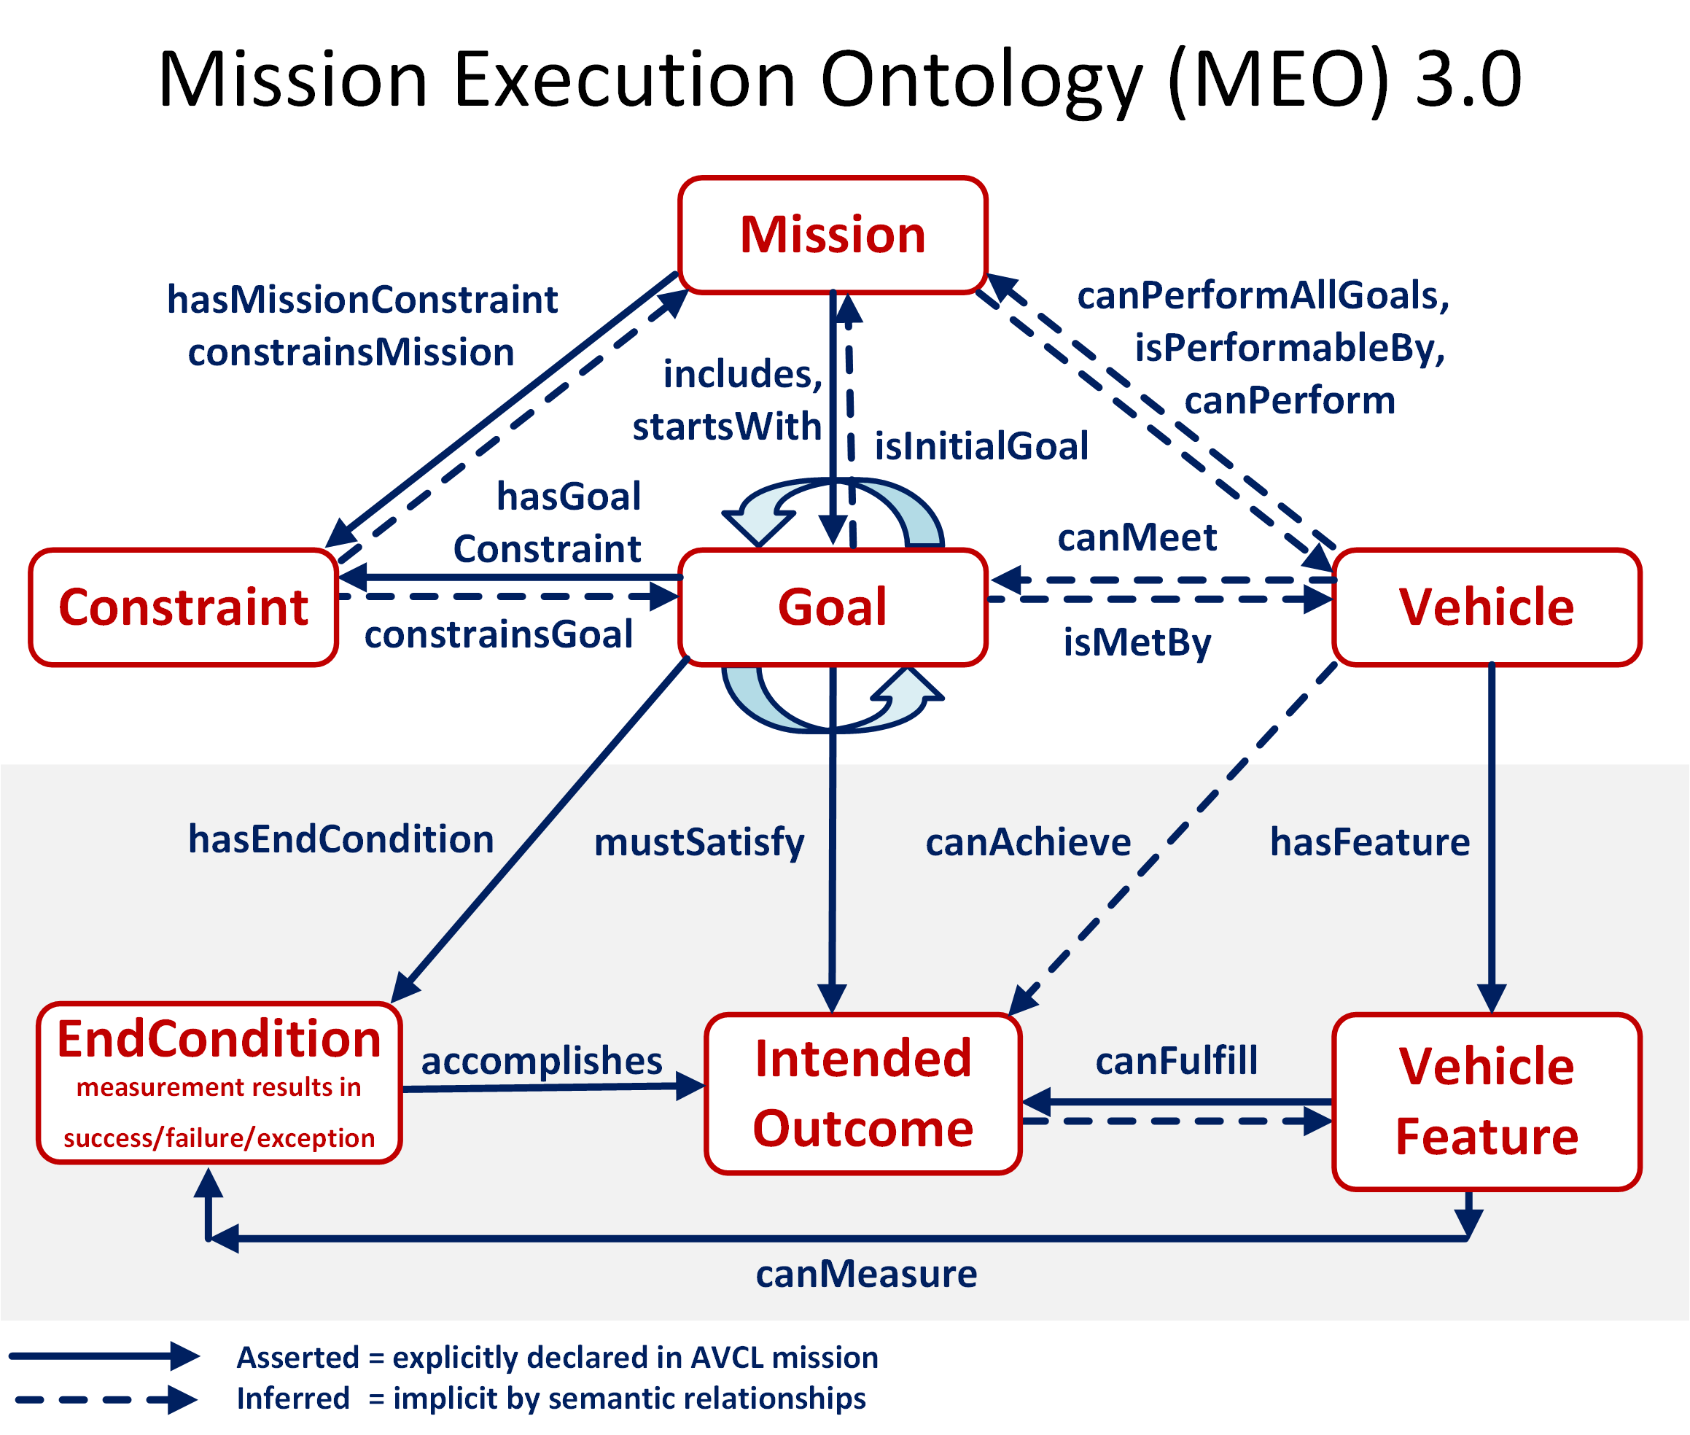

Slide 19
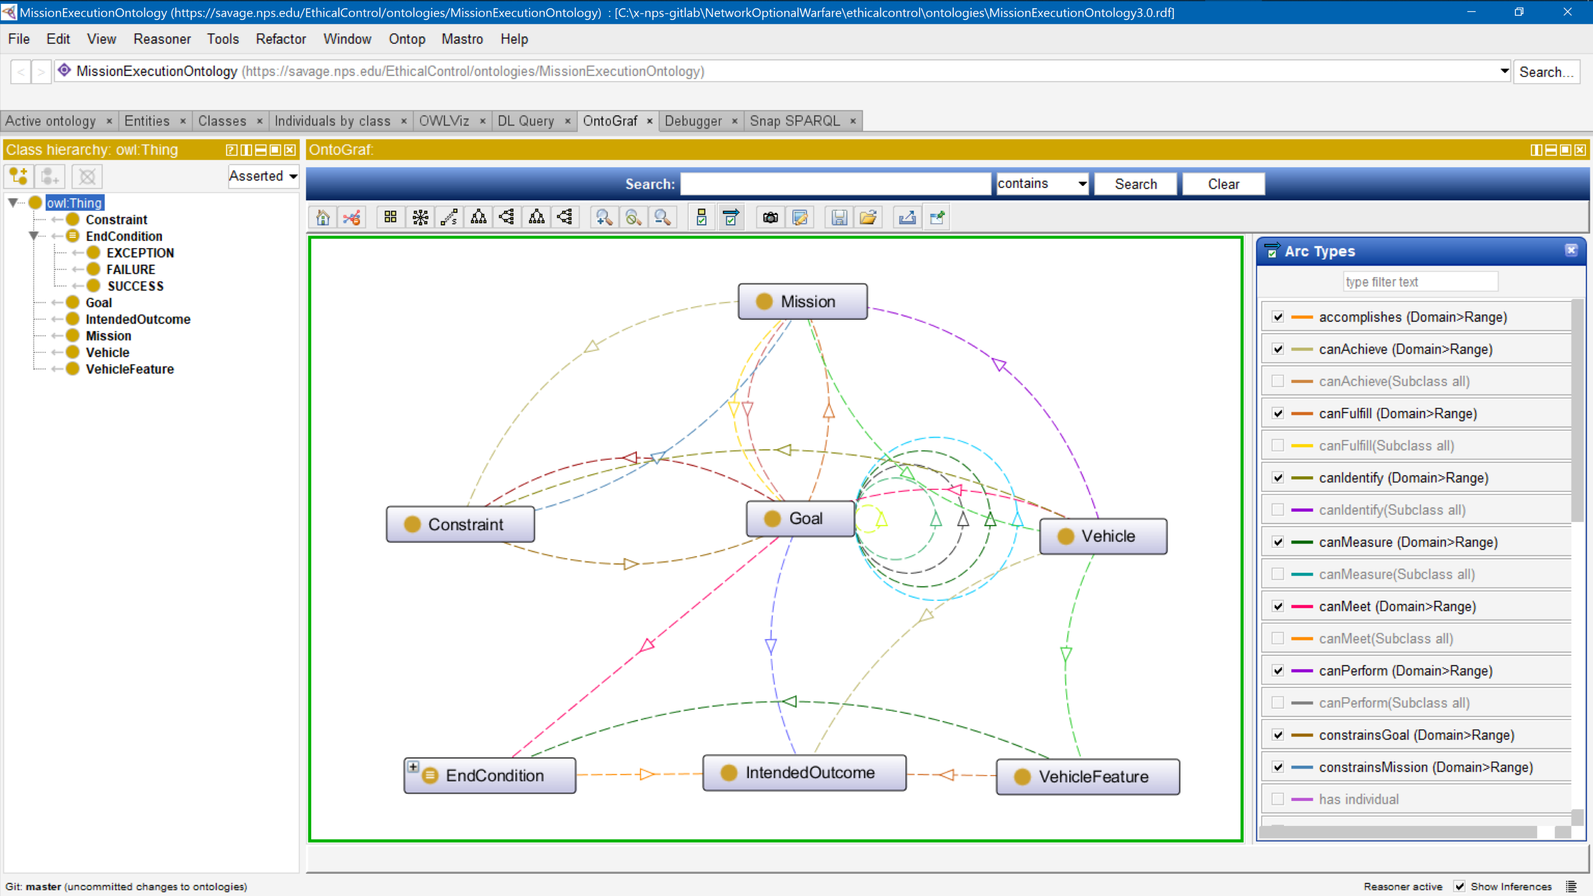
Mission Execution Ontology (MEO) source
implemented, tested
using Protégé tool

Slide 20
Mission Execution Ontology (MEO) for Ethical Control of Unmanned Systems in Surrogate Scenarios
Summary of relationships
Autonomous Vehicle Command Language (AVCL) for Missions.
  Declarative XML, years of NPS research.
Multiple Mission Representations.
  Imperative commands (orders/waypoints/etc.).
  Declarative commands (mission goals).
  Mission results (order log, telemetry etc.).
  Mission metadata for parameters, settings.
  Lisp and Prolog examples (Bob McGhee, NPS).
Autonomous Unmanned Vehicle (AUV) Workbench Simulation and Visualization Support
  Recently restored, debug testing commenced.
  AVCL 2.1 is prior published version, centered on syntactic validation, solo robot operations.
  AVCL 3.0 is new working version for testing range of multi-participant missions.
Mission Execution Ontology (MEO) for Semantic Validation
  Semantic Web framework of rules, relationships for ethical validation.
  Initial examples in IEEE JOE paper.
  Retested using current Protégé, Jena tools.
Sailor Overboard and Other Missions
  Hand-crafted triples using Turtle syntax.
  Beginning to build unit testing framework.
  Confirming correlation of AVCL information model to existing MEO ontology.
  Automatic conversion of AVCL missions to match, thus accelerating multiple-mission testing on diverse systems.
  Visualization, reporting via AUV Workbench can aid understanding, mission planning and further progress.

Slide 21
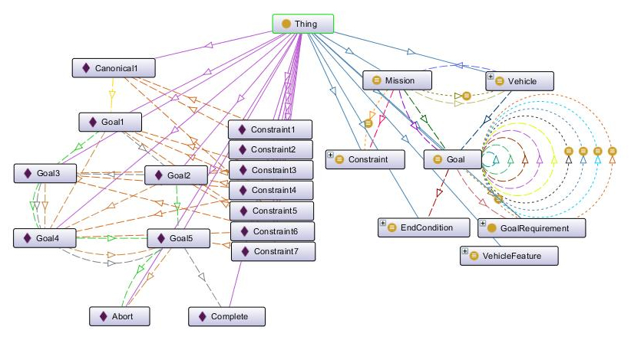
Example Mission Validation using Protégé Tool

Slide 22
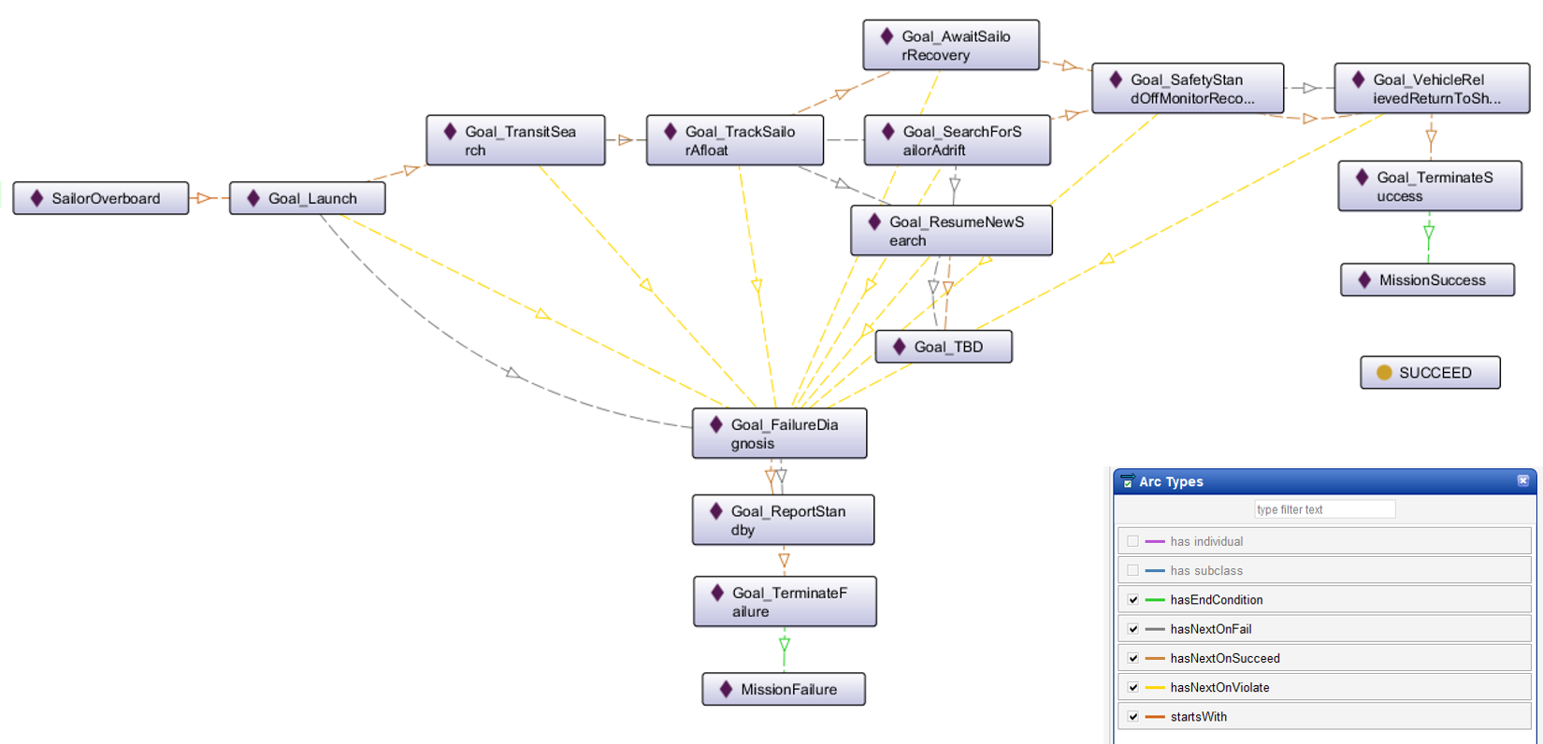
Ethical Control of Unmanned Systems in a Surrogate Scenario: Sailor Overboard Mission defined using the MEO Ontology
Current work is designing,
building and testing a set
of exemplar missions

Slide 23
SPARQL Protocol and RDF Query Language
“SPARQL is an RDF query language — that is, a semantic query language for databases — able to retrieve and manipulate data stored in Resource Description Framework (RDF) format.” -- Wikipedia
Standardized as World Wide Web (W3C) Recommendation
  Open-source implementations that we use include Apache ARQ and Protégé tool.
We use SPARQL to express queries against AVCL missions in RDF/OWL (Turtle syntax) together with Mission Execution Ontology (MEO).
Results reveal interesting properties about missions that are otherwise difficult to determine. Inferences can also be combined and correlated.
Goal is to express in-depth mission-related queries that determine
  Whether all logical mission prerequisites and constraints are satisfied, and
  Whether tactical policies and Rules of Engagement (ROE) are met.

Slide 24
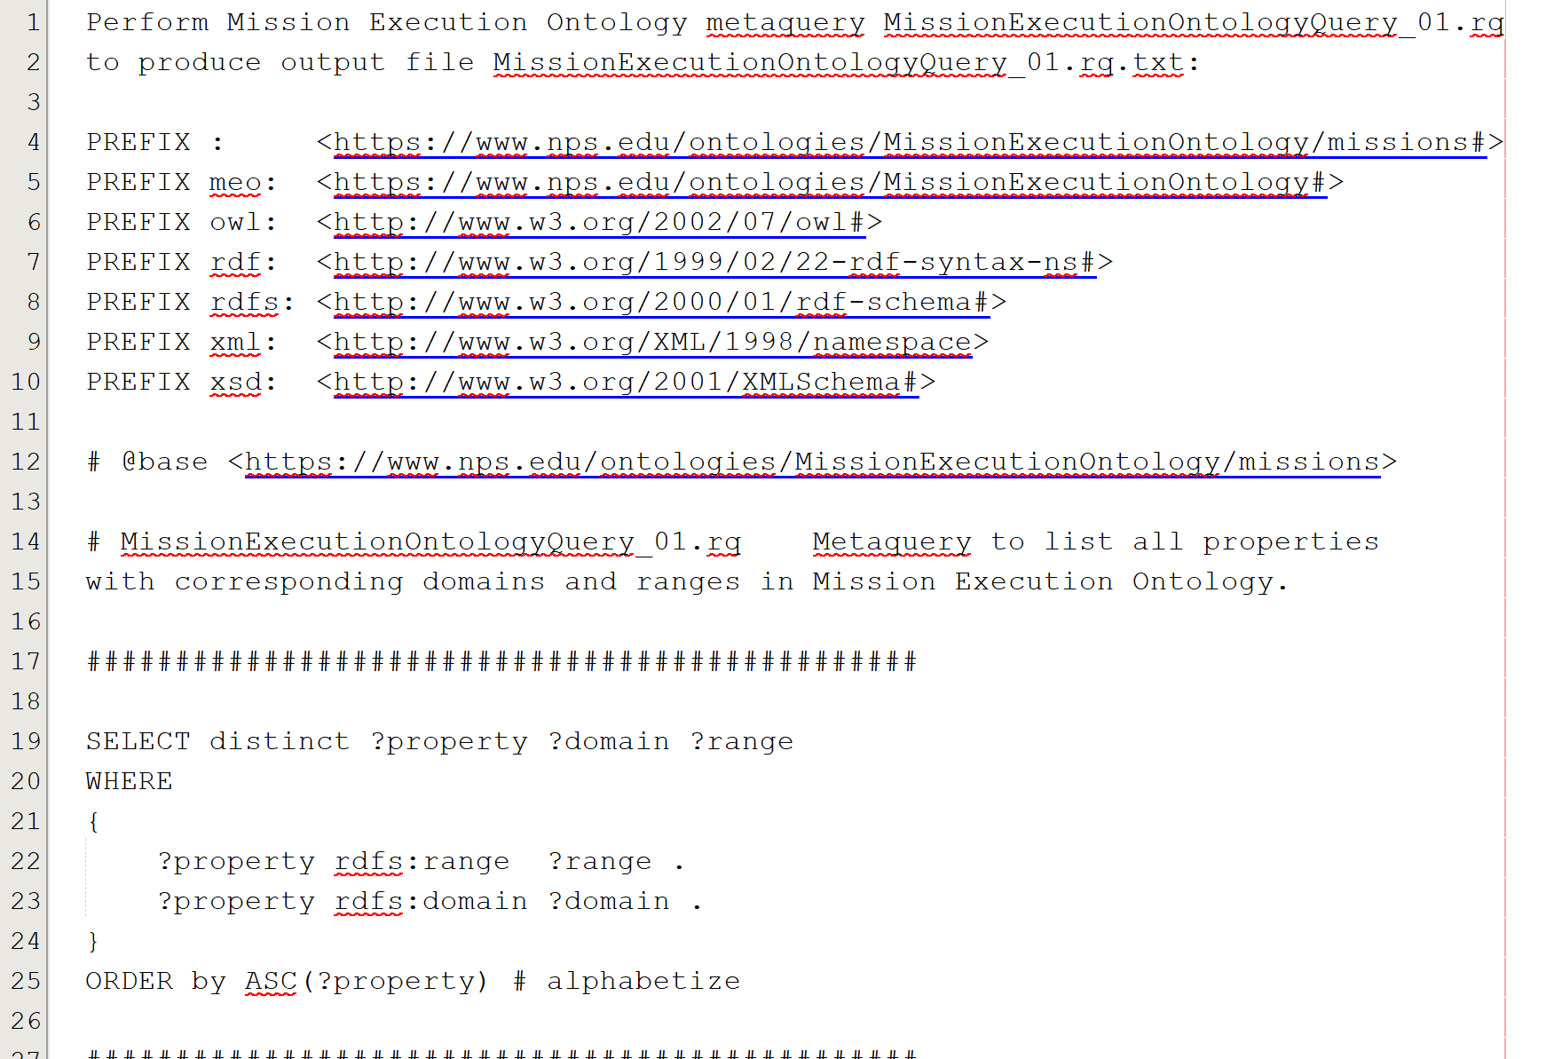
Confirm MEO via self-centered SPARQL metaquery
MissionExecutionOntologyQuery_01.rq

Slide 25
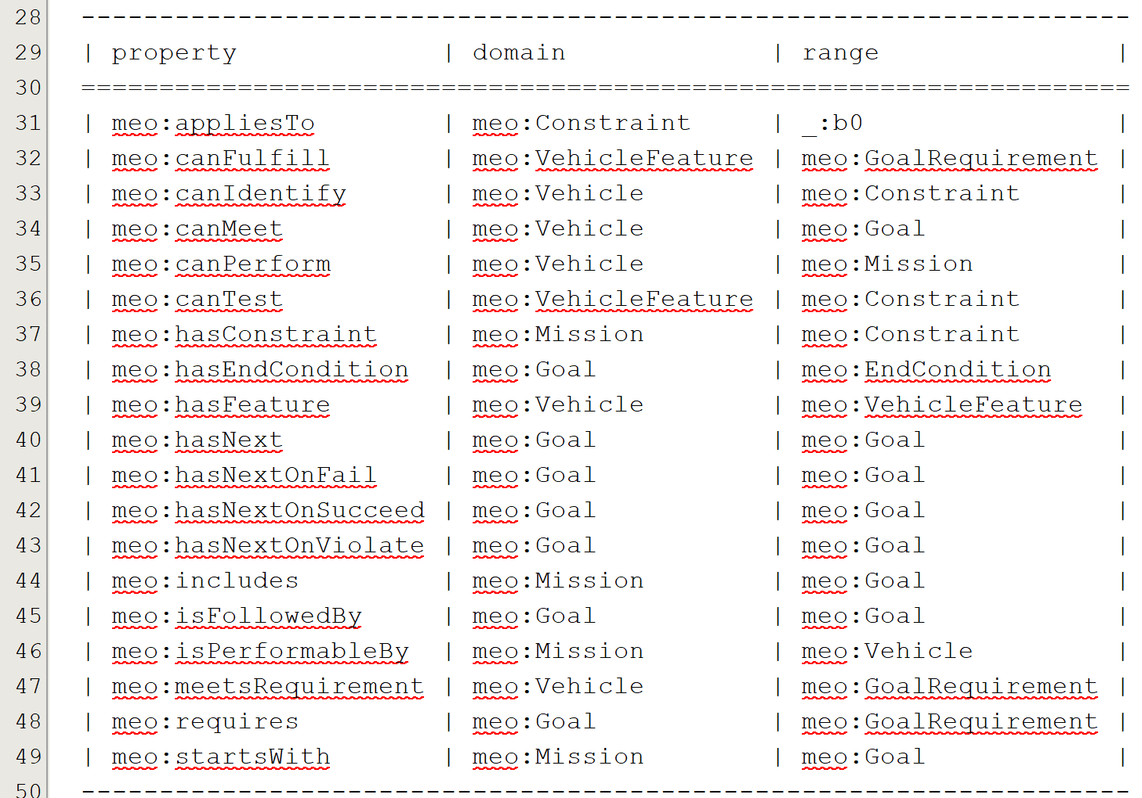
Confirm MEO via self-centered SPARQL metaquery response
MissionExecutionOntologyQuery_01.rq.txt

Slide 26
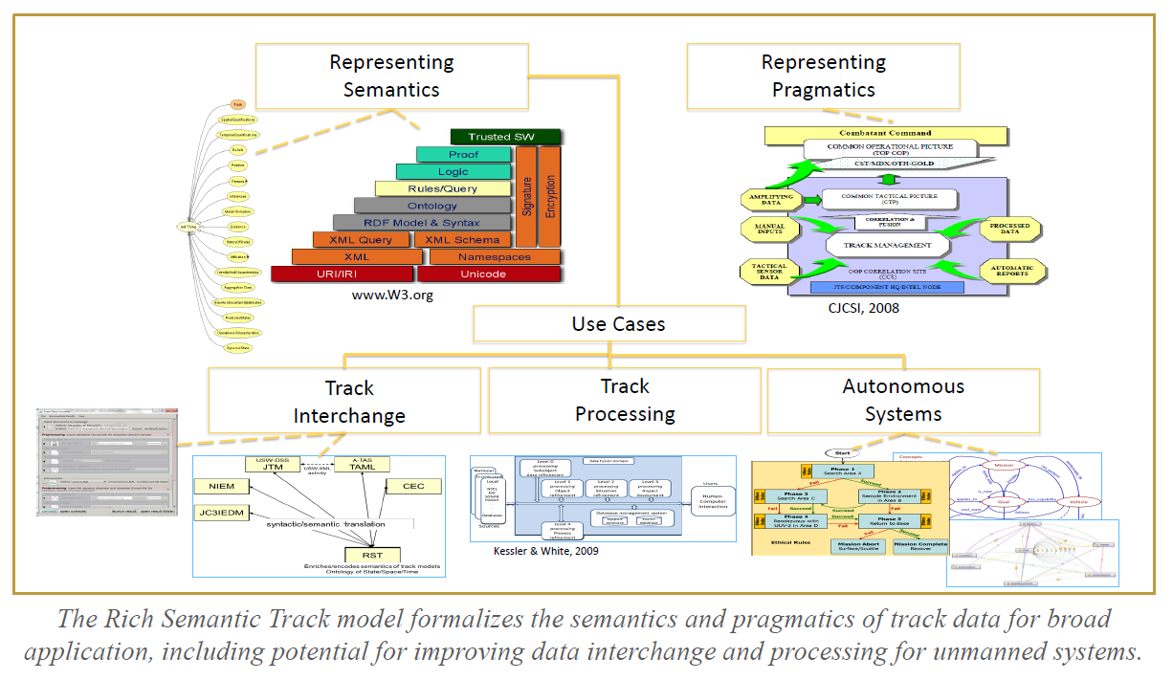
Rich Semantic Track (RST) Ontology

Slide 27
Rich Semantic Track Formalization
n

Slide 28
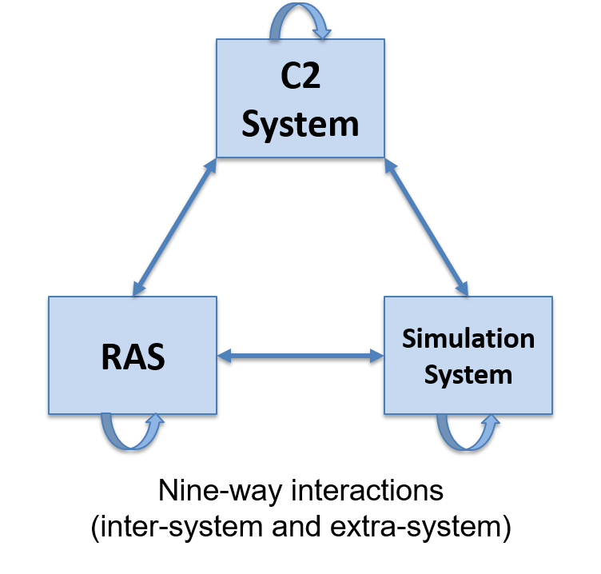
Coalition Interoperability:
C2SIM Standard
Only international standard for information interchange across C2 systems, simulation systems, and robotic and autonomous systems (RAS)
  Plans, orders, and reports
  Being adopted as NATO Standardization Agreement (STANAG)
  Identified standard for the NATO Federated Mission Networking initiative
Published April 2020 by the Simulation
Interoperability Standards Organization (SISO)
  C2SIM Core Ontology and Standard Military Extension
  C2SIM Land Operations Extension
  C2SIM Guide

Slide 29

IEEE P7000-series Standards Projects https://ethicsinaction.ieee.org
P7000 Model Process for Addressing Ethical Concerns during System Design
P7001 Transparency of Autonomous Systems
P7002 Data Privacy Process
P7003 Algorithmic Bias Considerations
P7004 Standard on Child and Student Data Governance
P7005 Standard on Employee Data Governance
P7006 Standard on Personal Data AI Agent Working Group
P7007 Ontological Standard for Ethically driven Robotics and Automation Systems
P7008 Standard for Ethically Driven Nudging for Robotic, Intelligent and Autonomous Systems
P7009 Standard for Fail-Safe Design of Autonomous, Semi-Autonomous Systems
P7010 Well-being metrics Standard for Ethical Artificial Intelligence and Autonomous Systems
P7011 Stadard for the Porcess of Identifying and Rating the Trustworthiness of News Sources
P7012 Standard for Machine Readable Personal Privacy Terms
P7014 Standard for Ethical Considerations in Emulated Empathy in Autonomous and Intelligent Systems

Slide 30
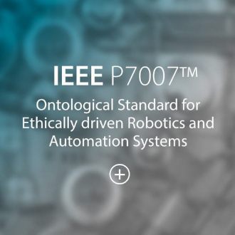
IEEE Standards Project P7007 for Ontological Standard for Ethically driven Robotics and Automation Systems
IEEE Global Initiative on Ethics of Autonomous and Intelligent Systems.
  https://ethicsinaction.ieee.org includes large document providing broad rationale.
  Includes 15 separate working groups in IEEE Standards Association (IEEE-SA).
Relevant group: P7007, Ethically driven Robotics and Automation Systems.
  “IEEE P7007 Standards Project for Ontological Standard for Ethically driven Robotics and Automation Systems establishes a set of ontologies with different abstraction levels that contain concepts, definitions and axioms that are necessary to establish ethically driven methodologies for the design of Robots and Automation Systems.”
  http://standards.ieee.org/develop/project/7007.html
  Must be IEEE member, observe patent-policy requirements to participate in working group.
  “Not the intent to specify required ethical behaviors, but rather to formalize a vocabulary of terms, concepts, and relationships that can be used to enable unambiguous discussion among […] communities regarding what it means for autonomous systems to exhibit ethical behaviors.”
  Excellent forum with rich references, worth observation and participation.
Active work: align several Ethical Control terms, concepts, use cases with P7007.
Published
November 2021!

Slide 31
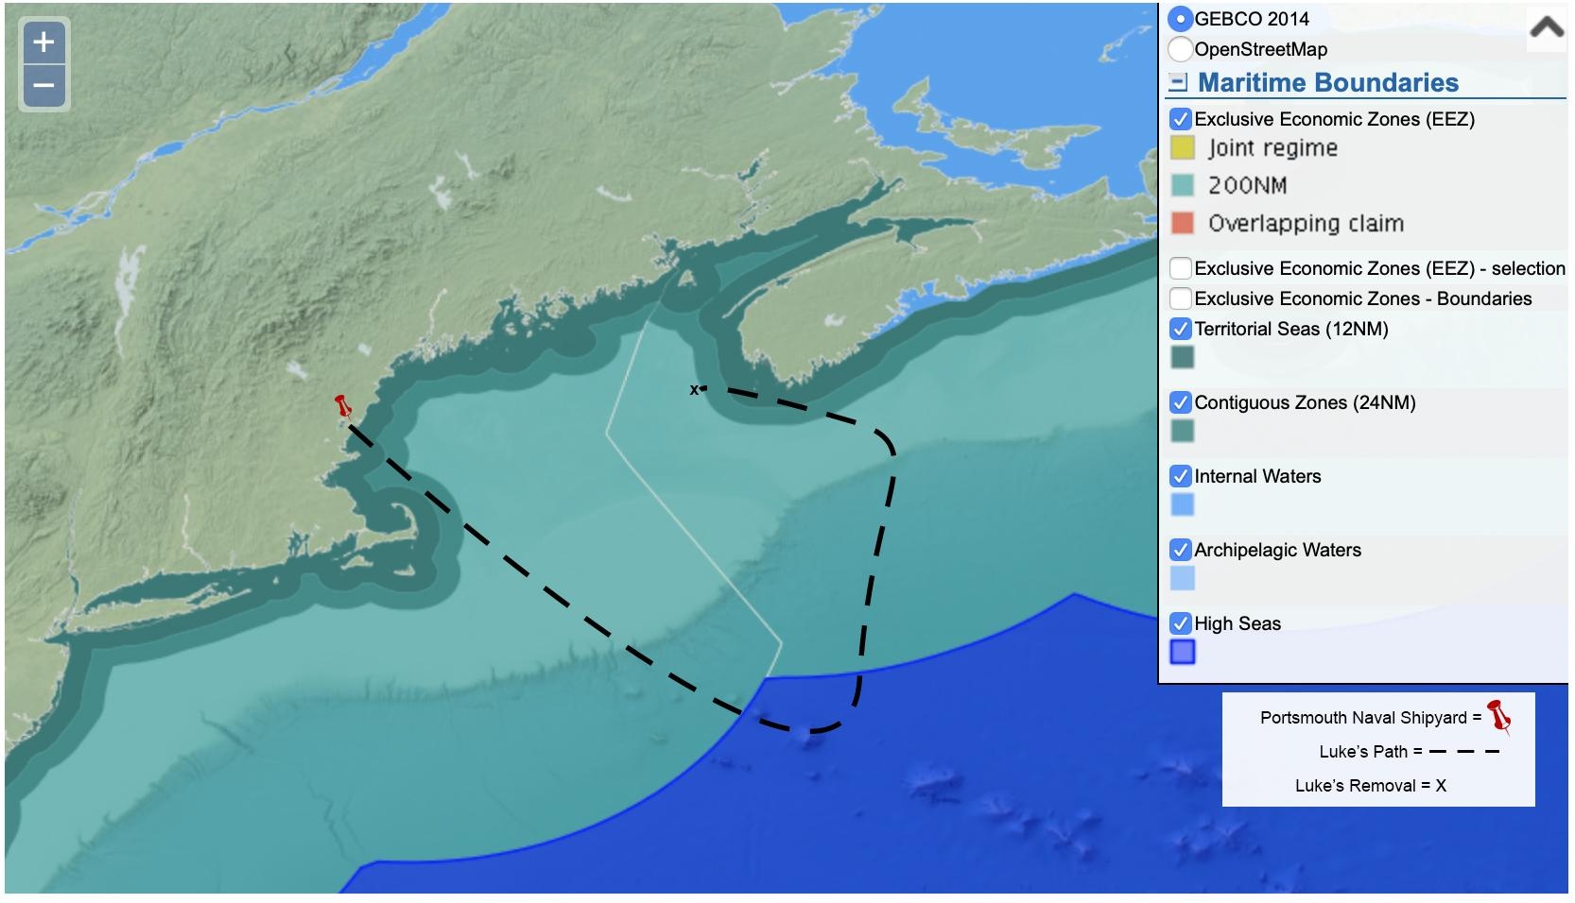
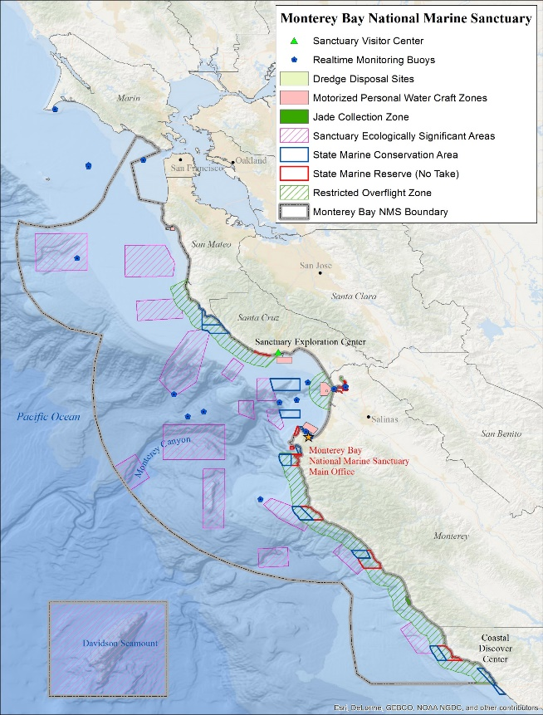
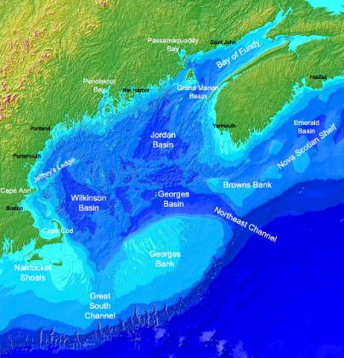
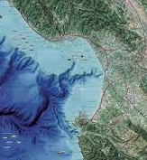
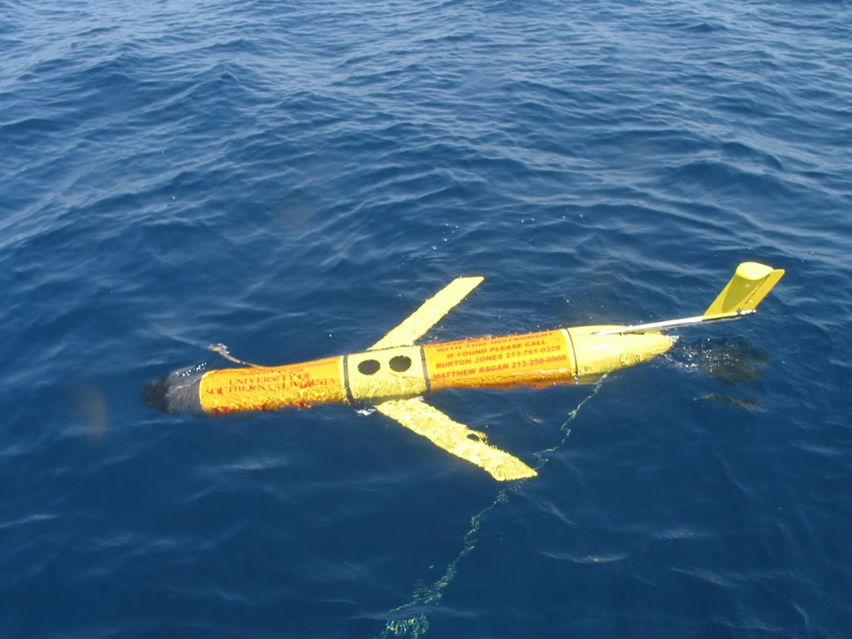
Kristen Fletcher
Legal and Ethical Policies
PROJECTS
SCENARIOS

Slide 32

2021:
Ethical Control of Unmanned Systems: Repeatable Mission Evaluation Through Unmanned Systems Data Strategy for UMAA/RAIL
Brutzman, Blais, Fletcher / CRUSER
Priority Legal and Policy Issues of Unmanned Systems
Fletcher, Hahn, Lesse, DeCocco / CRUSER
Formation, Implementation, and Verification of Requirements for Human-Autonomy Teaming
Van Bossuyt, Weger, Semmens, Fletcher, Mesmer, Tenhundfeld, Jones / CRUSER
TTCP AI Strategic Challenge: Law/Ethics Theme Team
Fletcher, Choinski, Palmer, international partners / OSD OUSD R-E
2022:
Advancing Clarity: Analysis of UxS Legal Questions
Fletcher, Hahn, Lesse / CRUSER
Interactive Synthetic Environment (ISE) to Evaluate Zero-Carbon UAS Launch Platforms in the Arctic
Dew, Balogh, Fitzpatrick, Fletcher, Lesse / CRUSER
TTCP AI Strategic Challenge: Law/Ethics Theme Team
Fletcher, Palmer, international partners / OSD OUSD R-E
The Projects
Notes:
Thank you, _____.
I’m Kristen Fletcher with the Energy Academic Group at NPS. I’m involved with a number of projects analyzing law and policy related to AS. Don’t worry about the details here: the real message of this slide is that the variety of projects with a law and policy component reinforces what many Navy and DOD reports are stating: The Navy needs to understand not only the physical environment in which it operates but also the legal one.
[click] You’ve just heard from my colleagues on this project.
[click] I’ll address these two projects focused on law and policy in the next few slides.

Slide 33

SCENARIOS
Luke
USNI News
WHAT ARE THE LEGAL REQUIREMENTS FOR AS/UxS TO OPERATE IN INTERNATIONAL WATERS AND EEZS?
WHAT ARE THE LEGAL CONSIDERATIONS FOR AS/UxS IN THE U.S. IN AREAS OF OVERLAPPING JURISDICTIONS?
Notes:
In order to put the legal elements in context, we used a fictional autonomous system named Luke (pictured in the center) and two scenarios where we send Luke on journeys for the Navy.
First (on the left) we wanted to lay out the legal requirements for AS in different maritime zones. We chose the Northeast US and Maritime provinces of Canada because they gave us the border proximity we needed.
Second, (on the right) we want to understand how the laws differ in complex US locations such as Monterey Bay and what happens if the system is lost or it’s a disposable system.

Slide 34
Scenario 1
Notes:
This image shows where Luke traveled in Scenario 1 – you can see he stays in US waters for some time, out into int’l waters and then into Canadian waters where he’s picked up by a Chinese warship so we examine the legality in each of these zones and in the hypothetical taking of a system like Luke.

Slide 35

Scenario 2
Protected Areas:
  National Marine Sanctuary
  State Marine Conservation Areas
  State Marine Reserves
Federal Laws
  Clean Water Act
  Laws related to:
    Discharges
    Marine Debris
    Hazardous Waste
Notes:
For our 2nd scenario, we place Luke in Monterey Bay – as NPS and other researchers do with regularity – and examine what laws apply in this area, especially given the different protected areas there and overlapping jurisdictions which you can see on the map on the right.
In our analysis, we’ll also include:
the loss of a system like Luke – which does happen in Monterey Bay
And, what changes legally if Luke is a disposable system, the use of which is on the rise.

Slide 36

Rapidly-evolving technology challenges the law: law and policy will often lag behind.
Applicable laws may differ depending on the operating environment and level of autonomy.
Key Findings
The need to understand the environmental and climate considerations for these systems is increasing. (CRUSER Advancing Legal Clarity Project)
Kristen Fletcher, Energy Academic Group: kristen.fletcher@nps.edu
Notes:
We are finalizing our report this month. The key findings from our legal work include these.
Rapidly-evolving technology challenges law as it lags behind; having lawyers, policy makers and ethicists involved in the design & operation stages can help fill these gaps.
Laws differ depending on the environment in which the system is operating and the level of autonomy present.
The need to understand environmental and climate considerations is increasing; we’ll include that in our 2022 legal project. We are slated to present at a spring CRUSER meeting on initial findings.
My email is noted below in case you’d like to talk more.
I’ll hand the floor back over to Don.

Slide 37
(added) Observations: Ethics, Law and Data
Conceptual Interoperability is straightforward for humans to measure: “does it make sense?”
We are not asking robots to make ethical decisions – illegal, not possible. We are enabling systems support for ethical human decision making.
“Answer to question” = “response to query” means we all have to get beyond curious syntax to shared terminology and understanding of results, otherwise (like it or not) your overall system design must be insufficient.
Rules followed by warfighters, peace officer, responsible individuals are all based on The Law. Thus we can now strive for consistency with LOAC, etc.
TRUST is the top of the semantic chain… bridging to next section:
In God We Trust. All Others Bring Data! W. Edwards Deming
Notes:
Laws of Armed Conflict (LOAC) = International Humanitarian Law (IHL) https://en.wikipedia.org/wiki/International_humanitarian_law

Slide 38
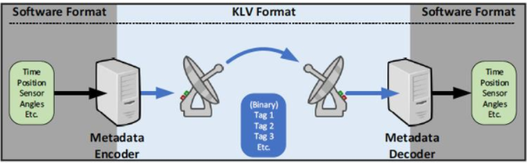
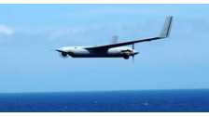

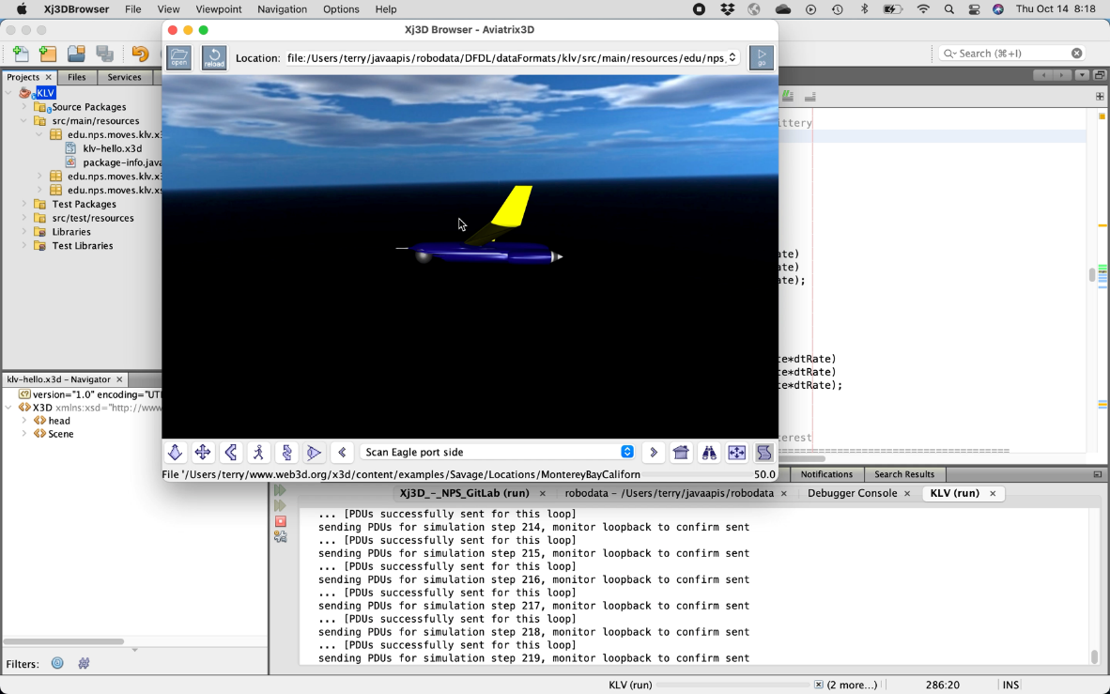
Terry Norbraten
Software Design, Development, and Testing
Onboard Robot
Ground Station
Network
Real-World
Mission
Execution
Virtual-World
Mission
Playback

Slide 39
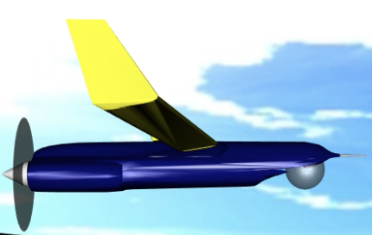
KLV 2 3D
The process of capturing wirelessly networked KLV Local Set data transmitted from an unmanned aerial system (UAS) to visualizing that data in 3D using Open Source, Open Standards technology.

Slide 40


Onboard Robot
Network
Ground Station
PCAPNG File
Filter for udp.port==4040
Marked up filtered PCAPNG (Hex Text)
(Parse)
file
Extract KLV (UDP payload)
(Hex Text)
file
Parse, visualize
KLV (Hex Text) as
marked up XML
file
{Wireshark/tshark}
{Wireshark/tshark}
{pcapng.dfdl.xsd}
{ExtractPcapng
DataValues.xslt}
{klv.dfdl.xsd}
{DFDL extract KLV Hex}
Java parse KLV
telemetry track into DIS
In-memory DOM objects
Decode KLV
(Hex Binary)
Generate DIS PDU Tracks
Save/Replay
DIS PDU streams
Visualize 3D Scene (Playback)
LVC
{Harder KLV Java}
{OpenDIS7 Java}
{OpenDIS}
{X3D, Spiders3D}
{Plan, Analyze, Train, Archive}
Decode KLV
(Decimal)
The Blais approach would be KLV XML -> XSLT -> RST XML
The top right + lower left blocks might be replaced by DIS Schema with
DFDL for KLV, as a general pattern for DIS DFDL parsing of any telemetry track values, leapfrog for future telemetry patterns. End result remains DIS XML in either case.
{West Ridge Systems jMisb}

Slide 41
Onboard Robot
Network
Ground Station
PCAPNG File
Filter for udp.port==4040
Marked up filtered PCAPNG (Hex Text)
(Parse)
file
Extract KLV (UDP payload)
(Hex Text)
file
Parse, visualize
KLV (Hex Text) as
marked up XML
file
{Wireshark/tshark}
{Wireshark/tshark}
{pcapng.dfdl.xsd}
{ExtractPcapng
DataValues.xslt}
{klv.dfdl.xsd}
{DFDL extract KLV Hex}
Java parse KLV
telemetry track into DIS
In-memory DOM objects
Decode KLV
(Hex Binary)
Generate DIS PDU Tracks
Save/Replay
DIS PDU streams
Visualize 3D Scene (Playback)
LVC
{Harder KLV Java}
{OpenDIS7 Java}
{OpenDIS}
{X3D, Spiders3D}
{Plan, Analyze, Train, Archive}
Decode KLV
(Decimal)
The Blais approach would be KLV XML -> XSLT -> RST XML
The top right + lower left blocks might be replaced by DIS Schema with
DFDL for KLV, as a general pattern for DIS DFDL parsing of any telemetry track values, leapfrog for future telemetry patterns. End result remains DIS XML in either case.
{West Ridge Systems jMisb}

Slide 42
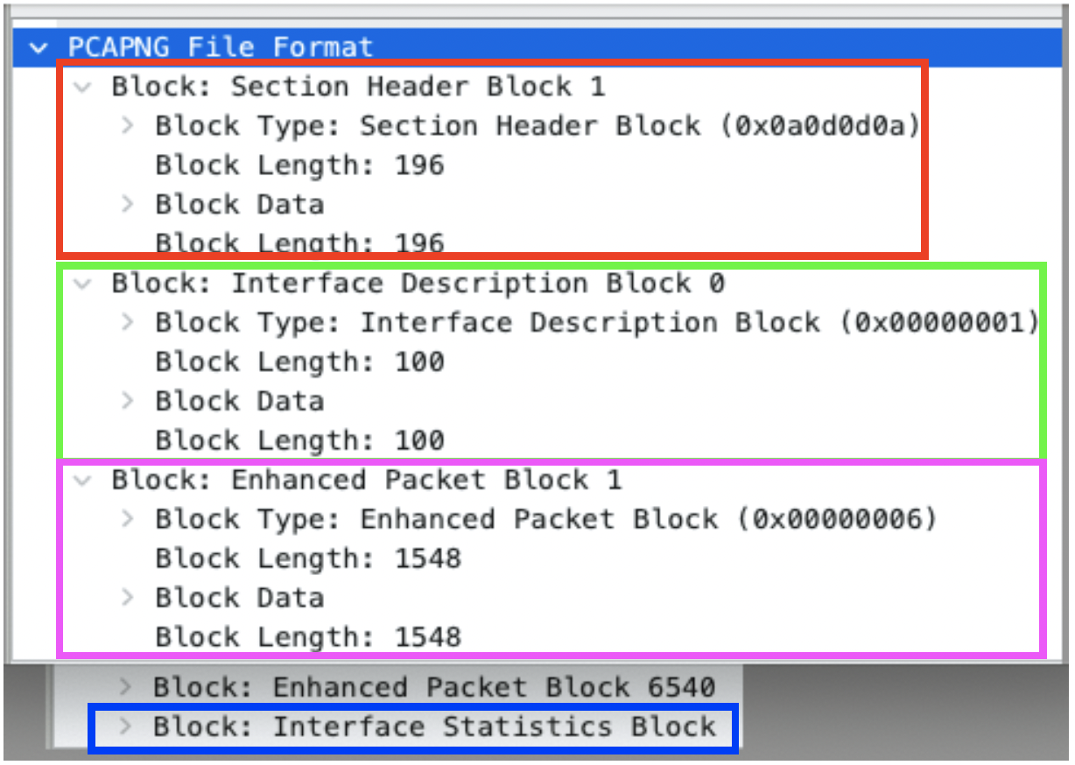
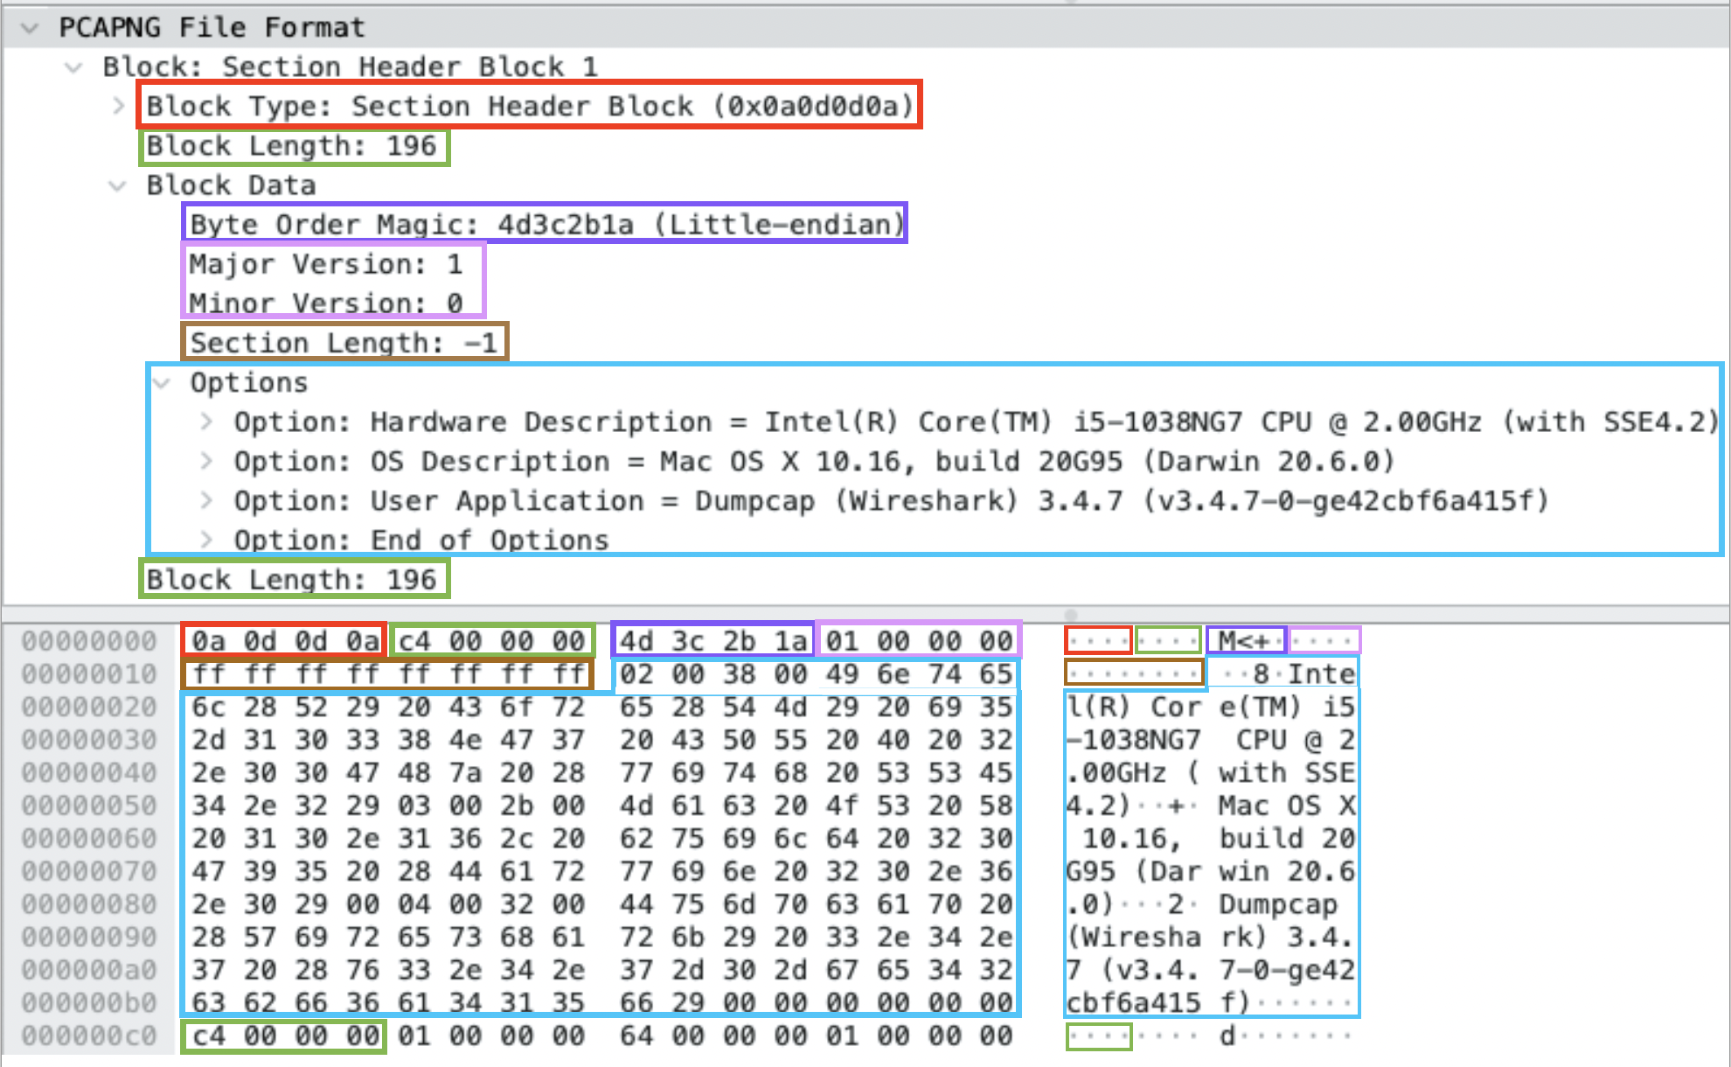

Slide 43
Onboard Robot
Network
Ground Station
PCAPNG File
Filter for udp.port==4040
Marked up filtered PCAPNG (Hex Text)
(Parse)
file
Extract KLV (UDP payload)
(Hex Text)
file
Parse, visualize
KLV (Hex Text) as
marked up XML
file
{Wireshark/tshark}
{Wireshark/tshark}
{pcapng.dfdl.xsd}
{ExtractPcapng
DataValues.xslt}
{klv.dfdl.xsd}
{DFDL extract KLV Hex}
Java parse KLV
telemetry track into DIS
In-memory DOM objects
Decode KLV
(Hex Binary)
Generate DIS PDU Tracks
Save/Replay
DIS PDU streams
Visualize 3D Scene (Playback)
LVC
{Harder KLV Java}
{OpenDIS7 Java}
{OpenDIS}
{X3D, Spiders3D}
{Plan, Analyze, Train, Archive}
Decode KLV
(Decimal)
The Blais approach would be KLV XML -> XSLT -> RST XML
The top right + lower left blocks might be replaced by DIS Schema with
DFDL for KLV, as a general pattern for DIS DFDL parsing of any telemetry track values, leapfrog for future telemetry patterns. End result remains DIS XML in either case.
{West Ridge Systems jMisb}

Slide 44
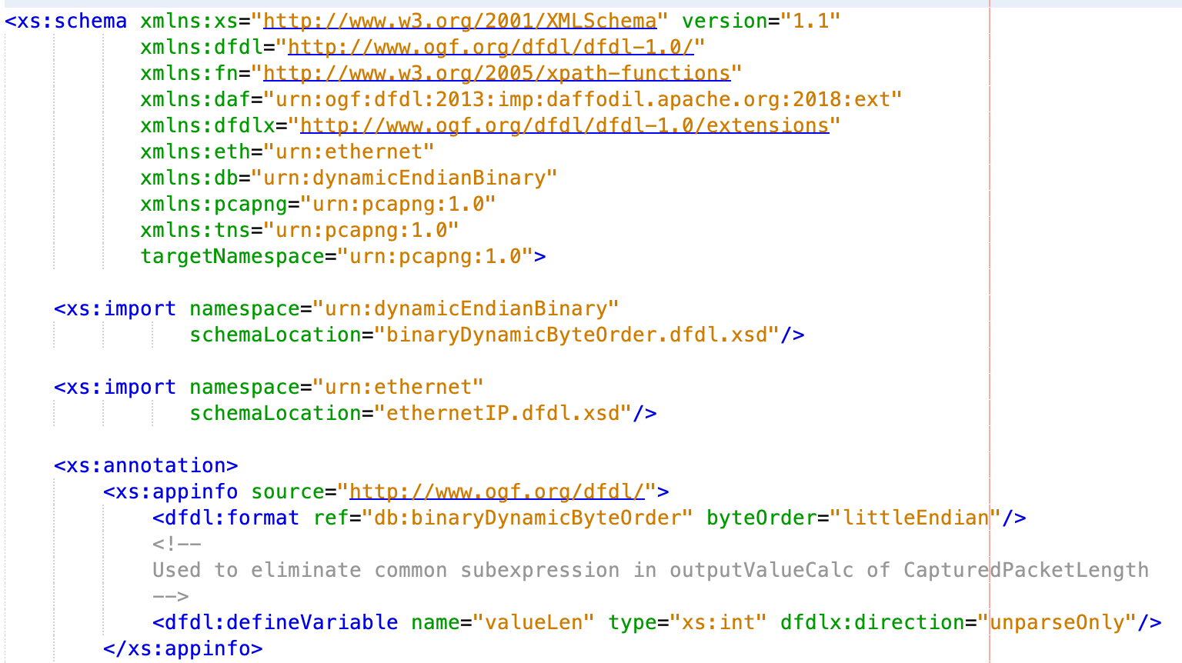
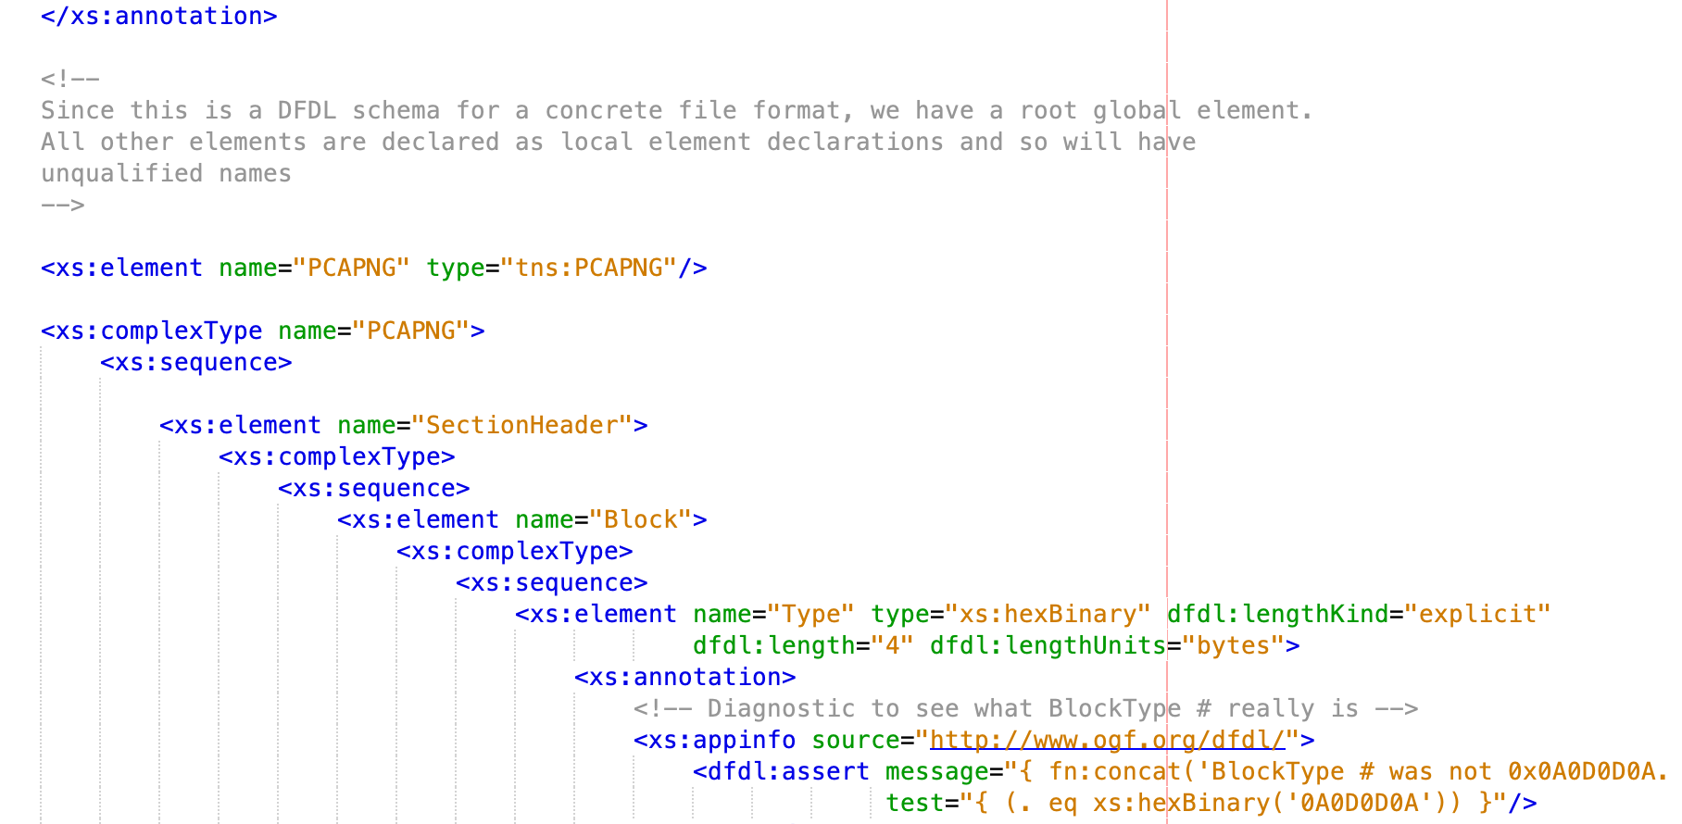
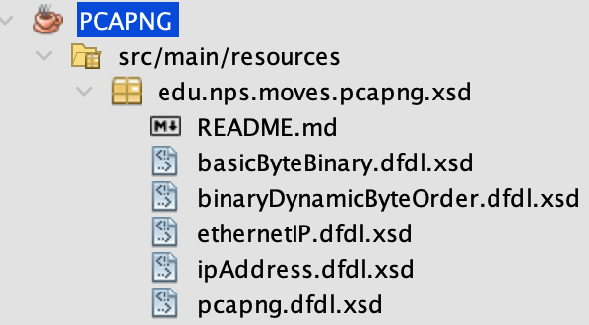
DFDL decorated
XML Schema
for PCAPNG

Slide 45
Onboard Robot
Network
Ground Station
PCAPNG File
Filter for udp.port==4040
Marked up filtered PCAPNG (Hex Text)
(Parse)
file
Extract KLV (UDP payload)
(Hex Text)
file
Parse, visualize
KLV (Hex Text) as
marked up XML
file
{Wireshark/tshark}
{Wireshark/tshark}
{pcapng.dfdl.xsd}
{ExtractPcapng
DataValues.xslt}
{klv.dfdl.xsd}
{DFDL extract KLV Hex}
Java parse KLV
telemetry track into DIS
In-memory DOM objects
Decode KLV
(Hex Binary)
Generate DIS PDU Tracks
Save/Replay
DIS PDU streams
Visualize 3D Scene (Playback)
LVC
{Harder KLV Java}
{OpenDIS7 Java}
{OpenDIS}
{X3D, Spiders3D}
{Plan, Analyze, Train, Archive}
Decode KLV
(Decimal)
The Blais approach would be KLV XML -> XSLT -> RST XML
The top right + lower left blocks might be replaced by DIS Schema with
DFDL for KLV, as a general pattern for DIS DFDL parsing of any telemetry track values, leapfrog for future telemetry patterns. End result remains DIS XML in either case.
{West Ridge Systems jMisb}

Slide 46
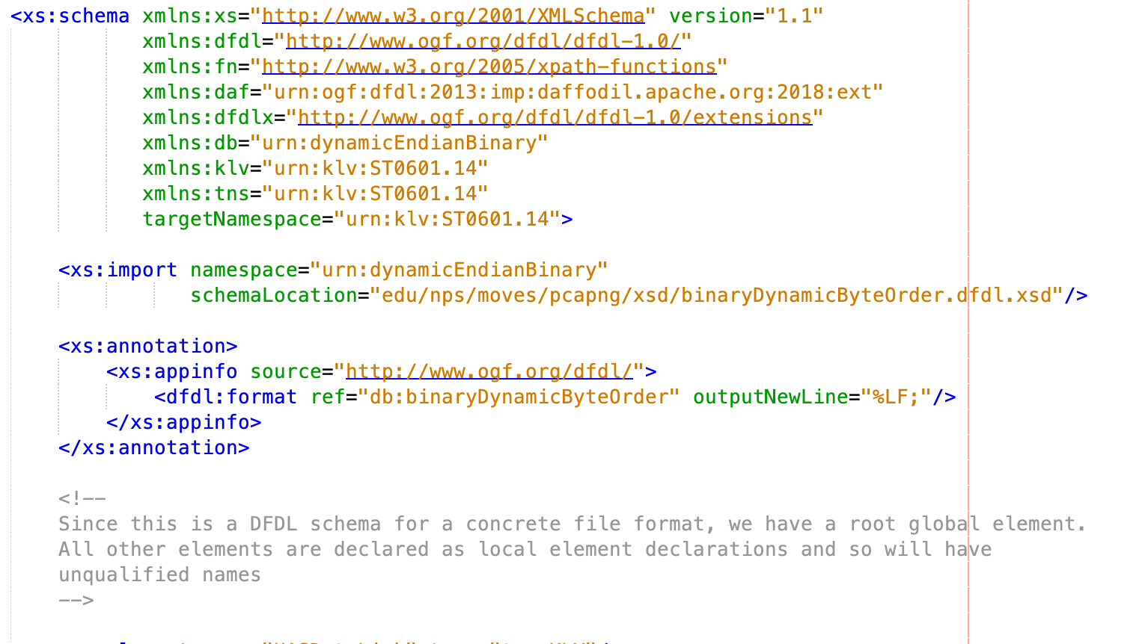
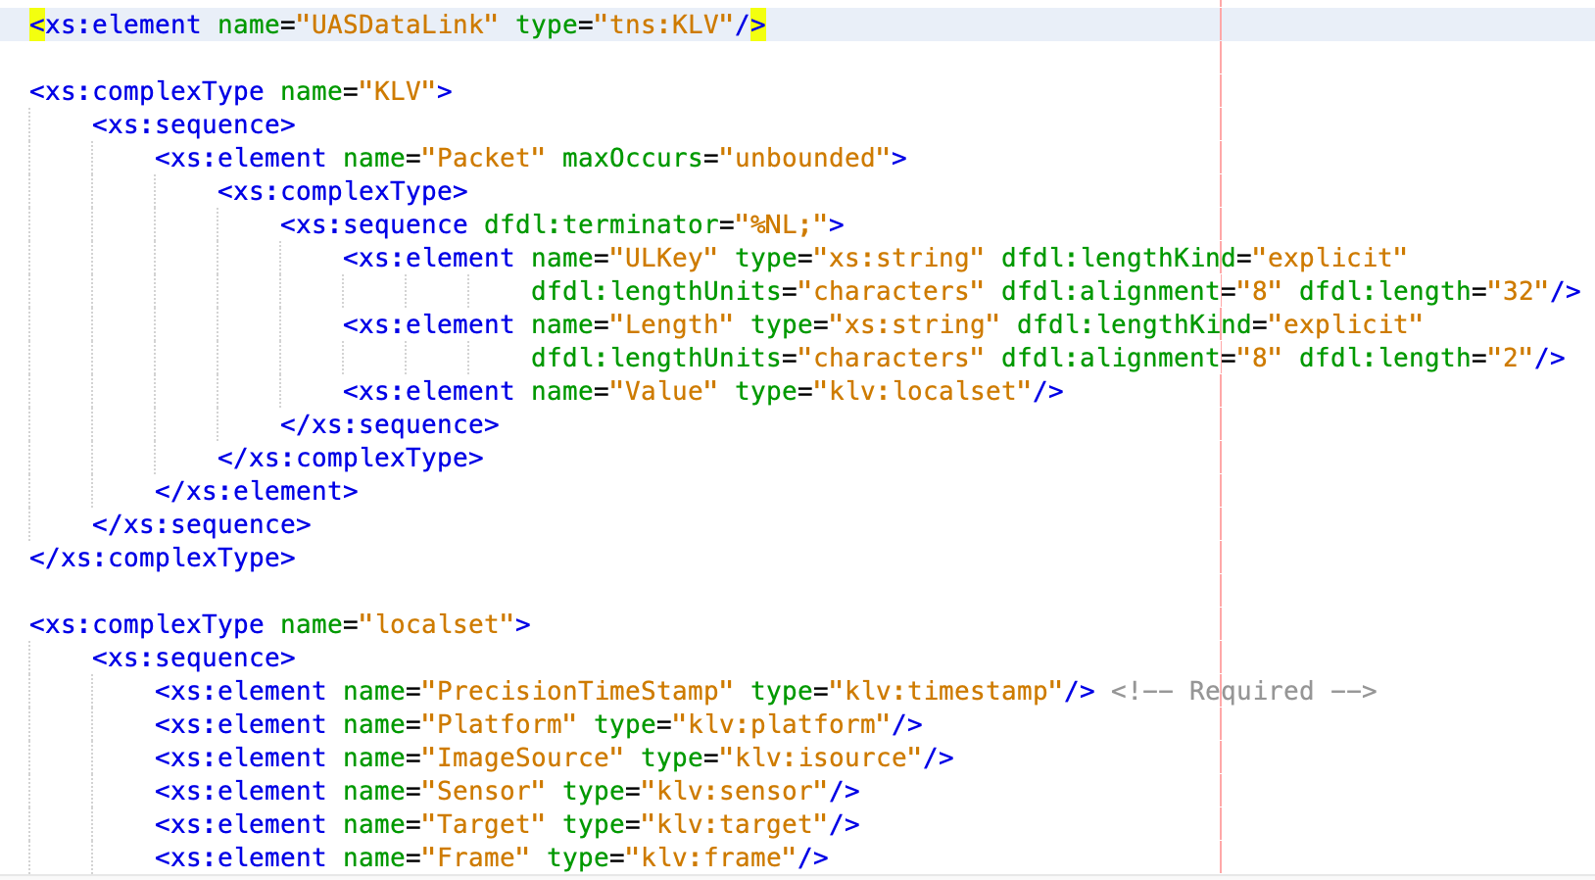
DFDL Decorated
XML Schema
for KLV

Slide 47
Onboard Robot
Network
Ground Station
PCAPNG File
Filter for udp.port==4040
Marked up filtered PCAPNG (Hex Text)
(Parse)
file
Extract KLV (UDP payload)
(Hex Text)
file
Parse, visualize
KLV (Hex Text) as
marked up XML
file
{Wireshark/tshark}
{Wireshark/tshark}
{pcapng.dfdl.xsd}
{ExtractPcapng
DataValues.xslt}
{klv.dfdl.xsd}
In-memory DOM objects
{DFDL extract KLV Hex}
Java parse KLV
telemetry track into DIS
Decode KLV
(Hex Binary)
Generate DIS PDU Tracks
Save/Replay
DIS PDU streams
Visualize 3D Scene (Playback)
LVC
{Harder KLV Java}
{OpenDIS7 Java}
{OpenDIS}
{X3D, Spiders3D}
{Plan, Analyze, Train, Archive}
Decode KLV
(Decimal)
The Blais approach would be KLV XML -> XSLT -> RST XML
The top right + lower left blocks might be replaced by DIS Schema with
DFDL for KLV, as a general pattern for DIS DFDL parsing of any telemetry track values, leapfrog for future telemetry patterns. End result remains DIS XML in either case.
{West Ridge Systems jMisb}

Slide 48
Onboard Robot
Network
Ground Station
PCAPNG File
Filter for udp.port==4040
Marked up filtered PCAPNG (Hex Text)
(Parse)
file
Extract KLV (UDP payload)
(Hex Text)
file
Parse, visualize
KLV (Hex Text) as
marked up XML
file
{Wireshark/tshark}
{Wireshark/tshark}
{pcapng.dfdl.xsd}
{ExtractPcapng
DataValues.xslt}
{klv.dfdl.xsd}
{DFDL extract KLV Hex}
Java parse KLV
telemetry track into DIS
In-memory DOM objects
Decode KLV
(Hex Binary)
Generate DIS PDU Tracks
Save/Replay
DIS PDU streams
Visualize 3D Scene (Playback)
LVC
{Harder KLV Java}
{OpenDIS7 Java}
{OpenDIS}
{X3D, Spiders3D}
{Plan, Analyze, Train, Archive}
Decode KLV
(Decimal)
The Blais approach would be KLV XML -> XSLT -> RST XML
The top right + lower left blocks might be replaced by DIS Schema with
DFDL for KLV, as a general pattern for DIS DFDL parsing of any telemetry track values, leapfrog for future telemetry patterns. End result remains DIS XML in either case.
{West Ridge Systems jMisb}

Slide 49
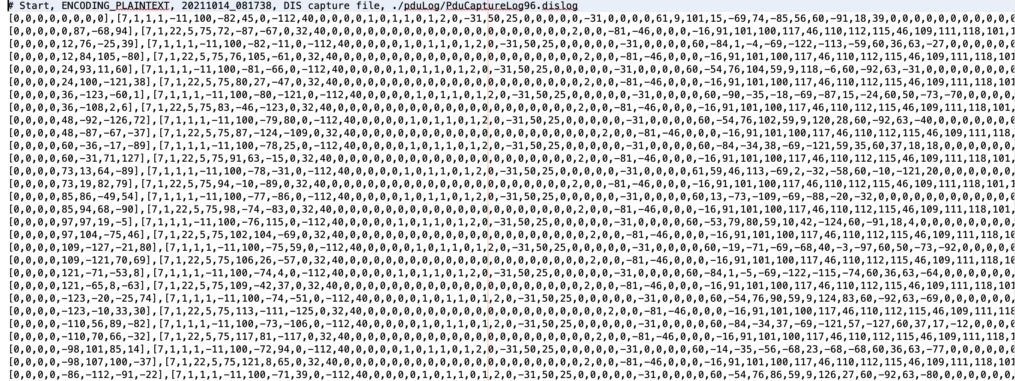
Saved DIS PDU Capture

Slide 50
Onboard Robot
Network
Ground Station
PCAPNG File
Filter for udp.port==4040
Marked up filtered PCAPNG (Hex Text)
(Parse)
file
Extract KLV (UDP payload)
(Hex Text)
file
Parse, visualize
KLV (Hex Text) as
marked up XML
file
{Wireshark/tshark}
{Wireshark/tshark}
{pcapng.dfdl.xsd}
{ExtractPcapng
DataValues.xslt}
{klv.dfdl.xsd}
{DFDL extract KLV Hex}
Java parse KLV
telemetry track into DIS
In-memory DOM objects
Decode KLV
(Hex Binary)
Generate DIS PDU Tracks
Save/Replay
DIS PDU streams
Visualize 3D Scene (Playback)
LVC
{Harder KLV Java}
{OpenDIS7 Java}
{OpenDIS}
{X3D, Spiders3D}
{Plan, Analyze, Train, Archive}
Decode KLV
(Decimal)
The Blais approach would be KLV XML -> XSLT -> RST XML
The top right + lower left blocks might be replaced by DIS Schema with
DFDL for KLV, as a general pattern for DIS DFDL parsing of any telemetry track values, leapfrog for future telemetry patterns. End result remains DIS XML in either case.
{West Ridge Systems jMisb}

Slide 51
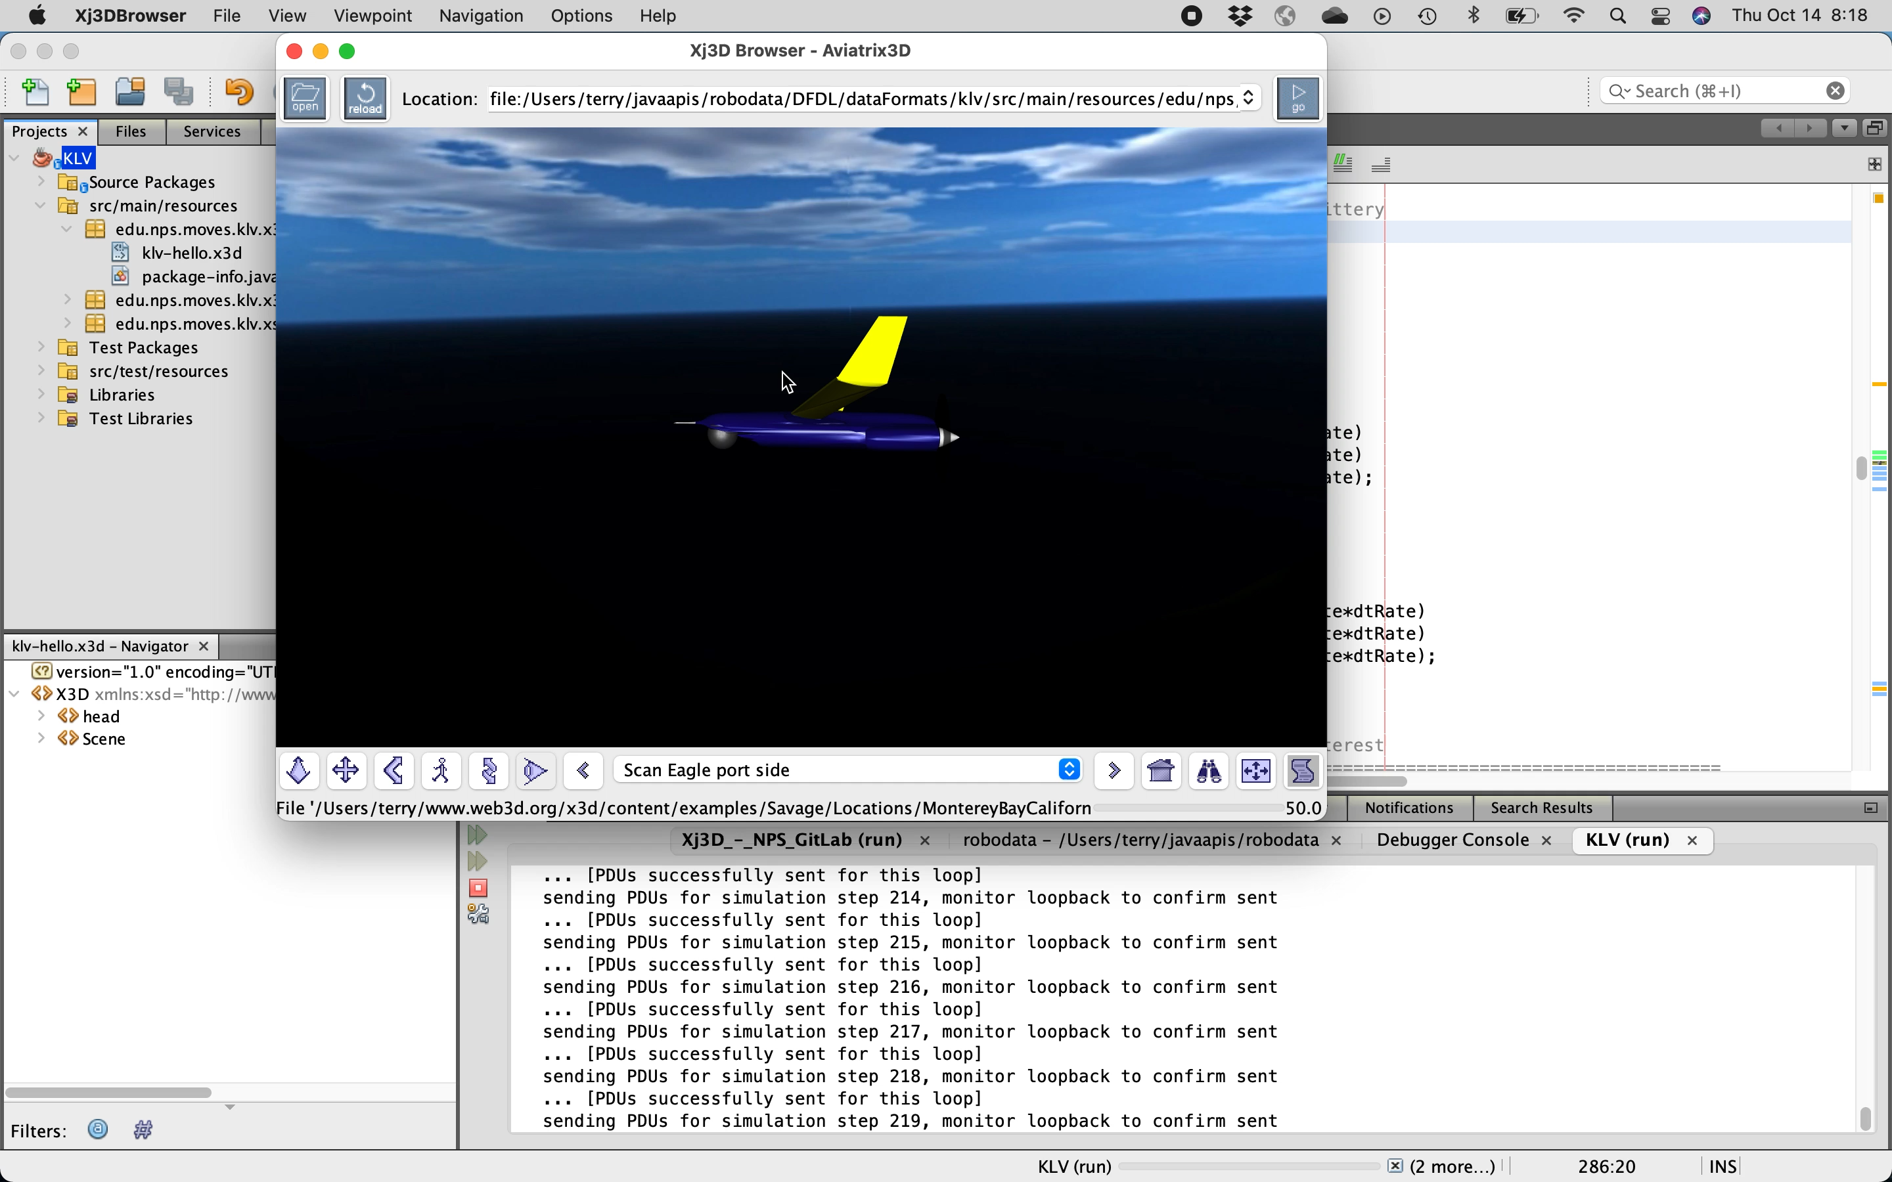
I
t
wo
r
k
s
☺
online

Slide 52
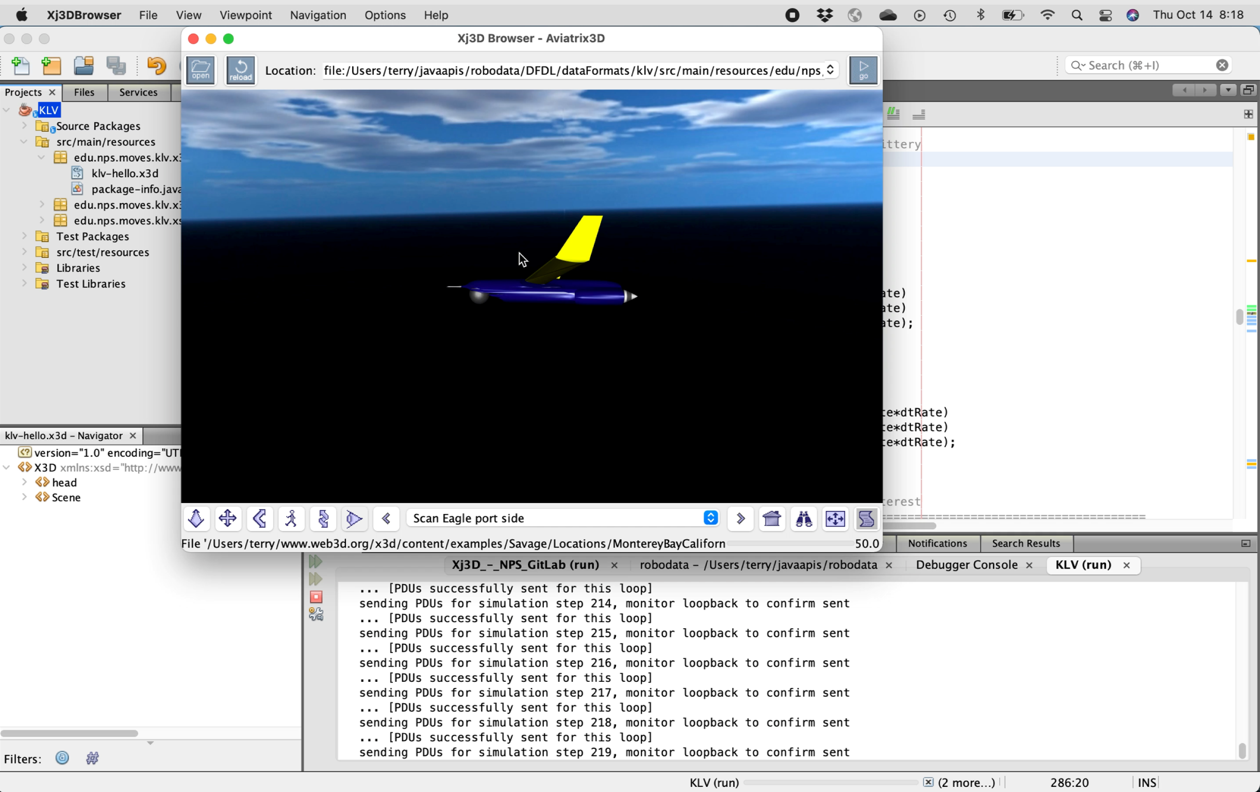
I
t
wo
r
k
s
☺
online
Notes:
Image-based version of slide for PDF export

Slide 53
Open-Source, Open-Standards
Technology Used
Wireshark
PCAPNG
ST 0601.17
SMPTE ST 336
Apache Daffodil
OpenDIS7 Java
Harder KLV
West Ridge Systems jMisb
X3D Graphics
Xj3D
XML (Schema, XSLT)
OpenJDK
Apache NetBeans IDE

Slide 54
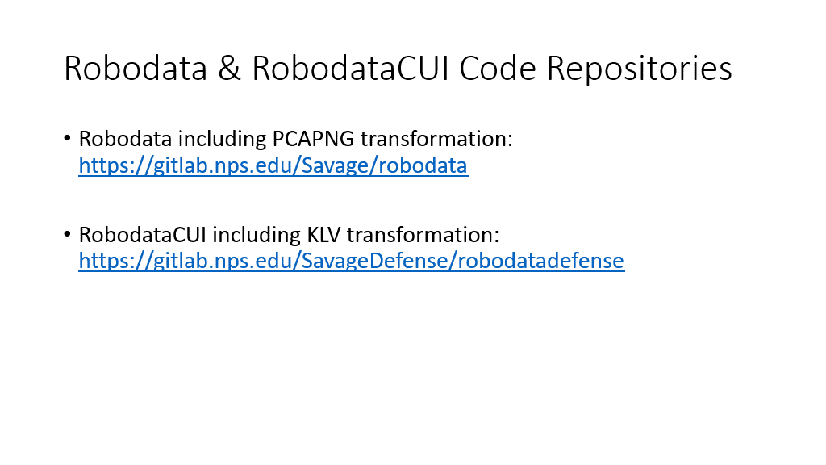

Slide 55
(added) Check Questions
No prior knowledge of this robot? Standards, bits, go? YES
Peeling computer-science onion: unlike other flow diagrams, your boxes aren’t programs but rather refined data? YES
You modified community’s pcap Packet Capture mappings written for Data Format Description Language (DFDL), added next-generation PCAPng support and posted back? YES
If you can handle this robot, are we ready for any other? YES
The Purpose of Computing is Insight, Not Numbers
Richard W. Hamming
Notes:
Hamming Resources at NPS: https://www.nps.edu/hamming

Slide 56
Don Brutzman
Synopsis: Ethical Control of Unmanned Systems
Project Motivation: ethically constrained control of unmanned systems and robot missions by human supervisors and warfighters.
Precept: well-structured mission orders can be syntactically and semantically validated to give human commanders confidence that offboard systems
  will do what they are told to do, and further
  will not do what they are forbidden to do.
Project Goal: apply Semantic Web ontology to scenario goals and constraints for logical validation that human-approved mission orders for robots are semantically coherent, precise, unambiguous, and without internal contradictions.
Long-term Objective: demonstrate that no technological limitations exist that prevent applying the same kind of ethical constraints on robots and unmanned vehicles that already apply to human beings.
Paraphrase: can qualified robots correctly follow human orders?

Slide 57
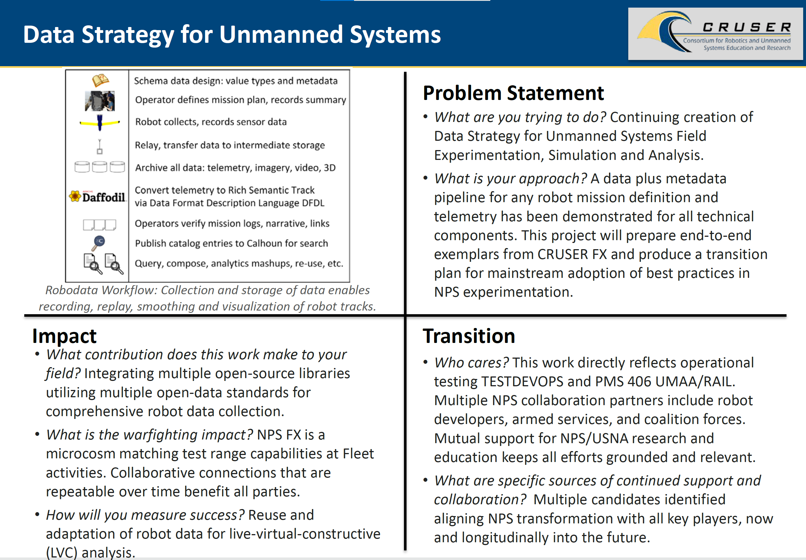
Exemplars Implemented and Ready
to Scale Up

Slide 58
We Want All Your Data!
Huge amounts of data gets collected by CRUSER experimenters
Huge amounts of data gets saved and ignored, remaining unused
This is not uncommon
What if everything was saved, structured, annotated with metadata?
What if analysis, replay, re-use, Live Virtual Constructive (LVC) were easy?
What if all student/faculty/partner products were archivable?
What if best practices influenced DoD and DTIC, all for the better?

Slide 59
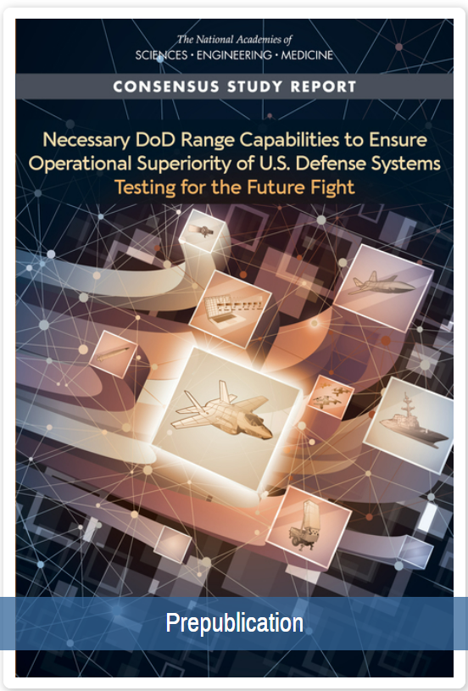
NPS Field Experimentation (FX) as DoD Test Range
JIFX at Camp Roberts quarterly
New Sea Land Air Military Robotics (SLAMR) by NPS is possible even more frequently
Connect via TENA infrastructure for Distributed Interactive Simulation (DIS) and NATO C2/SIM repeatability and mashups
Open or CUI access
Outcome: NPS “looks like” a DoD Test Range with best practices for TestDevOps
Consider annual focus on Test + Evaluation with COTF and other testing commands
National Academies' report, November 2021
Necessary DoD Range Capabilities to Ensure Operational Superiority of U.S. Defense Systems: Testing for the Future Fight.
https://www.nap.edu/catalog/26181/necessary-dod-range-capabilities-to-ensure-operational-superiority-of-us-defense-systems

Slide 60
Where must we all go next
Massive testing of unmanned hardware + software ability to follow both orders and constraints in physically realistic virtual environments: TestDevOps for learning-improvement cycles.
Influence and impact operations: certify real-world capabilities via field experimentation (FX), confirmed by Big Data analysis, defense test range exercises, wargames and theses.
Human warfighters and mission commanders (not just engineers) review and approve unmanned systems as… qualified.
New normal will be human + machine teaming together; future must mainstream all capabilities in acquisition and deployment.
Welcome to the future – the horizon is here!

Slide 61
Acknowledgements
This work builds upon 3 decades of essential inquiry by NPS faculty, staff and graduate/doctoral students serving on active duty. We thank them all.
Co-investigators Dr. Curtis Blais and Dr. Robert B. McGhee. CRADA leads RADM Jerry Ellis USN (Ret.) and Julie Leeman, Raytheon Technologies.
Research support by Raytheon Missile Systems (RMS) and Raytheon BBN Technologies (Tucson Arizona and Arlington Virginia) has been instrumental in recent progress during 2019-2020.
Significant contributions by Hsin-Fu “Sinker” Wu, Richard Markeloff and others at Raytheon, supporting current work under CRADA with NPS.
Work with Dr. Jakub Flotyński on X3D Ontology for Semantic Web was an essential prerequisite to the capabilities demonstrated here.
Collaborative design efforts with numerous skilled engineers and scientists is gratefully acknowledged. Further activity is welcome.

Slide 62
Contact
Curt Blais
clblais@nps.edu
https://nps.edu/faculty-profiles/-/cv/clblais
Code MV/Bl, Naval Postgraduate School
Monterey California 93943-5000 USA
1.831.656.3215 work
Notes:
Questions and feedback are always welcome. Thanks for considering the possibilities.

Slide 63
Contact
Kristin Fletcher
kristen.fletcher@nps.edu
https://nps.edu/faculty-profiles/-/cv/kristen.fletcher
Energy Academic Group
Naval Postgraduate School
Monterey California 93943-5000 USA
Notes:
Questions and feedback are always welcome. Thanks for considering the possibilities.

Slide 64
Contact
Don Brutzman
brutzman@nps.edu
http://faculty.nps.edu/brutzman
Code USW/Br, Naval Postgraduate School
Monterey California 93943-5000 USA
1.831.656.2149 work
1.831.402.4809 cell
Notes:
Questions and feedback are always welcome. Thanks for considering the possibilities.

