Slide 1
Visualizing X3D Radar Beam Model Dynamics
Sungmin Kwon lucidaim@gmail.com
Don Brutzman Brutzman@nps.edu
27 JUL 2018

Slide 2
Motivation and Goals
Motivation
  Explore various 3D visualization techniques for presenting dynamic radar characteristics.
  “The purpose of computing is insight, not numbers.” by Richard. W. Hamming, 3rd winner of the Turing Award.
Goal
  Improve understanding of radar through meaningful, dynamic, physics-based presentations.
  We will not find one single technique - it doesn’t exist! Visualization is exploration using multiple approaches.
Purpose of this briefing: we seek expert feedback on radar and 3D visualization to improve further.
Notes:
Audience – Radar experts and 3D visualization experts – We want a dialog.
Motivation – Explore various 3D visualization techniques for presenting dynamic radar characteristic.
Not a Goal – find one single technique – it doesn’t exist
Goal – Improve understating of radar through better presentation

Slide 3
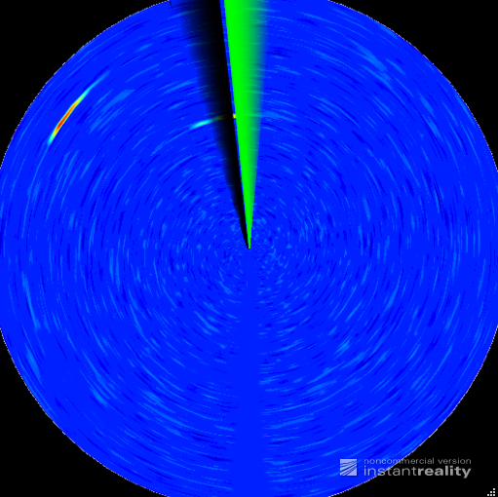
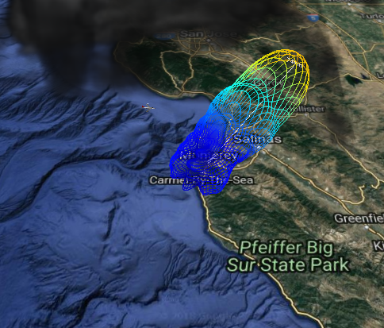
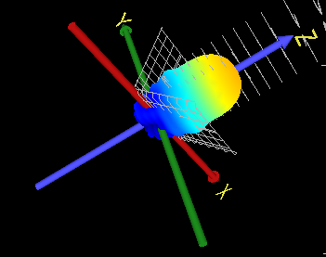
3D Visualization of Radar
Three categorized presentations
(3) Simulated Radar Screen
(2) Beam Coverage & Propagation:
Atmosphere, Ground, Sea
(1) Antenna Radiation Pattern:
Shape and Power
Notes:
3 common presentation
(2) References can be on slide comments
(3) Page
(4) Better yet : can you just use your images in this index slide?

Slide 4
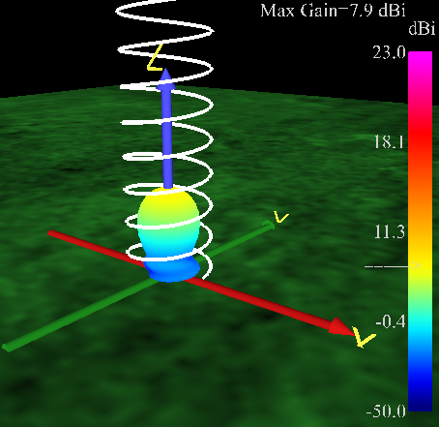
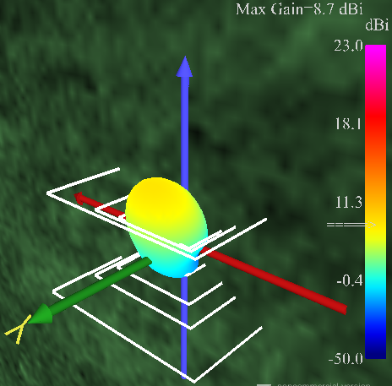
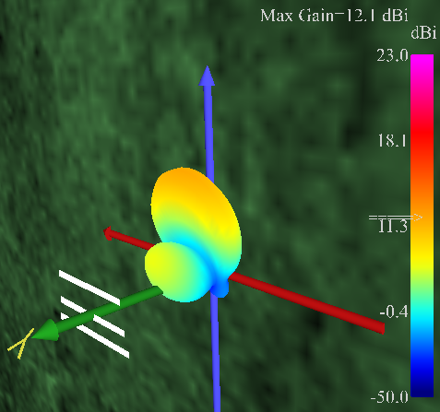
(1) Antenna Radiation Pattern
Useful techniques
  Fixed color map for surfaces: for easy comparison and beam consistency
  Explicitly presentation of max gain: for easy comparison
  Z axis beam propagation in logarithmic scales: for easy comparison
  Line properties also can be mapped to characteristics.
→ X3D visualizations using beam pattern examples from 4nec2.exe [1]
Main Lobe
Main Lobe
Main Lobe
Side Lobe
Side Lobe
<Helical Antenna>
<Spider Quad Antenna>
<3-Element Yagi Antenna>
  [1] Arie Voors, http://www.qsl.net/4nec2/
Notes:
Title + ‘Examples’
Beam Propagation + ‘power -3dB Iso-surfaces.’
for and + ‘and beam consistency’
Figure name : Helical Antenna, Spider Quad Antenna, 3-Element Yagi Antenna

Slide 5
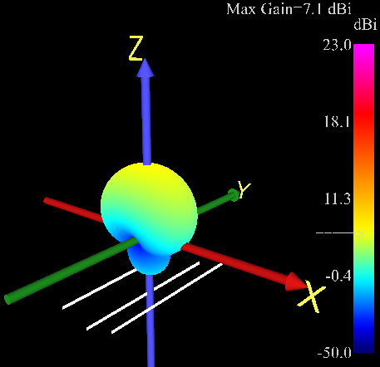
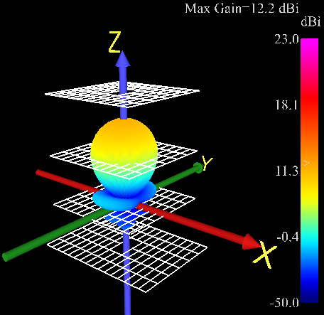
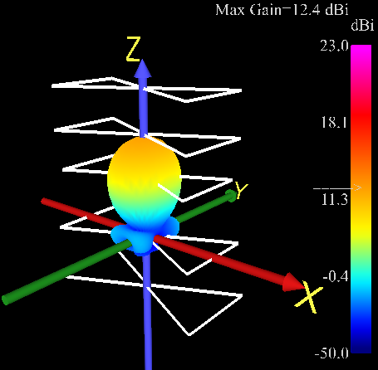
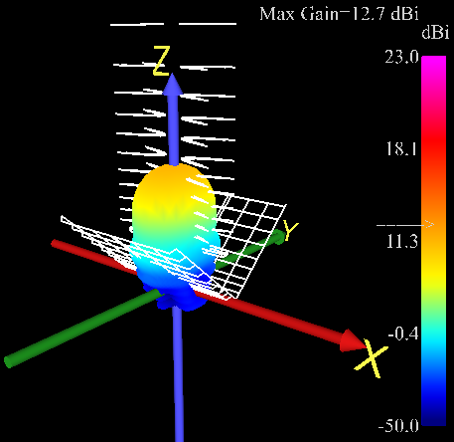
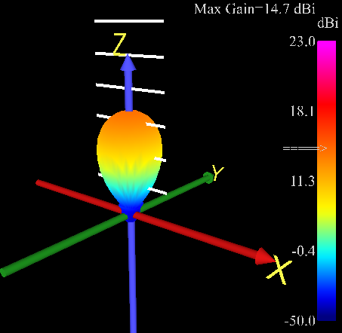
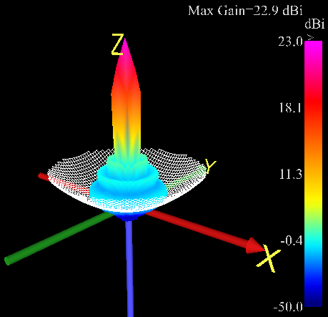
Examples continued for various antenna
<NecVerticalYagi3Element.x3d>
<NecGridYagiWireFence.x3d>
<Nec5ElementTwinDeltaLoop2m.x3d>
<NecBowtieXg91a.x3d>
<NecTvUhf.x3d>
<NecParabola50x50.x3d>
Notes:
Title : using (various antenna types and ) beam pattern ~~~
Can we make antennas more noticeable?

Slide 6
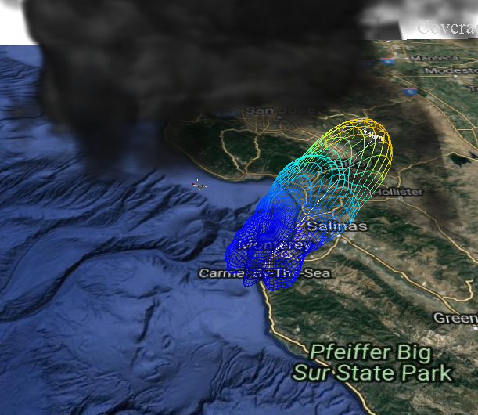
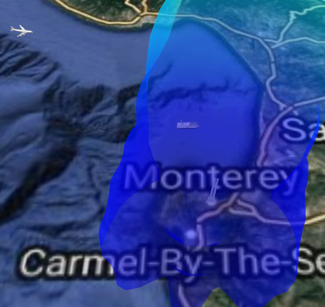
(2) Beam Coverage & Propagation
- Scenario for proposed techniques
Weather Effects
  Thick precipitation cloud [2] to the North
  Additional parameters possible
Objects and Radar Cross Section (RCS)
  Airplane (RCS : 1.6)
  Cruise ship (RCS : 2.2)
Long Range Antenna
  Spanagel Hall, NPS, Monterey
  1 revolution per 12 sec.
  1 revolution for Cruise ship
  and 1 resolution for Airplane
  [2] Yeonsoo Yang, http://examples.x3dom.org/example/RadarVolumeStyle
Notes:
Switch order of bullets to untangle arrows.
Weather -> Weather Effects
- Additional parameters possible
(3) Object -> Object, Radar Cross Section
- Align for readability

Slide 7
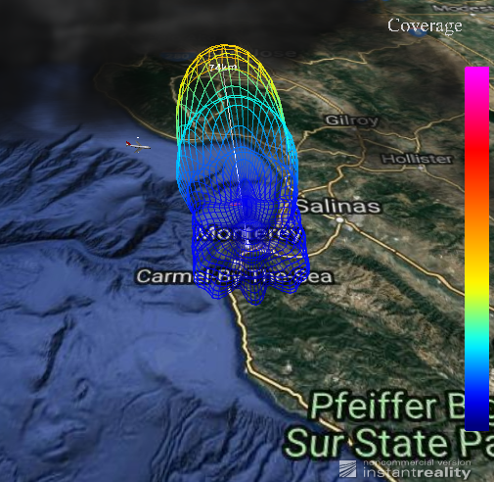
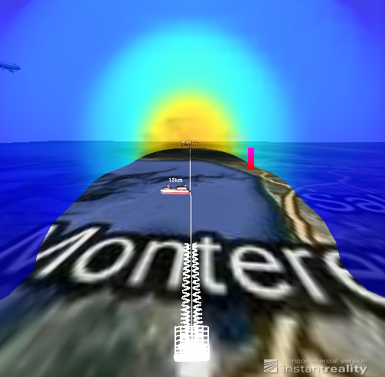
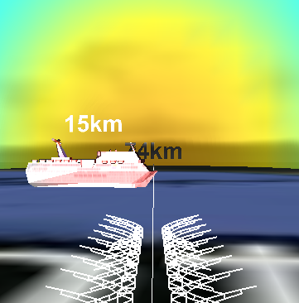
Useful techniques
3D coverage envelop over the map
  To present 3D range that radar can detect
Variant color on objects
  To present power level to be delivered
  Intuitive way to visualize power inside radar beam
Bent radar beam
  To show effects of weather condition (attenuation and refractive)
Goal : Effective Visualization to show ‘how much power is delivered to some point?’
→ Need more study to calculate accurate power
  Simple calculations are used to show visualization concept.
  Ongoing study using AREPS 3.0[3]
3D Coverage
Power
  [3] W.L.Patterson, “Advanced refractive effects prediction system (AREPS),” Conf. 2007 IEEE Radar, pp. 891–895, 2007.
Notes:
De-confliction and selection are important
Assist discussion : include slide numbers

Slide 8
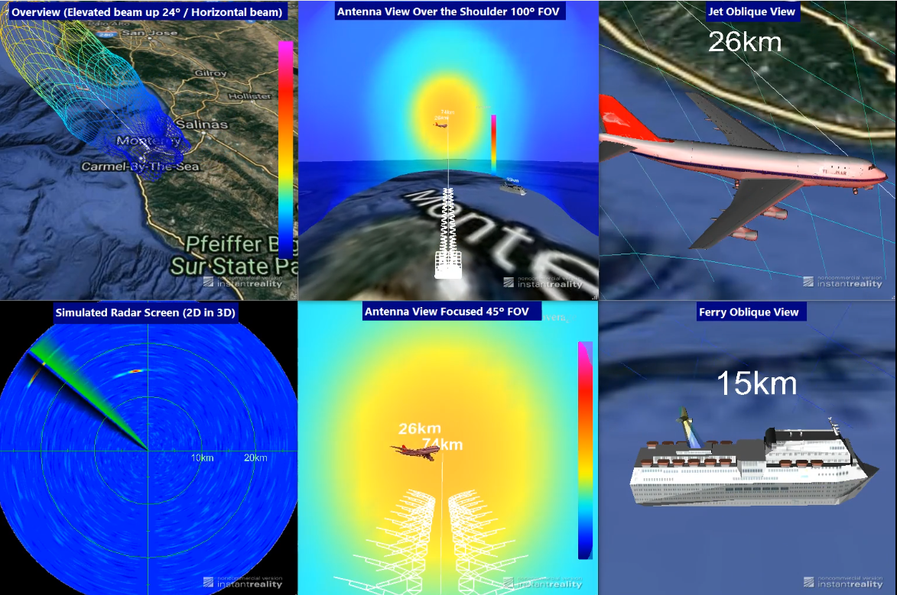
Video compares multiple presentation techniques for single real-world scenario in single X3D scene
Jet
Ferry
Antenna
Ship
Airplane
Notes:
Video comparing multiple presentation techniques for single scenario
Discuss with me
Cloud volume data
Show ship and aircraft here
3D as 2D

Slide 9
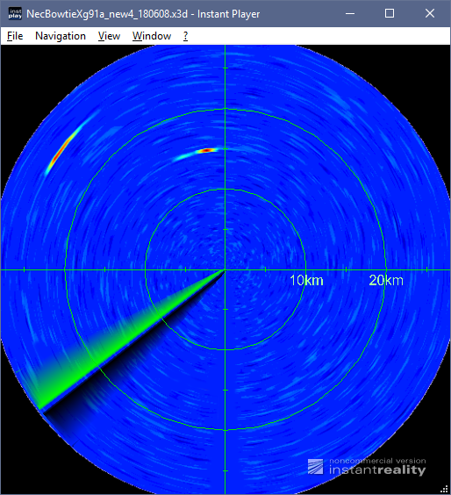
Consideration
Simulated Radar Screen
  3D as 2D presentation
  Until now calculated by Matlab example [4].
  Need digital radar data to validate
Simulated Radar Screen
[4] www.mathworks.com/help/phased/examples/scan-radar-using-a-uniform-rectangular-array.html
Notes:
(1) 3D as 2D presentation

Slide 10
Media assets availability
All research products are published as open source.
These models, imagery and video are all online at
  https://savage.nps.edu/Savage/CommunicationsAndSensors/Radar

Slide 11
Reference

Slide 12
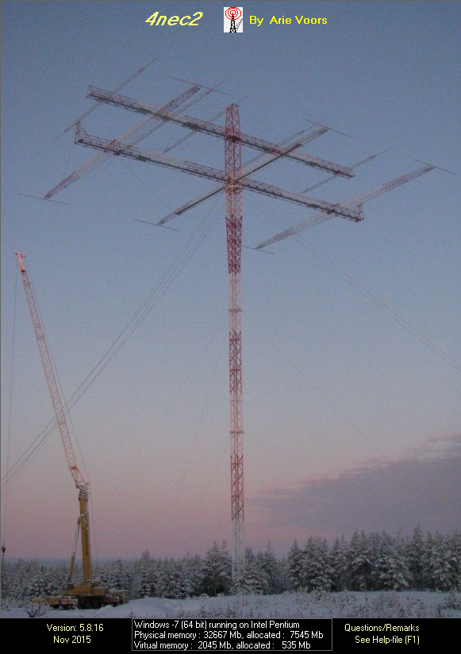
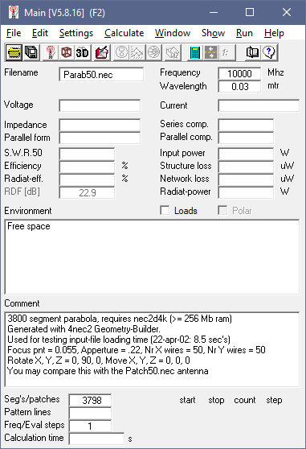
[1] 4nec2.exe Program
NEC-2 based antenna modeler and optimizer
  Arie Voors encapsulates NEC2 code with windows-based GUI and provides good environment to use NEC2 code.
  You can get this program free. (ver 5.8.16)
  http://www.qsl.net/4nec2/
NEC (Numerical Electromagnetics Code)
  Popular antenna modeling system for wire and surface antennas
  It was originally written in FORTRAN in the 1970s by Gerald Burke and Andrew Poggio of the Lawrence Livermore National Laboratory.
  By far the most common version is NEC-2, the last to be released in fully public form
  https://en.wikipedia.org/wiki/Numerical_Electromagnetics_Code

Slide 13
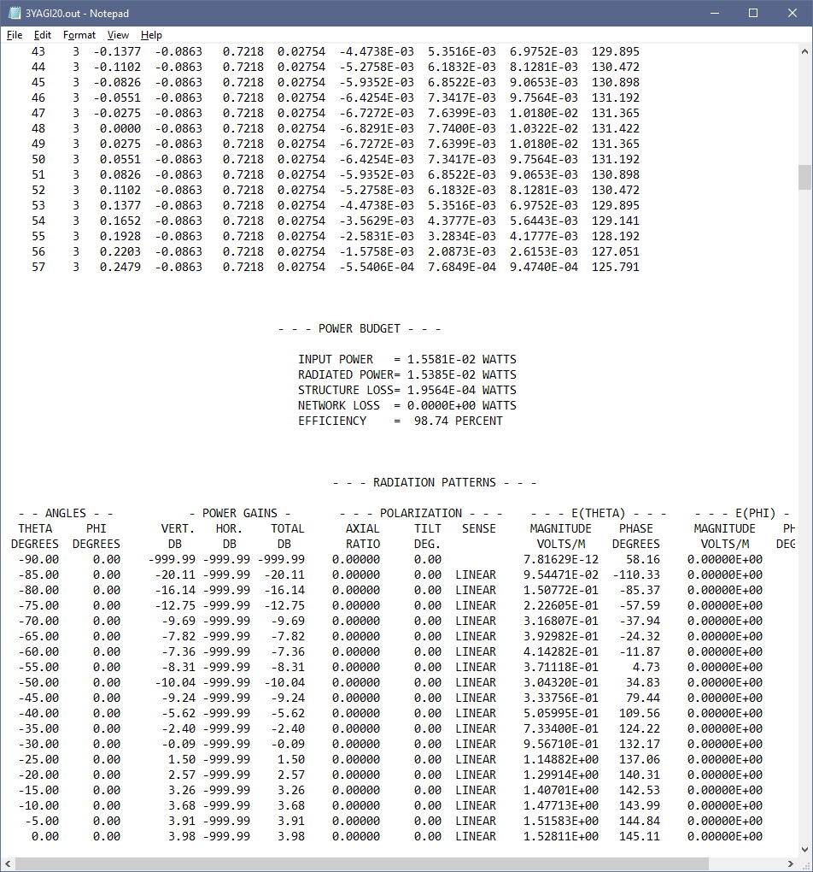
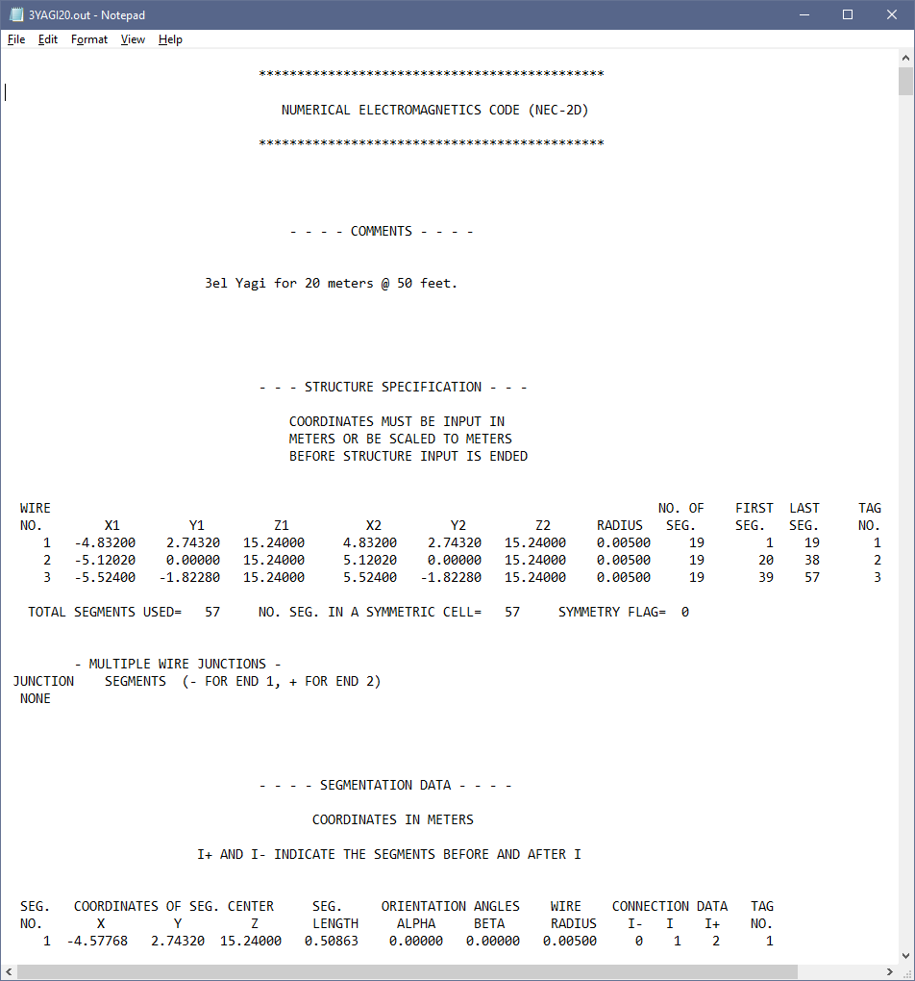
4nec2.exe Output for Antenna Examples
Input/output files are ascii text files and easy to read.
4nec2.exe is good software for a beginner of Antenna beam pattern to understand.
Notes:
Output File -> Output for Antenna Examples

Slide 14
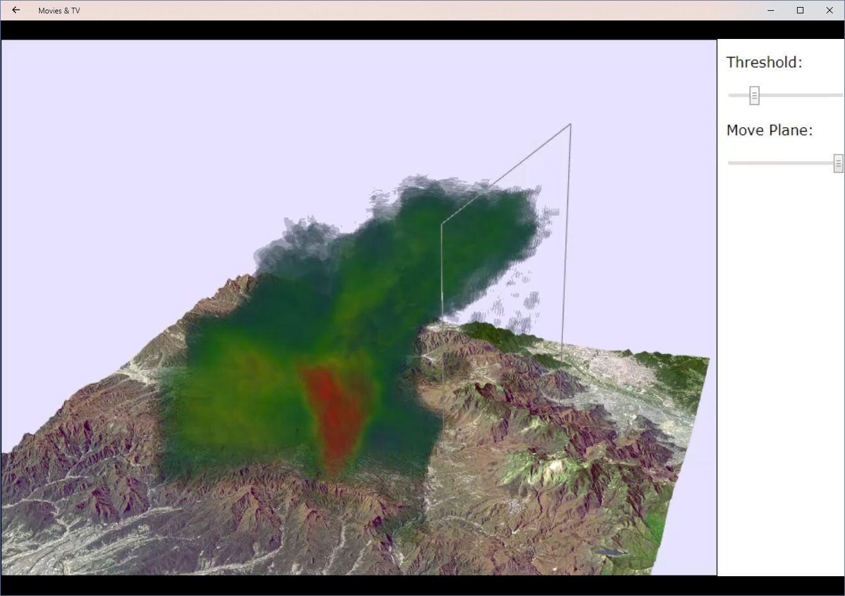
[2] Cloud data from Weather radar
https://examples.x3dom.org/example/RadarVolumeStyle
  with a fog of kansai_pawr_20120726175907.png
https://dl.acm.org/citation.cfm?id=2775323
https://vimeo.com/103145827
Notes:
Need to show progressive slices
Also add to video

Slide 15
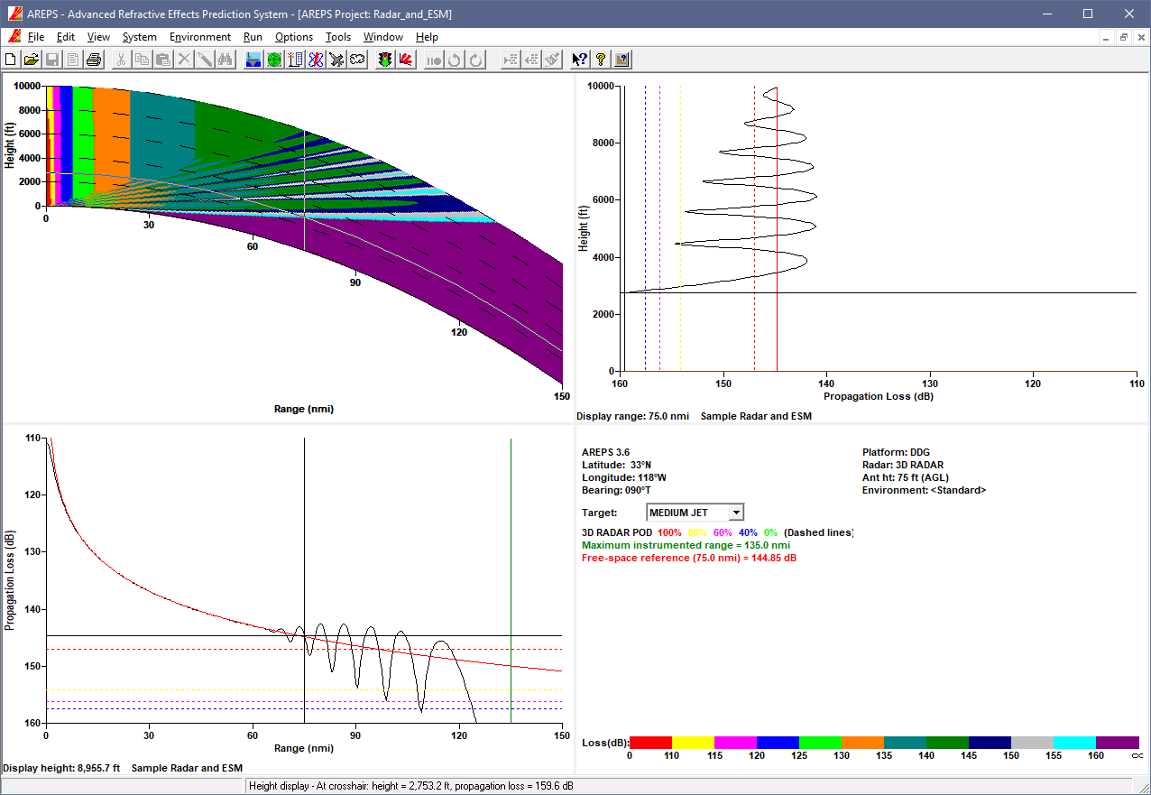
[3] AREPS 3.0 example
W. L. Patterson, “Advanced refractive effects prediction system (AREPS),” Conf. 2007 IEEE Radar, pp. 891–895, 2007.

Slide 16
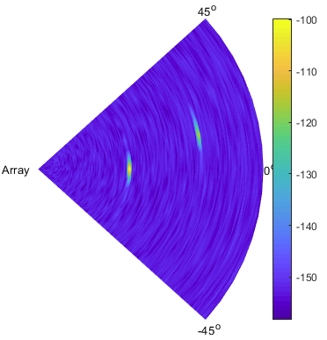
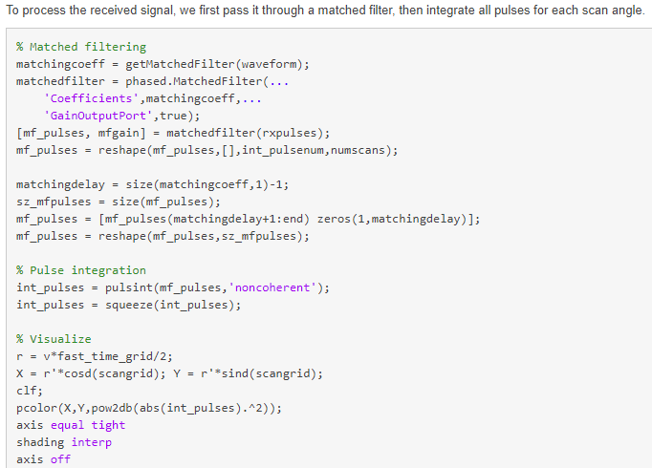
[4] Scan Radar Matlab Example
www.mathworks.com/help/phased/examples/scan-radar-using-a-uniform-rectangular-array.html

